Slide 1
Discrete Probability Distributions

Slide 2
Binomial Experiments-I
Binomial experiments are those for which the outcome from each trial is one of only two options (“success” or “failure”). The properties of a binomial experiment are:
The experiment is repeated for a fixed number of trials, N, where each trial is independent of all the others.
There are only two possible outcomes for each trial. The outcomes can be classified as a success (S) or a failure (F).
The probability of success is the same for all trials.
The random variable X counts the number of successful trials out of N trials.

Slide 3
Binomial Experiments-II
Why is the following a binomial experiment?
  We randomly sample 500 fish from the population.
  We record whether each animal is mature or immature.
  The random variable X is the number of mature animals.

Slide 4
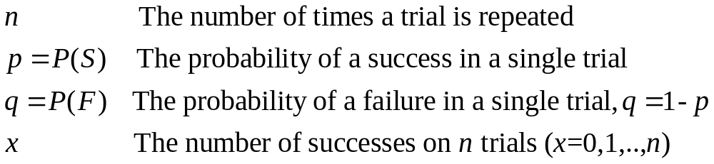
Binomial Experiments-II
(Notation)
Also N
New
terms
Also k

Slide 5
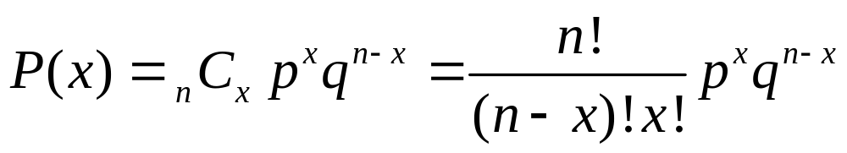
Binomial Probabilities-I
In a binomial experiment, the probability of exactly x successes in n trials is:
This is a probability mass function, pmf
The binomial probability therefore involves the probability of x successes and n - x failures multiplied by the number of ways choosing x successes out of n trials.
n and p are parameters (q = 1 - p). We will use data to estimate the values for unknown parameters.
# ways you can have x out of n successes/
E.g. HHT, HTH, THH

Slide 6
One Binomial Trial: The Bernoulli Distribution
In a binomial experiment, the probability of exactly x successes in n trials is:
With n = 1, the Binomial becomes the Bernoulli distribution
  P(x) = p^{x} (1 - p)^{1 – x}
  Where x can take the values of 0 or 1
Bernoulli → probability a single coin flip comes up heads
Binomial → Probability that 10 coin flips yield 3 heads
So the Binomial is the distribution for the sum of independent Bernoulli trials

Slide 7
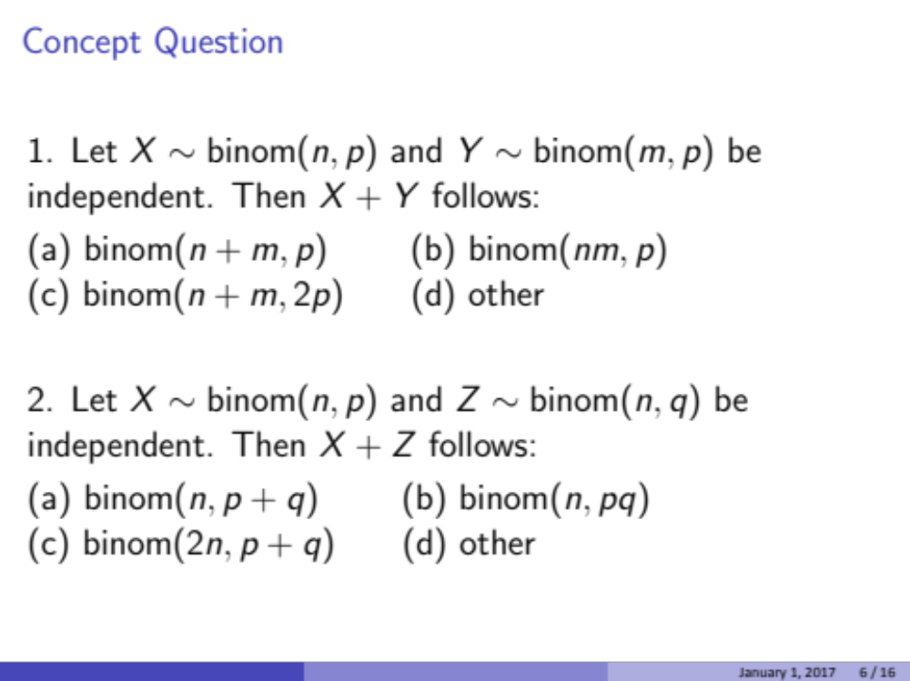

Slide 8
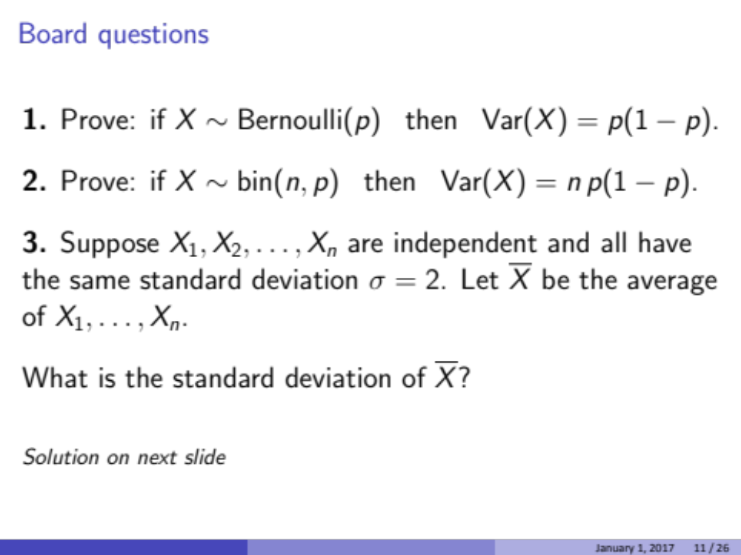
Group Work
Hints:
Make a table with X, p(x), and (X - µ )². Remember µ = E[X]
Remember that variances of independent random variables add
  Var(X + Y) = Var(X) + Var(Y)

Slide 9
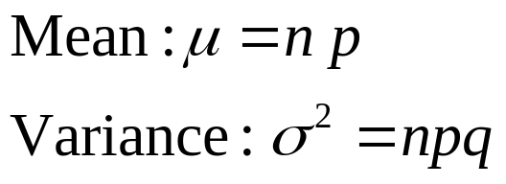
Binomial Probabilities-II
Notation:
We read this as “The random variable X is distributed binomially with parameters n and p”
Recall: q = 1 - p
X ~ B(n,p); X ~ Bin(n,p); X ~ Binom(n,p)

Slide 10
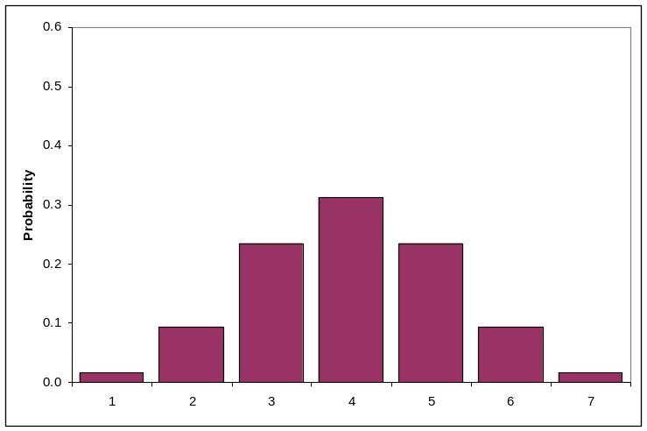
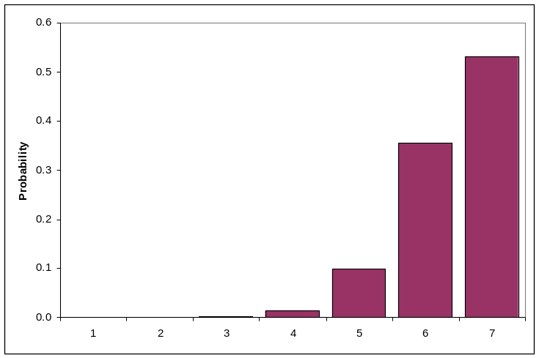
The Binomial Distribution
n=6; p=0.5
n=6; p=0.9
0 1 2 3 4 5 6
0 1 2 3 4 5 6
This is a probability mass function; PMF

Slide 11
Examples of the Binomial Distribution-I
Group Work
We examine 12 animals for the presence of a disease (p = 0.1). What is the probability that:
  We find exactly 2 animals with the disease?
  We find no animals with the disease?
  We find 2 or more animals with the disease?

Slide 12
Sneak peak: Maximum likelihood is just doing this in reverse!!!
Instead of knowing N and p, we often collect data in which p and sometimes also N are unknown.
To understand how the world works, we want to determine p
  What is the prevalence of a disease?
  What is the probability of giving birth?

Slide 13
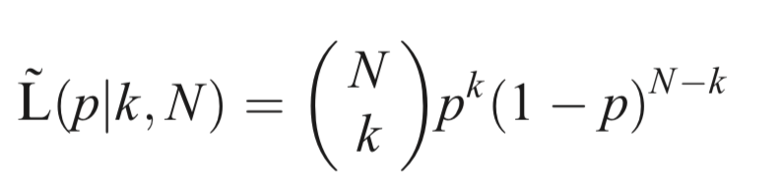
Sneak peak: Maximum likelihood is just doing this in reverse!!!
Instead of knowing N and p, we often collect data, k #successes, to determine p and/or N
Let’s assume that N is known. Say we conduct N trials, observe k successes, and want to make inference about p, given k and N
This is among the easiest possible likelihood problems

Slide 14
Sneak peak: Maximum Likelihood is just doing this in reverse!!!
This equation is exactly what we’ve been working with but the interpretation is very different
The binomial probability summed over all values of k equals 1
But now the Likelihood is a function of p with k fixed. k is our observation.
The range of p must be 0 to 1, but there is no requirement that the integral of the likelihood from 0 to 1 = 1 (as would be the case for a probability)
Why did I say “integral” and not “sum”

Slide 15
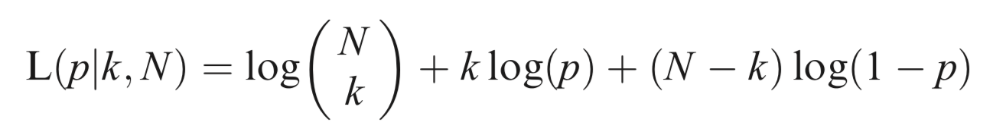
Sneak peak: Maximum likelihood is just doing this in reverse!!!
This equation is exactly what we’ve been working with but the interpretation is very different
We usually work with the log-likelihood. Can you find that? → log(a*b) = log(a) + log(b), log(a^{b})=b*log(a)
Should I show you the derivation?

Slide 16
Sneak peak: Maximum likelihood is just doing this in reverse!!!
How do we find the “maximum likelihood estimate” (MLE) for p?
Enter Calculus!
Find the MLE for p

Slide 17
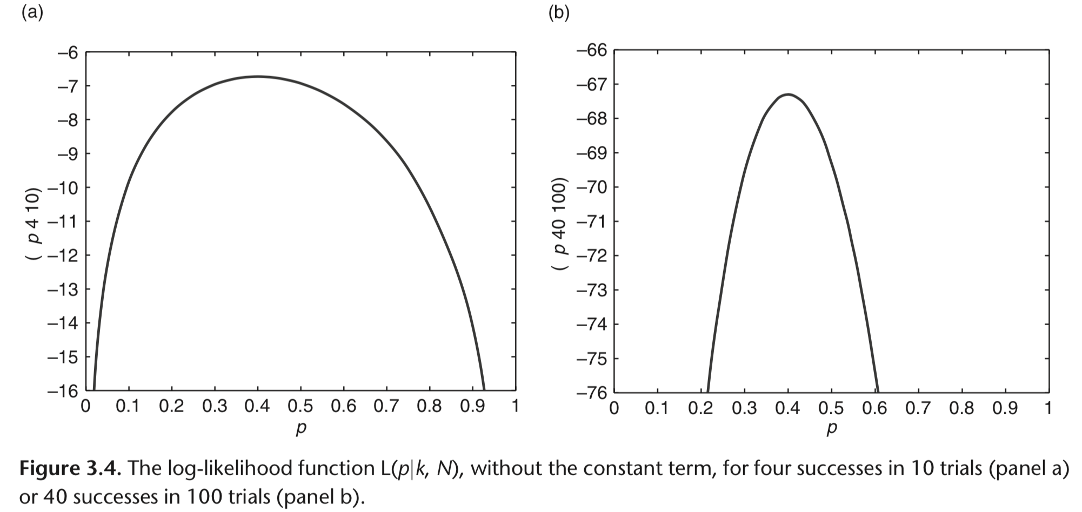
Sneak peak: Maximum likelihood is just doing this in reverse!!!
Hudson (1971) showed that an approximate 95% CI for a single peaked likelihood function occurs 2 log-likelihood units below the peak.
Can you see why sample size is so important based on these shapes?

Slide 18
Back to distributions
We’ll discuss maximum likelihood later
Bayesian statistics is very similar - making inference about the parameter given the data - but the inference will be a real probability rather than a point estimate and confidence interval.

Slide 19
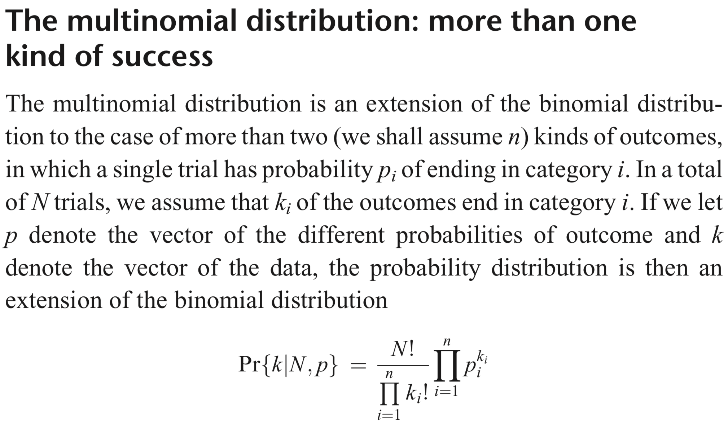
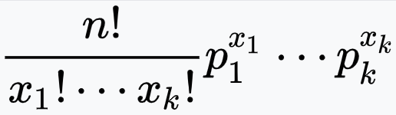
Alternatively written

Slide 20
The Poisson Distribution-I
The Poisson distribution is used to determine the probability that a specific number of occurrences takes place within a given unit of time or space.
A random variable X is Poisson distributed if:
The experiment consists of counting the number of times, x, an event occurs in a given interval (the interval can relate to e.g. time, area, volume).
The probability of the event occurring is the same for each interval.
The number of occurrences in one interval is independent of the number of occurrences in other intervals.

Slide 21
The Poisson Distribution-I
In short – Poisson models ”random” count data
  Number of ladybugs or leaves per bush
  Number of prey encountered per unit time
  Number of eggs produced by a fish
This is different from bounded count data, which is binomial
  # offspring that survive out of N offspring
  #cameras that detect wolves out of N cameras
You might think that the Poisson could be a good approximation of the binomial if N is large and p is small. You are right!

Slide 22
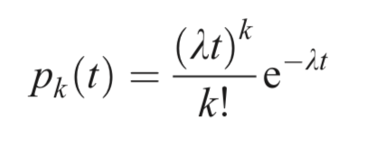
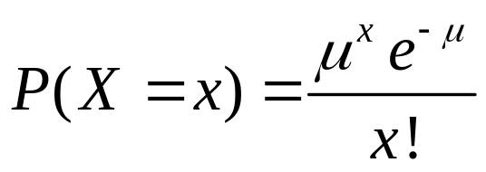
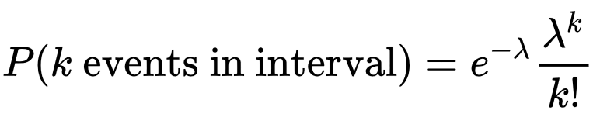
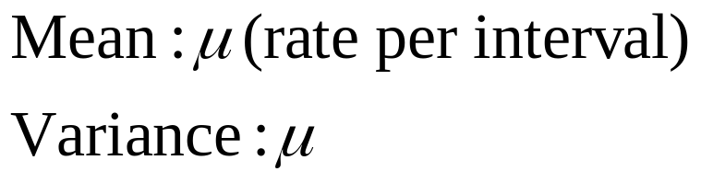
The Poisson Distribution - pmf
Various notations:
Note that x (or k) can be any non-negative integer.

Slide 23
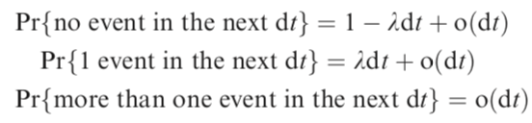
Where does the Poisson distribution come from?
In a very small interval of time, either nothing happens or one event happens
Where o(dt) represents higher order term of dt that can be ignored as dt → 0

Slide 24

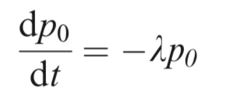

Where does the Poisson distribution come from?
What we want is the probability of k events in a a longer interval, say time = t
How could we have no events up to time t + dt?
Use the definition of the derivative to show that this leads to
Solve to find the zero term of the Poisson, Pr(no events)
)

Slide 25

Zero term of the Poisson Distribution
Probability Mass Function:

Slide 26
First term of the Poisson Distribution
How can you have one event in time 0 to t + dt?
Either we had no event in 0 to t and one event in t to t + dt or we had one event in 0 to t and no event in t to t + dt
Continue like this to derive other terms
Another derivation starts with the Binomial distribution where the average number of successes, Np, is replaced by. and N approaches infinity

Slide 27
The Poisson Distribution - pmf
Various notations:
Note that x (or k) can be any non-negative integer.

Slide 28
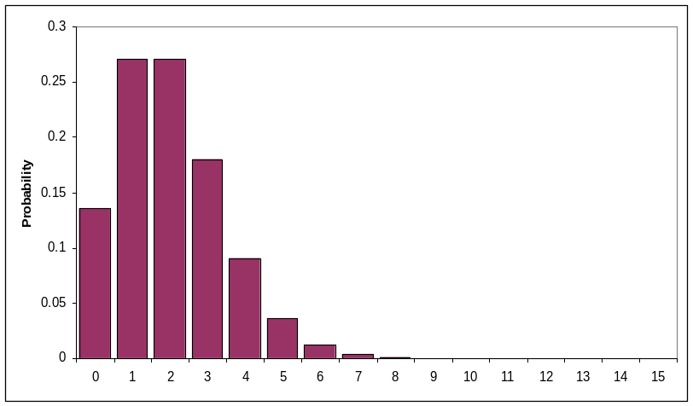
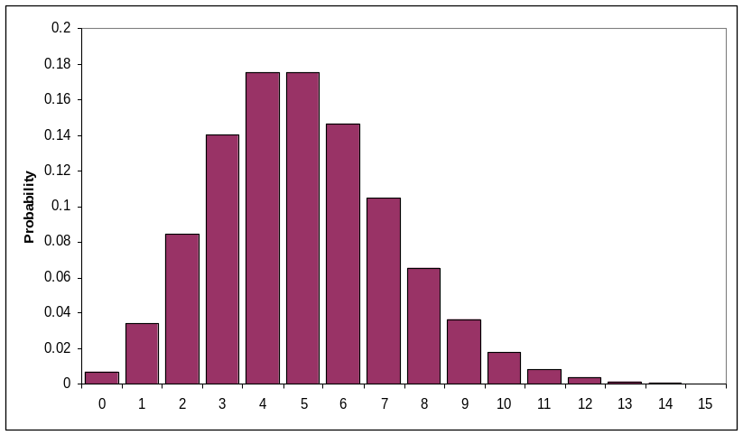
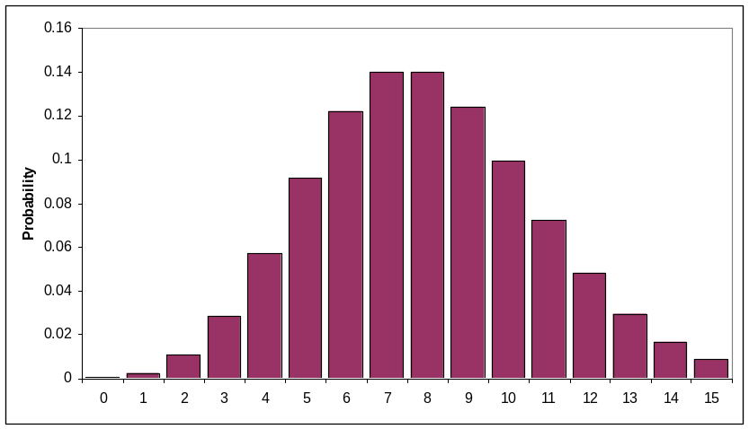
The Poisson Distribution Graphically
μ=2
μ=5
μ=8

Slide 29
An Example of the Poisson Distribution-I
Group Work
The mean bycatch of dolphins per month in the Eastern Tropical Pacific is 3
  What is the probability that the catch will be 4 in a given month?
  What is the probability that the catch will be 2 or less in a given month?
  What is the probability that at least one dolphin is killed?
Breakout groups: Try to find analytical solutions AND a solution using built in functions in R

Slide 30

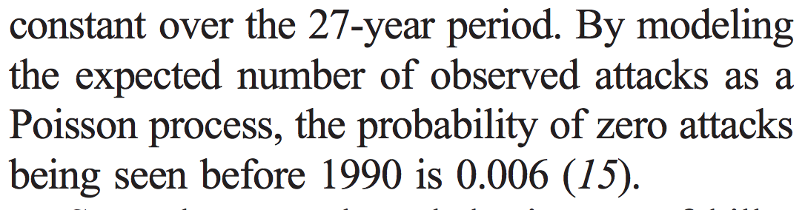
Example of using Poisson Probabilistic Arguments in Research

Slide 31
The Poisson Distribution - Caveat
The Poisson distribution would seem to be a good distribution to assume for catch data in fisheries. However, fish school. What does this imply regarding the assumptions of the Poisson distribution?
Variance would be high relative to the mean
  You catch zero or a shit ton!!!
  This is called overdispersion → Onward to negative binomial!

Slide 32


But first: MLE for the Poisson Distribution
Let’s find the MLE of the Poisson distribution
Let’s do it for a dataset of n Poisson distributed observations. (very common to assume that t =1 since counts per period is typically desired)

Slide 33
The Negative Binomial Distribution
(1) # failures/trials before fixed number of successes
We have an experiment with two outcomes: success (with probability p) and failure (with probability q =1-p).
Let N be the number of trials to achieve k successes, each with probability p
Number of trials, N, is now the random variable!
  Recall, k, was the R.V. in the binomial case

Slide 34
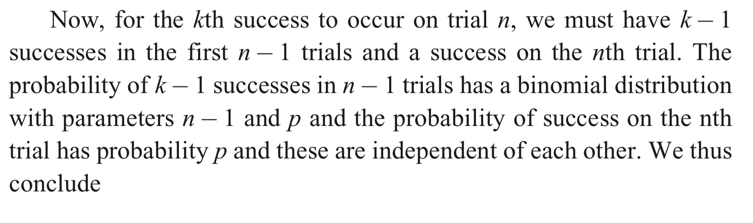
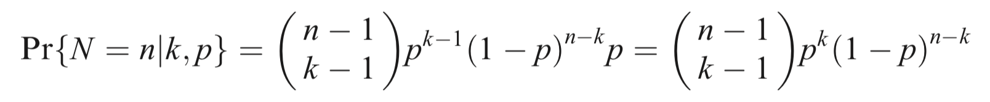
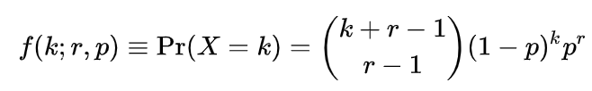
The Negative Binomial Distribution
(1) # failures/trials before fixed number of successes
Try to derive it based on this argument
How do we turn this into “failures”, X=k, until r successes?

Slide 35
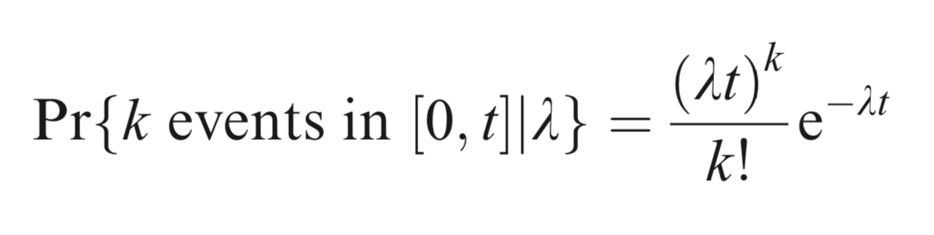
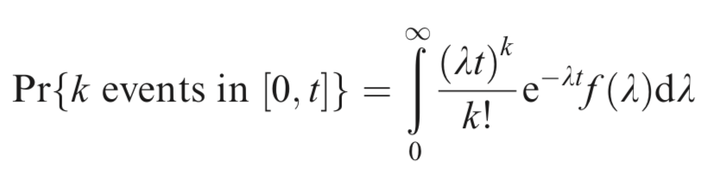

The Negative Binomial Distribution
(2) Poisson with a variable rate parameter
Start with Poisson
But let’s give lambda a continuous probability (continuous distributions come soon!) and then integrate over all possible values of lambda (this is called “marginalizing”)
Because:

Slide 36

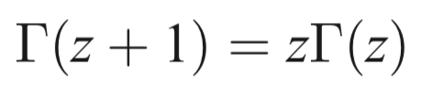
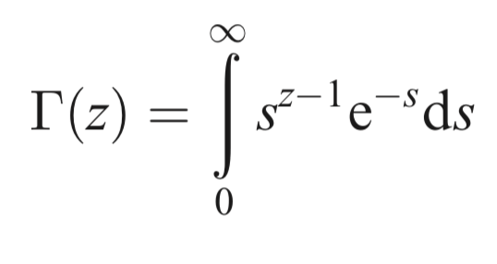
Quick note on Gamma function
Continuous version of factorial
For integers, z,
In general
Defined (for z > 0):

Slide 37
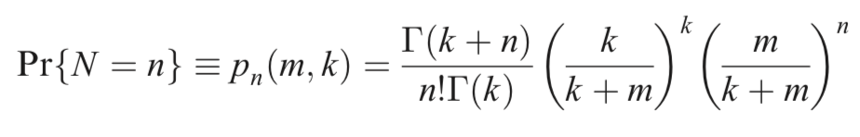
The Negative Binomial Distribution
(2) Poisson with a variable rate parameter
Common parameterization in ecology with the mean as a parameter:
We model N overdispersed counts as function of mean, m, and dispersion, k

Slide 38
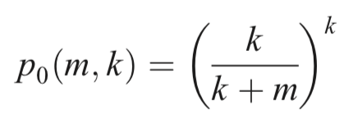
The Negative Binomial Distribution
(2) Poisson with a variable rate parameter
What is the probability of no events?
This probability can be large if k is small even if m is big

Slide 39
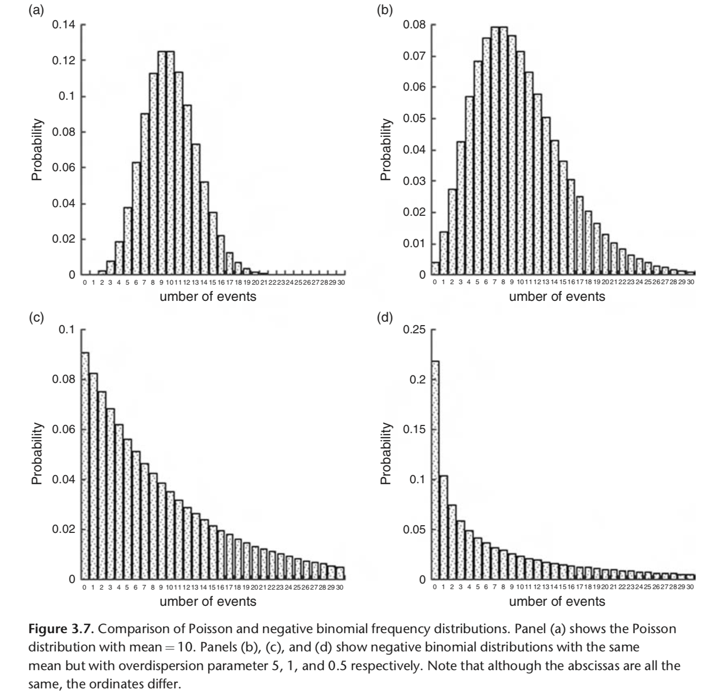
Poisson vs. Negative Binomial

Slide 40
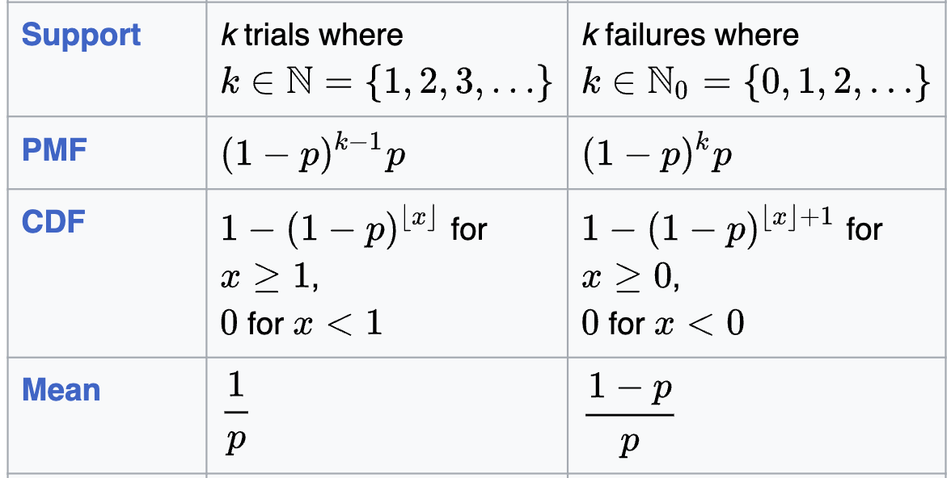
The Geometric Distribution
This is a special case of the negative binomial distribution for which k =1 (i.e. the probability of the number of trials or failures until one success is recorded).

Slide 41
Summary of Discrete Distributions
Distribution | Number of trials | Random Variable | Parameters
Binomial | Pre-specified | Number of successes | n, p
Negative Binomial | Repeated until a given number of successes | Number of failures | r, p
Geometric | Repeated until one success occurs | Number of failures | p
Poisson | N/A | Number of occurrences | μ

