Slide 1
Generalized Linear Models
Some material from Olivier Gimenez 2020

Slide 2
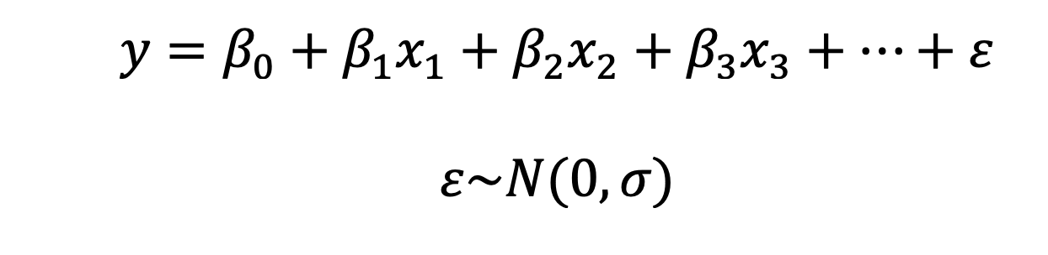
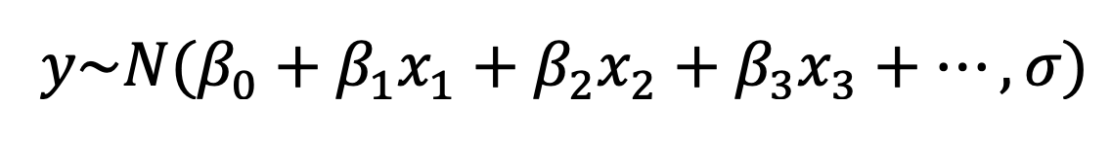
General Linear Model
Often written as:
But even clearer:
From this we can see assumption of constant variance

Slide 3
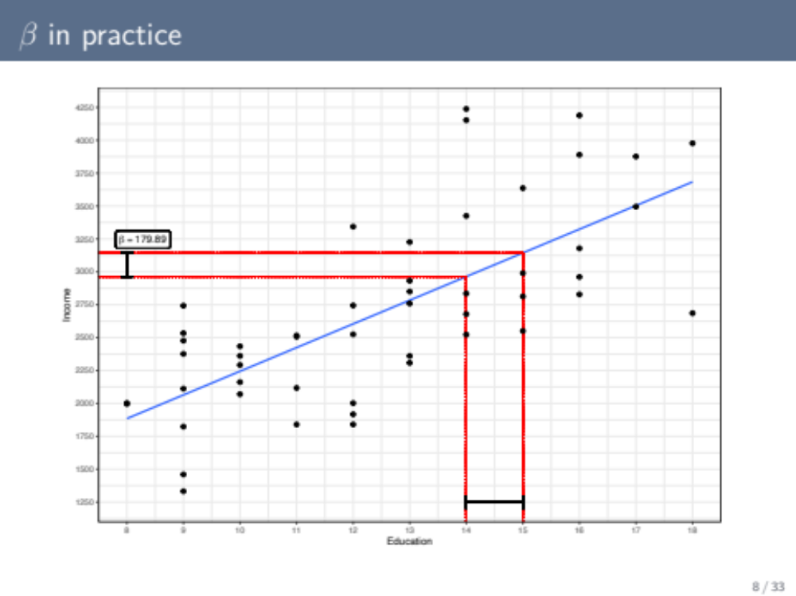
Slide from Federico Vegetti

Slide 4
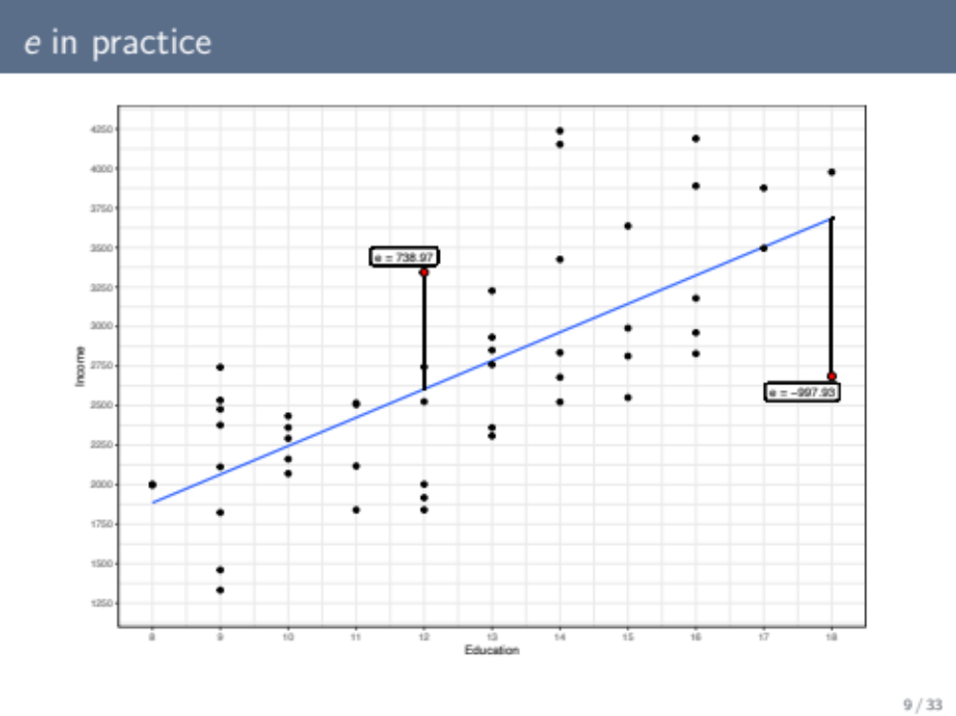
Slide from Federico Vegetti

Slide 5
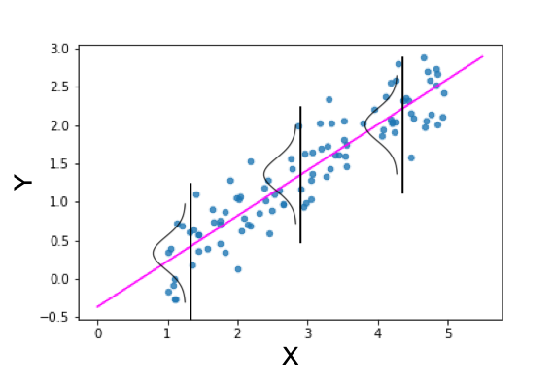
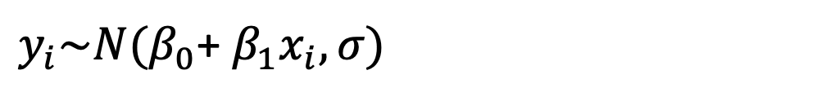
Regression is ONE KIND of General Linear Model
$y_{i}\sim N(β_{0}$+ $β_{1}x_{i},σ)$

Slide 6
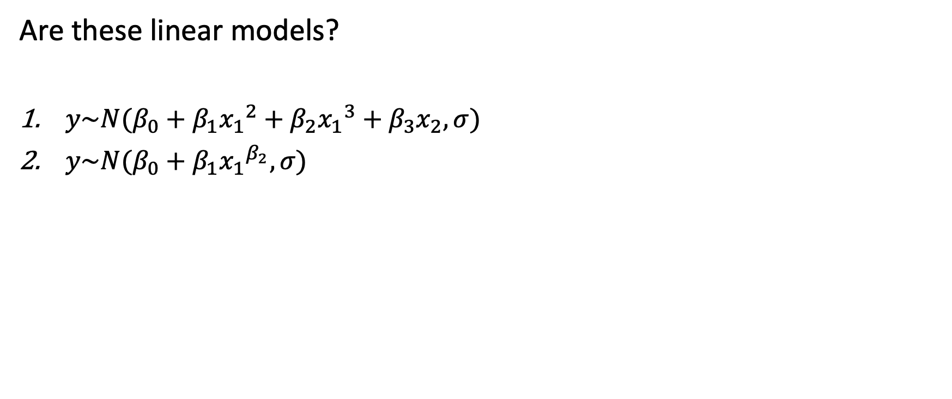
What does it mean to be linear?
Are these linear models?
$y\sim N(β_{0}+β_{1}{x_{1}}^{2}+β_{2}{x_{1}}^{3}+β_{3}x_{2},σ)$
$y\sim N(β_{0}+β_{1}{x_{1}}^{β_{2}},σ)$
#1 is a linear model.
The COEFFICIENTS need to be linear. Not the predictors!

Slide 7
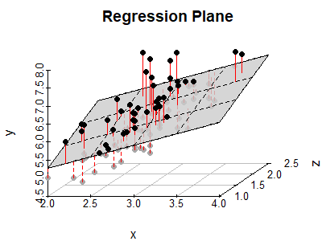
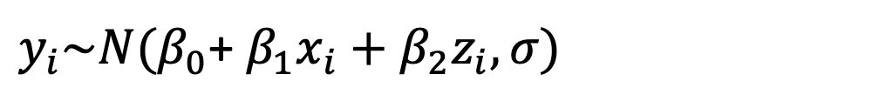
All models have stochastic part for errors and deterministic “scientific” model defined by both algebra and geometry
$y_{i}\sim N(β_{0}$+ $β_{1}x_{i}+β_{2}z_{i},σ)$
What is the associated R code for this?

Slide 8
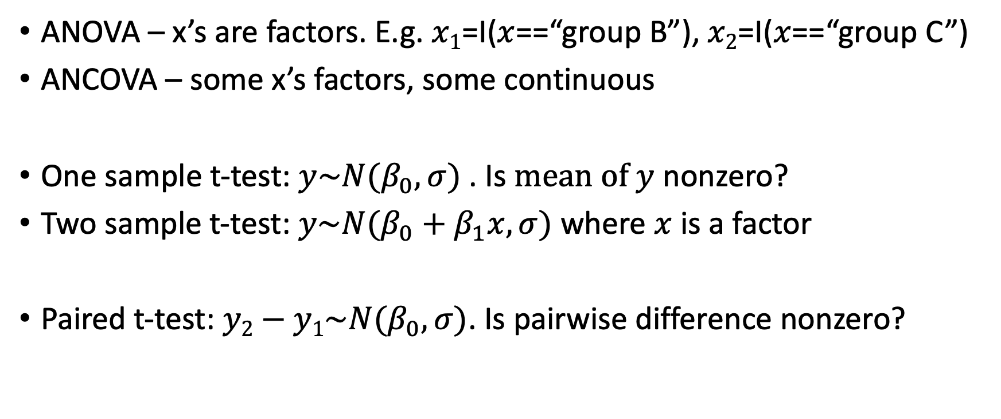
General Linear Model
ANOVA – x’s are factors. E.g. $x1$=I($x$==“group B”), $x2$=I($x$==“group C”)
ANCOVA – some x’s factors, some continuous
One sample t-test: $y\sim N(β_{0},σ)$ . Is $mean of y$ nonzero?
Two sample t-test: $y\sim N(β_{0}+β_{1}x,σ)$ where $x$ is a factor
Paired t-test: $y2−y1\sim N(β_{0},σ)$. Is pairwise difference nonzero?

Slide 9
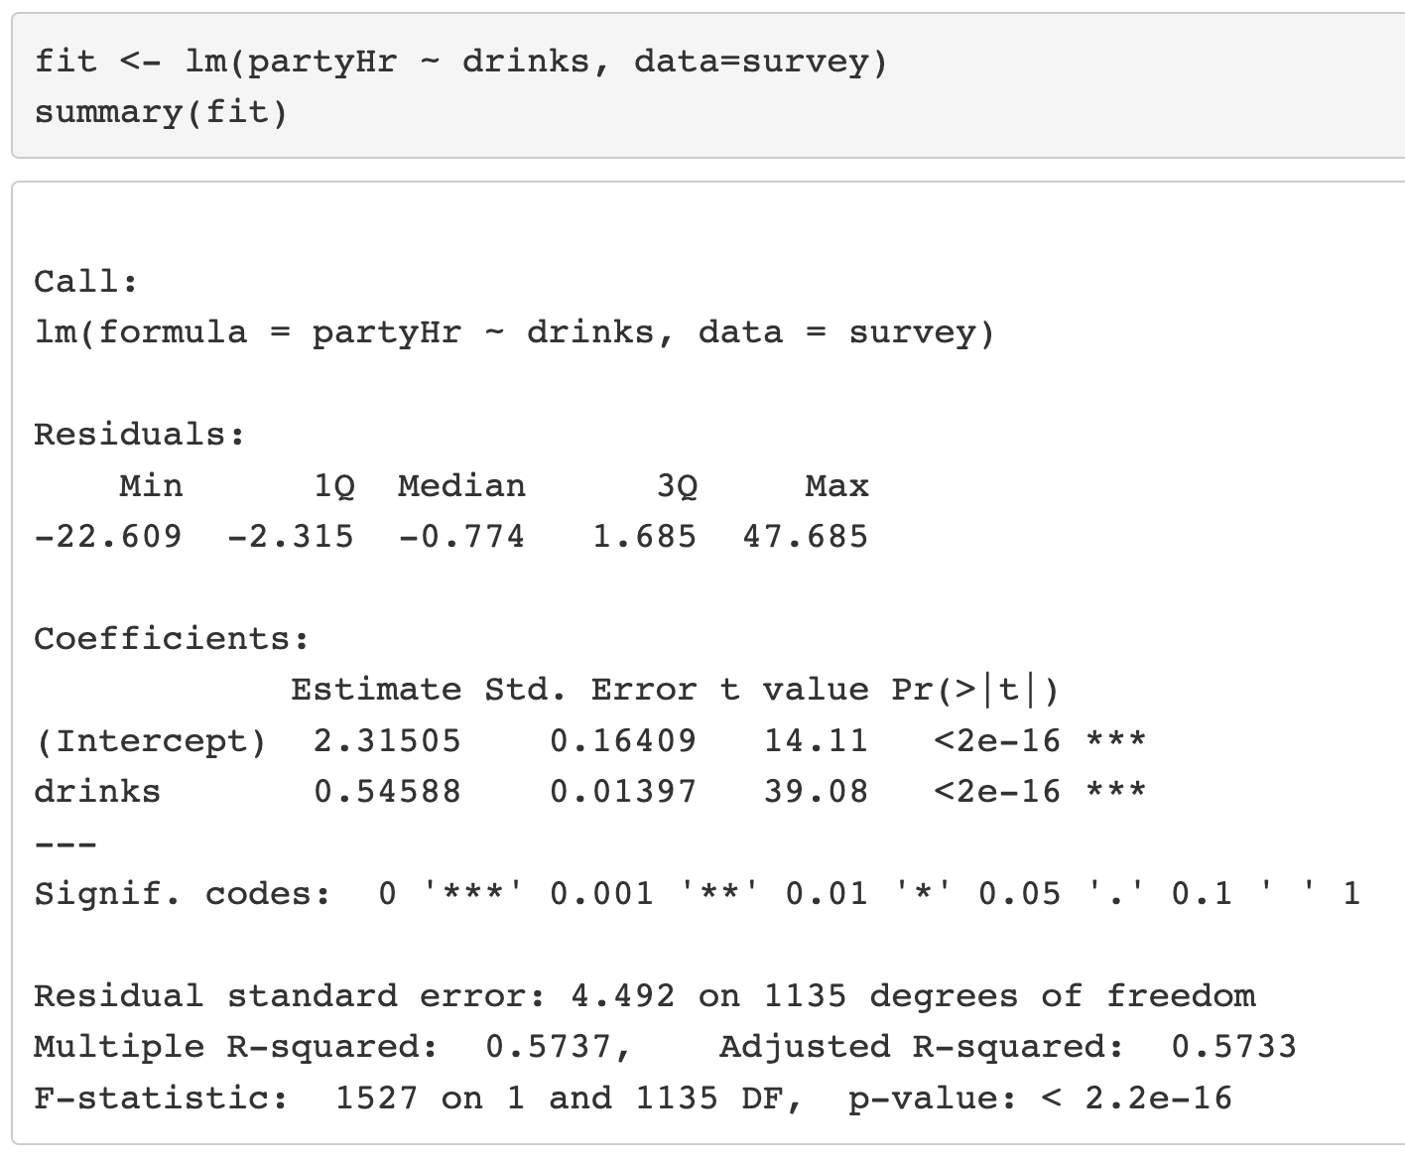
What influences partying in college?
partyHr
  student’s party hours per week
drinks
  average number of drinks per week
Is there also a difference among male and female students?
From Yuk Tung Liu’s STAT 390EF
Notes:
What kind of model is this? (regression)
How would bad scientists interpret?
Let’s interpret correctly

Slide 10
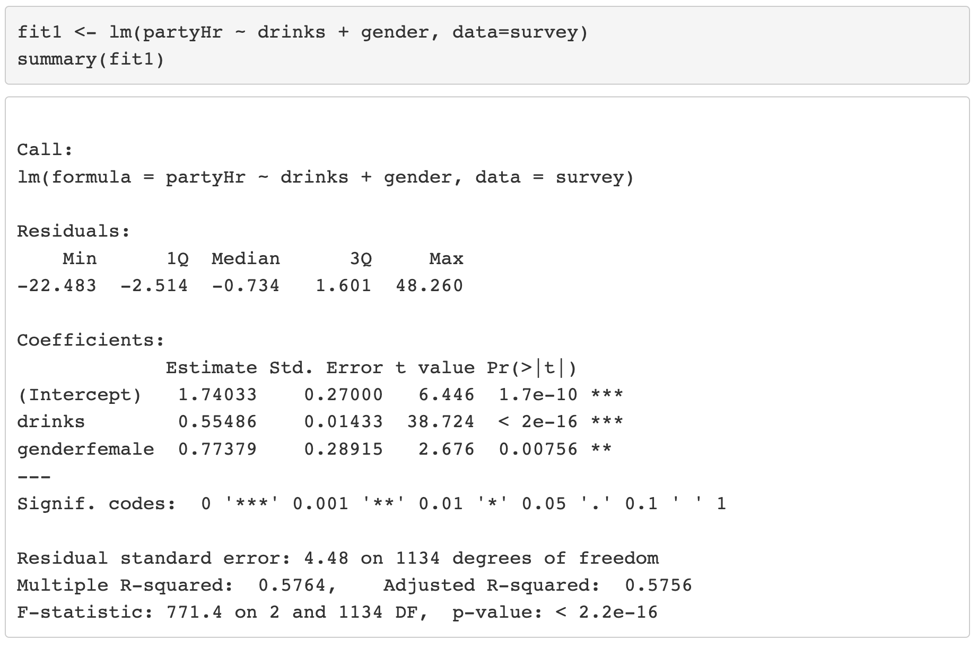
What influences partying in college?
Group Work
What is the average number of party hours for males and females who don’t drink?
What is the average number of party hours for males and females who have an average of 5 drinks per week?
What does the algebra and geometry (graph) of this model look like?
Notes:
What is this model called in stats classes? (ANCOVA)

Slide 11
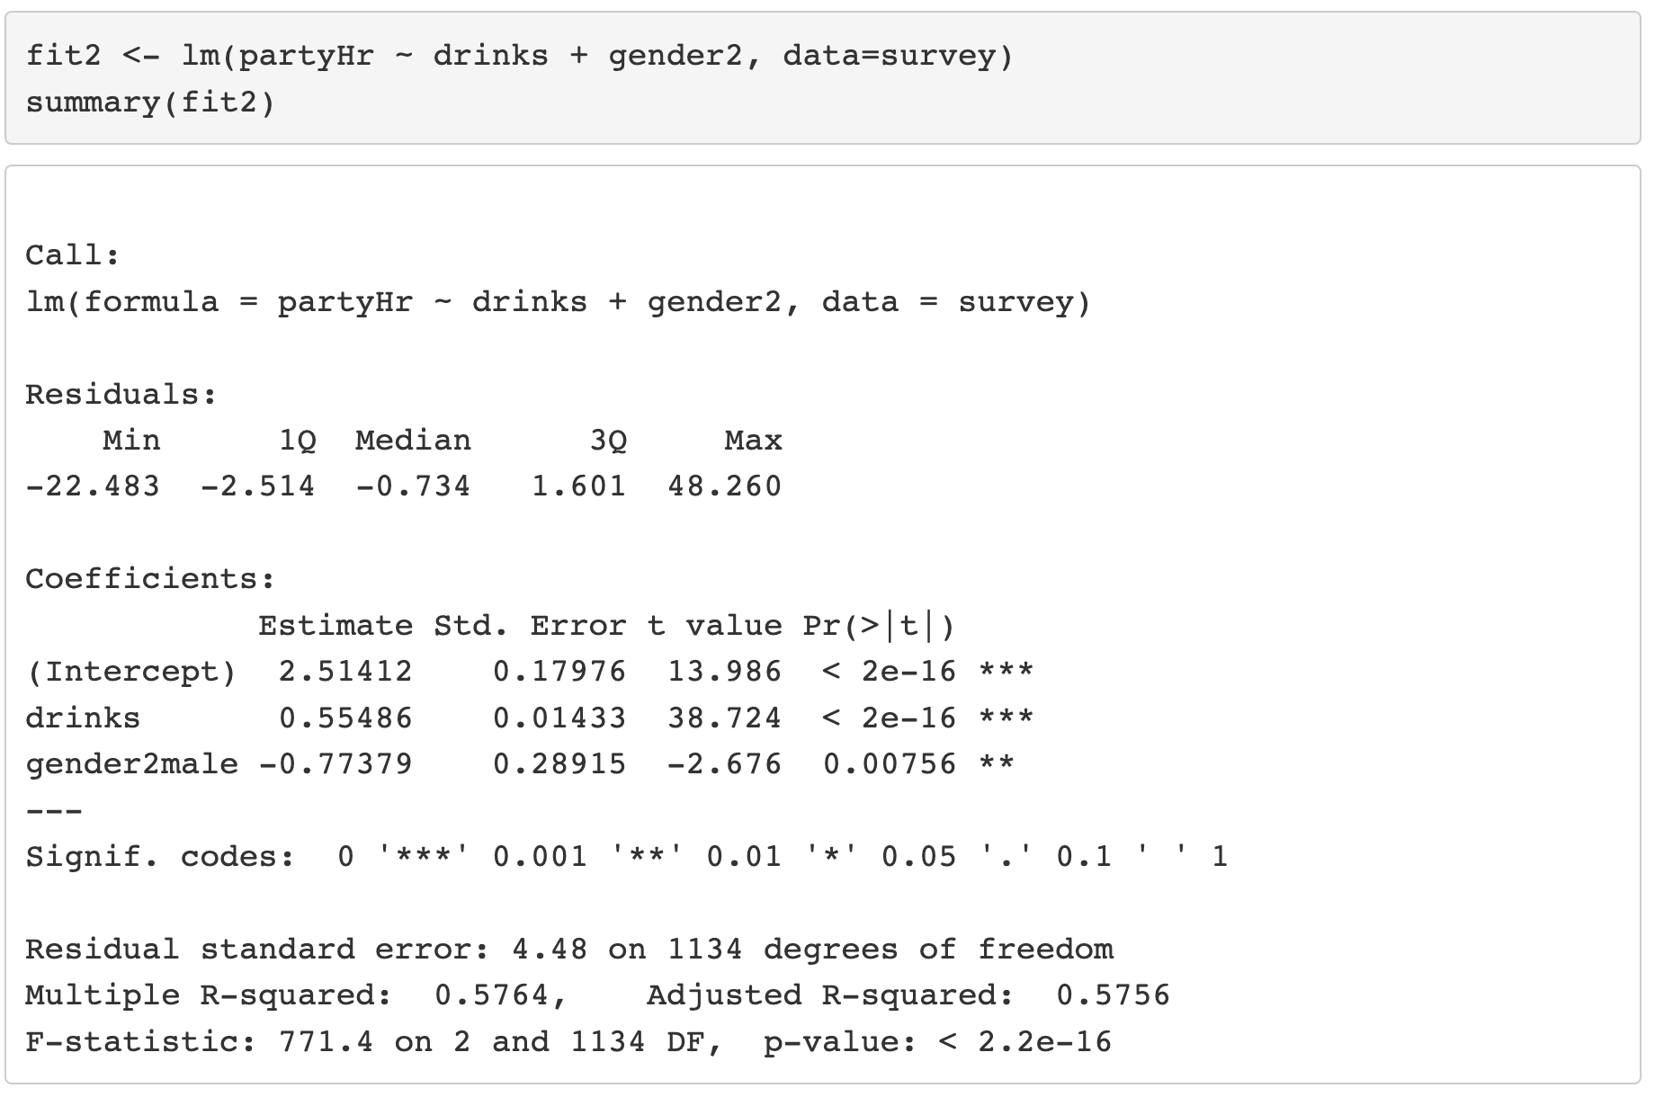
Can change the reference level to female
  survey$gender2 <- relevel(survey$gender,"female")

Slide 12
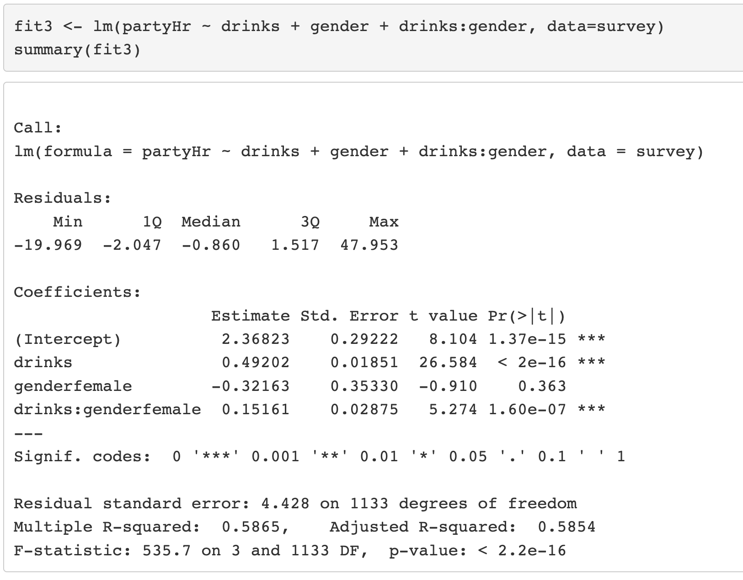
Interaction term
Group Work
What is the interpretation?
What is the average number of party hours for males and females who have an average of 5 drinks per week?
What does the algebra and geometry (graph) of this model look like?

Slide 13
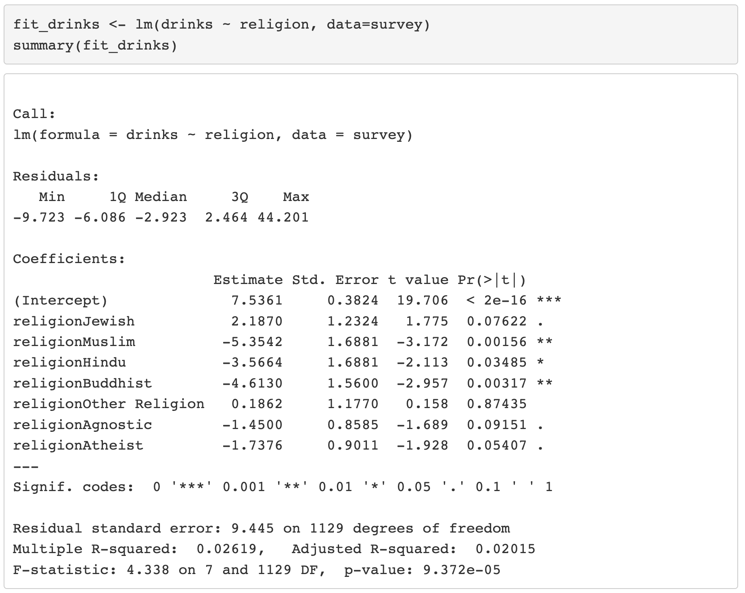
More than two levels – Drinking by religion
Start with reference level “Christian”

Slide 14
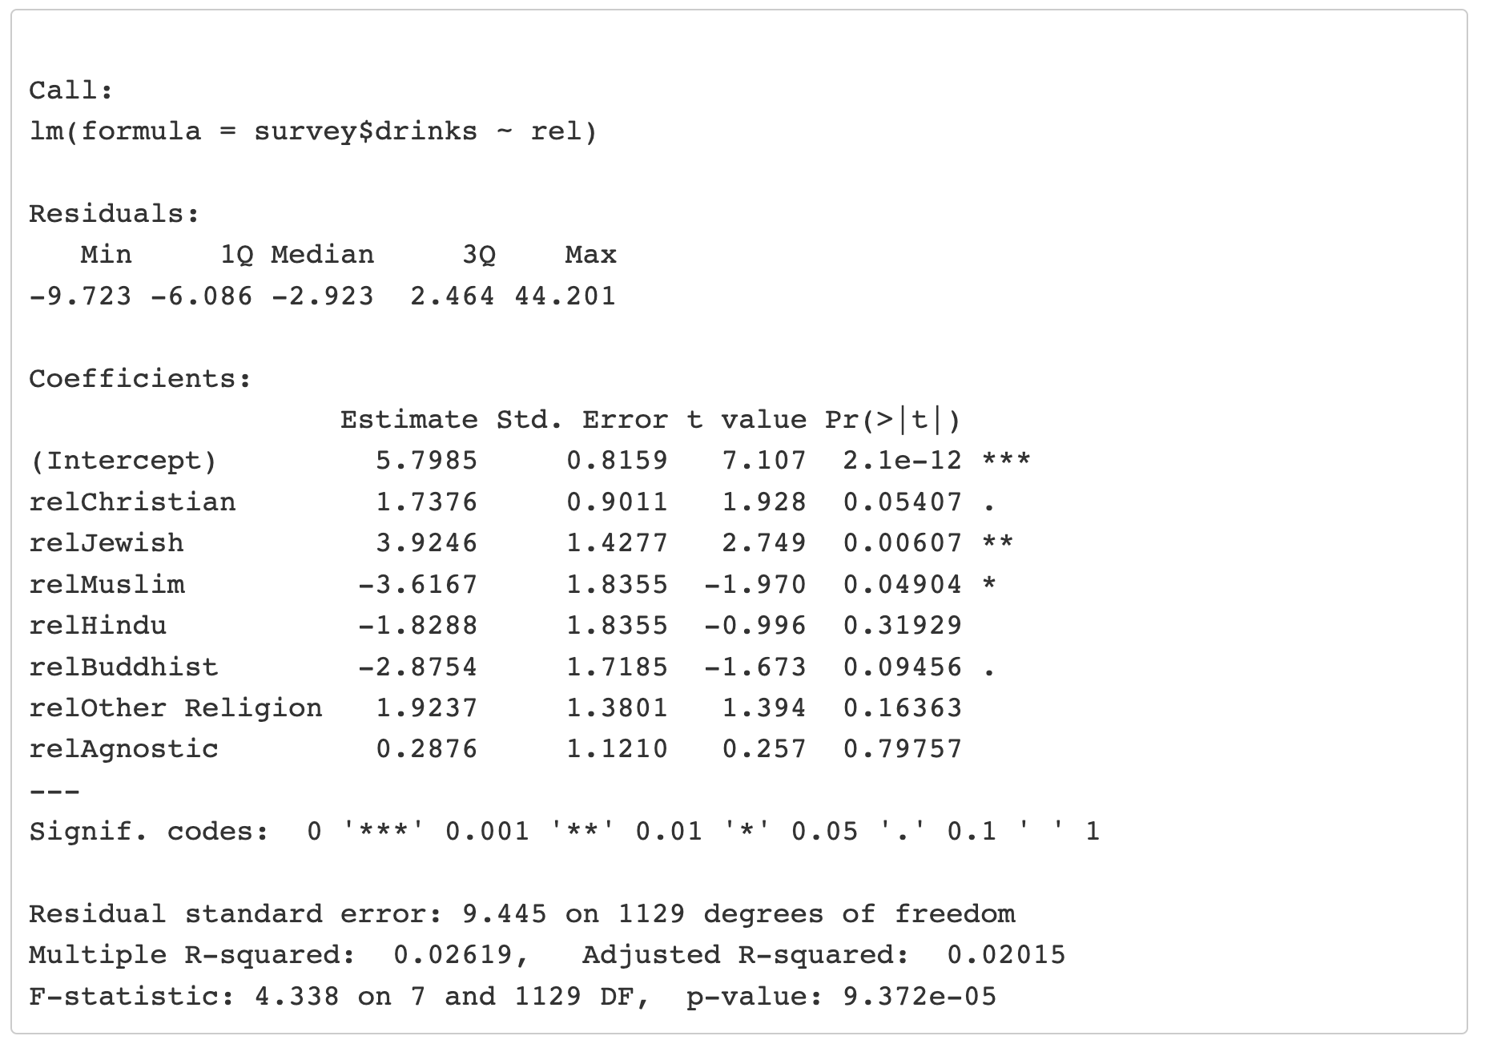
More than two levels – Drinking by religion
Now with reference level “Atheist”
Why might this model not by ideal?
Is there a problem with releveling to assess all pairwise interactions?
Notes:
Remember to think about sample size

Slide 15
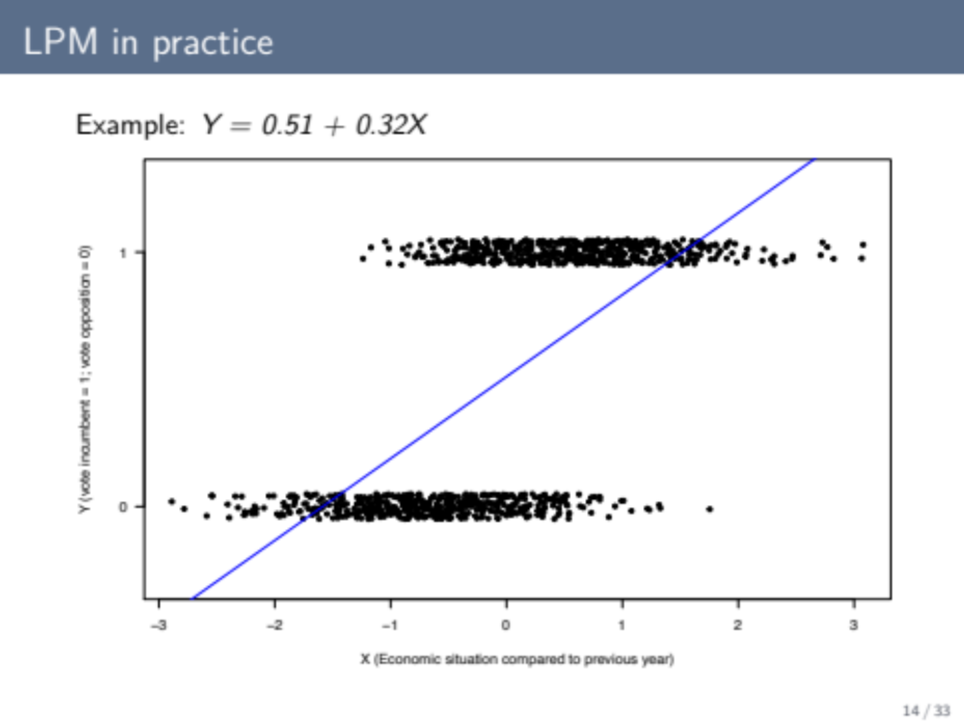
Sometimes we can’t be Normal

Slide 16
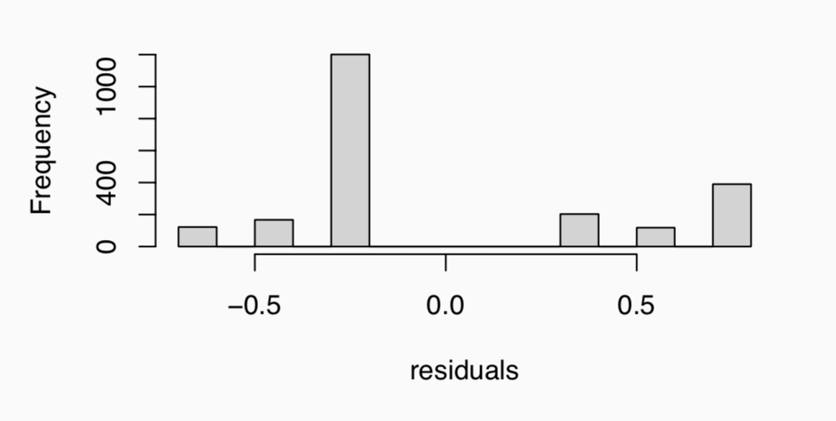
Titanic Data – Try a General Linear Model
Survival (1/0) for passengers with known age, sex, and class
We could try fitting the linear model for class (crew, first, second, third)
  titanic.lm <- lm(survived ~ class, data = titanic)
  But the residuals, of course, are not remotely normally distributed.
    And model is grossly misspecified because “survival” can only be 0 or 1
The actual probability model under the hood
$$Y_{i}\sim Normal(a+b_{1}I\left(class=first\right)+b_{2}I\left(class=second\right){+b}_{3}I\left(class=third\right),σ^{2})$$

Slide 17
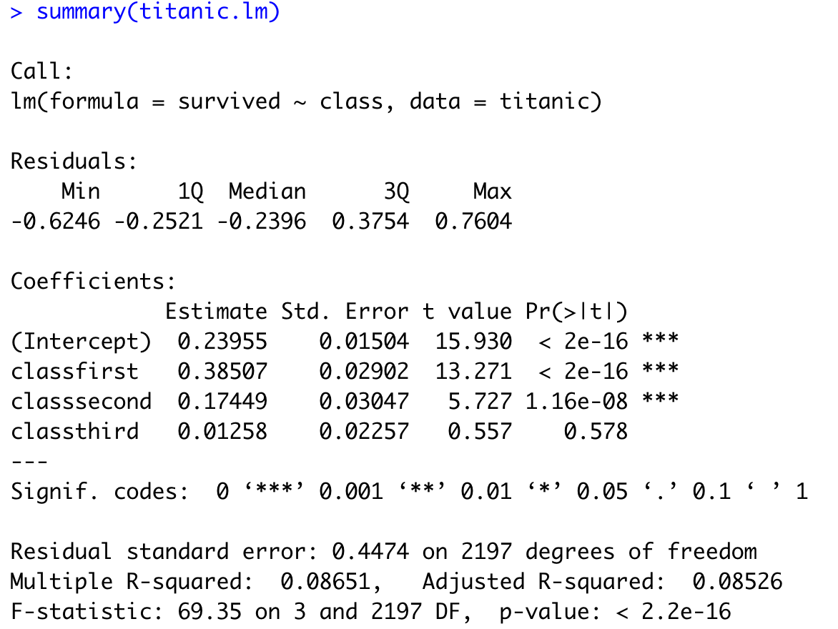
Titanic Data – General Linear Model
Let’s interpret this output

Slide 18
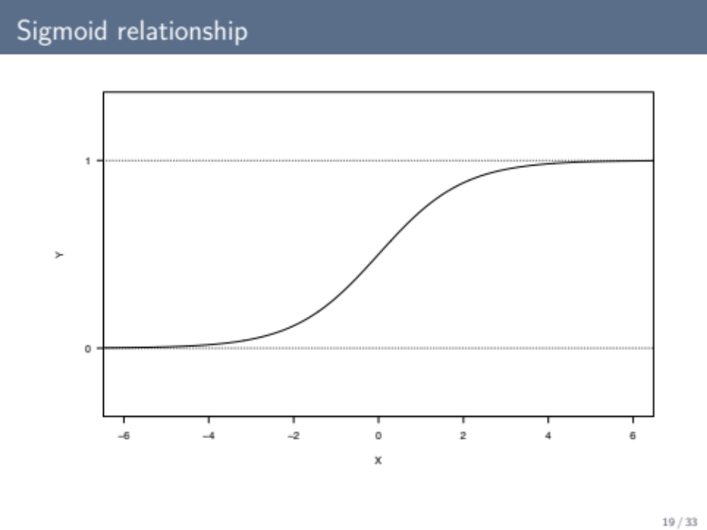
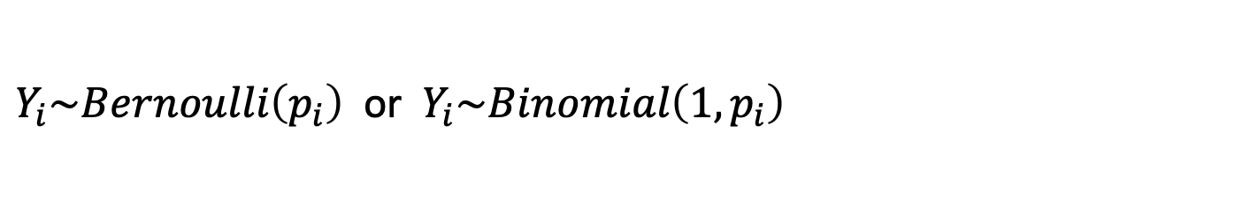
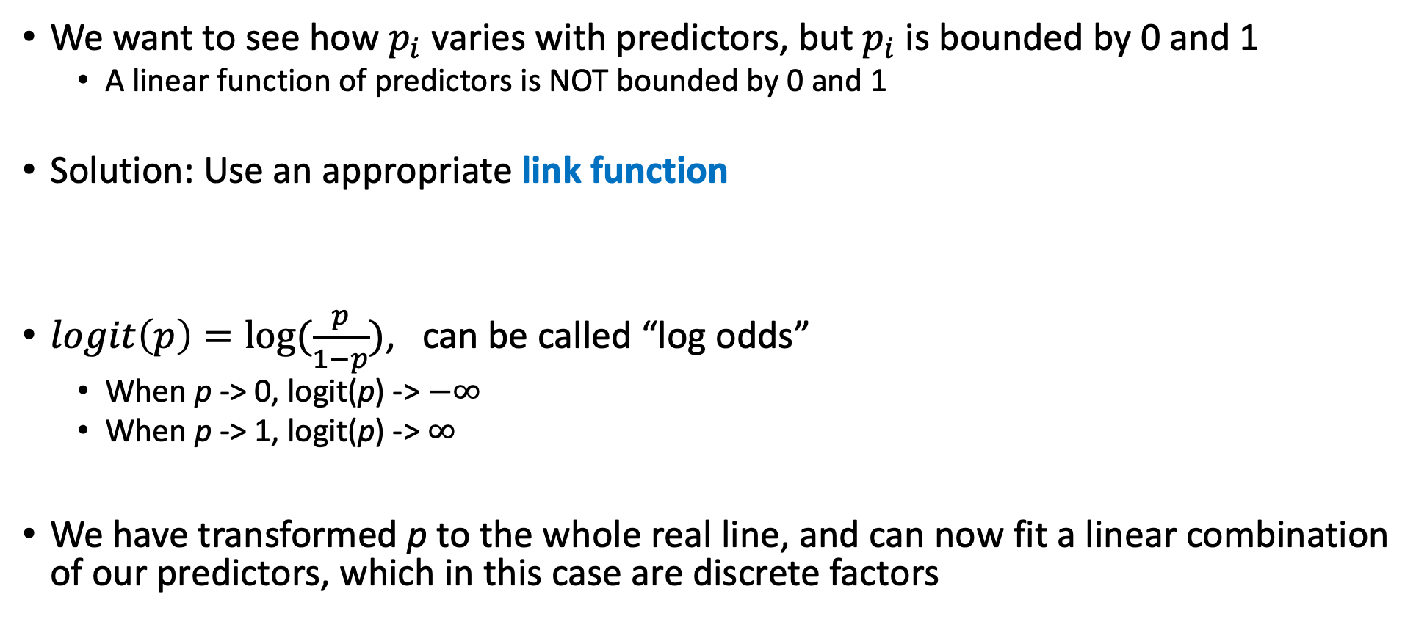
Titanic Data – Generalized Linear Model
$Y_{i}\sim Bernoulli\left(p_{i}\right)$ or $Y_{i}\sim Binomial\left(1,p_{i}\right)$
We want to see how $p_{i}$ varies with predictors, but $p_{i}$ is bounded by 0 and 1
  A linear function of predictors is NOT bounded by 0 and 1
Solution: Use an appropriate link function
$logit\left(p\right)=log⁡(\frac{p}{1−p})$, can be called “log odds”
  When p -> 0, logit(p) -> $−∞$
  When p -> 1, logit(p) -> $∞$
We have transformed p to the whole real line, and can now fit a linear combination of our predictors, which in this case are discrete factors
$$logit(p_{i})=a+bx_{i}$$

Slide 19
From probability to odds to log of odds
Imagine the probability of success of some event is .8. Then the probability of failure is 1 – .8 = .2. The odds of success is the ratio of the probability of success over the probability of failure. 0.8/0.2 = 4. That is to say that the odds of success are 4 to 1. If the probability of success is .5, i.e., 50-50 percent chance, then the odds of success is 1 to 1.
The transformation from probability to odds is a monotonic transformation, meaning the odds increase as the probability increases or vice versa. Probability ranges from 0 and 1. Odds range from 0 and positive infinity. Log odds from negative Inf to Inf
MUCH easier to interpret probability

Slide 20
Titanic Data – Generalized Linear Model
The logit link function. If:
Then what is p? Find it.
$$logit(p_{i})=a+bx_{i}$$
Group Work

Slide 21
Titanic Data – Let’s look at the data

Slide 22
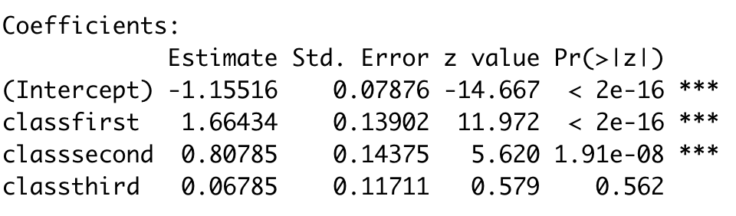
Binomial GLM (i.e. Logistic Regression)
How do we interpret this?

Slide 23
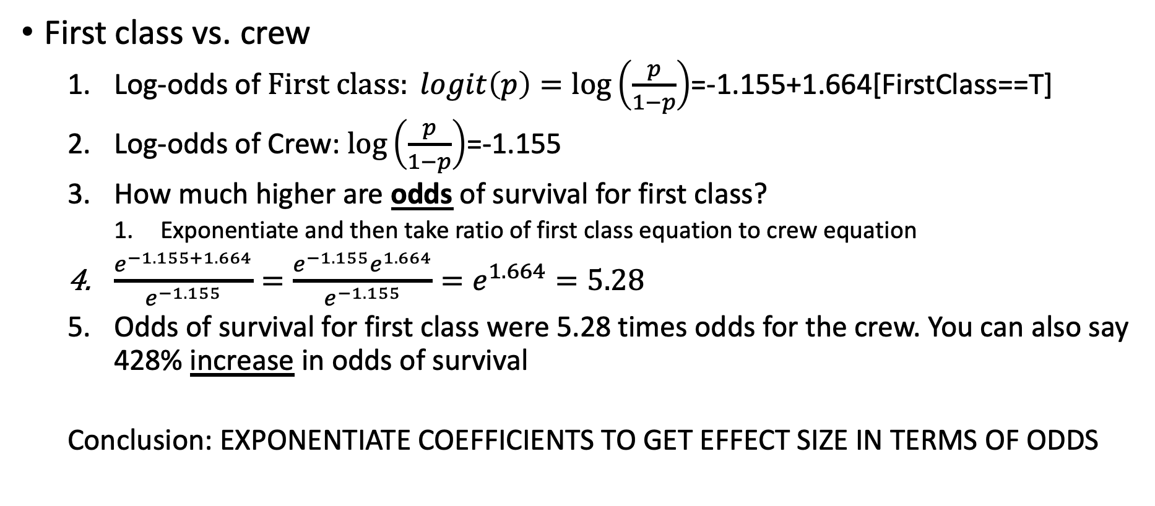
Interpreting the effect size with odds ratio
$\text{First class vs. crew}$
  Log-odds of $First class: logit\left(p\right)=\log\left(\frac{p}{1−p}\right)$=-1.155+1.664[FirstClass==T]
  Log-odds of Crew: $\log\left(\frac{p}{1−p}\right)$=-1.155
  How much higher are odds of survival for first class?
    Exponentiate and then take ratio of first class equation to crew equation
  $\frac{e^{−1.155+1.664}}{e^{−1.155}}=\frac{e^{−1.155}e^{1.664}}{e^{−1.155}}=e^{1.664}=5.28$
  Odds of survival for first class were 5.28 times odds for the crew. You can also say 428% increase in odds of survival
  Conclusion: EXPONENTIATE COEFFICIENTS TO GET EFFECT SIZE IN TERMS OF ODDS
Group Work
Show that this is also true for any continuous variables, x, by using the odds ratio of x + 1 to x

Slide 24
Questions
Group Work
Based on the model output, what is the probability that a member of the crew, first, second, third class survived? How much higher is the probability of survival for first class relative to crew?
How should these probabilities relate to the data in this model?
What are the p-values telling you?

Slide 25
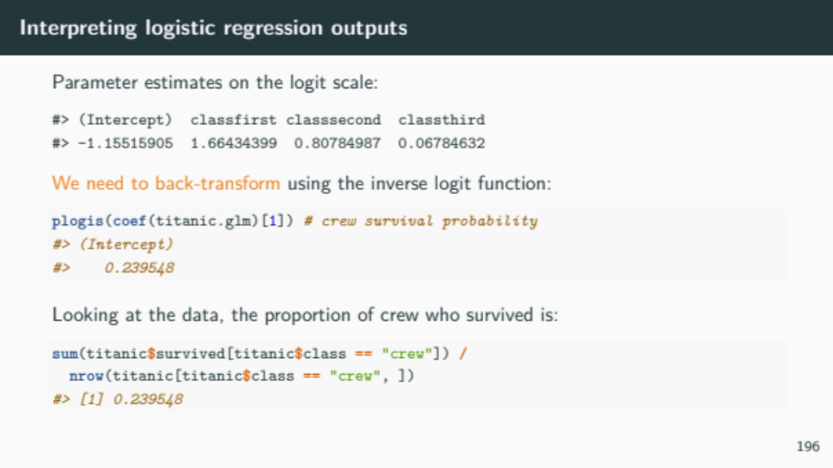

Slide 26
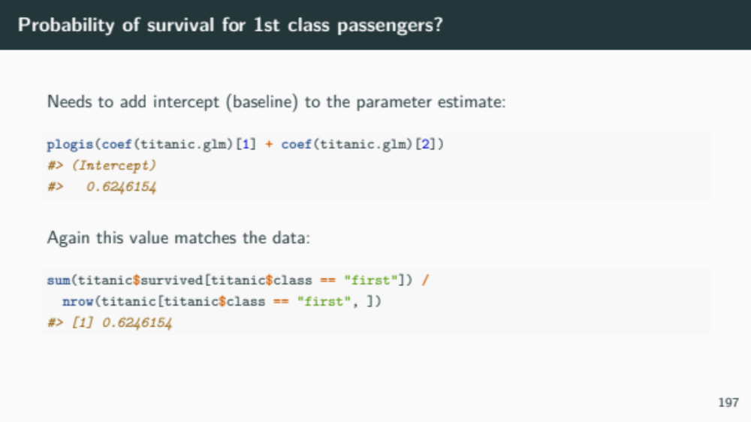
So this model was trivial for estimation but was still needed for inference!

Slide 27
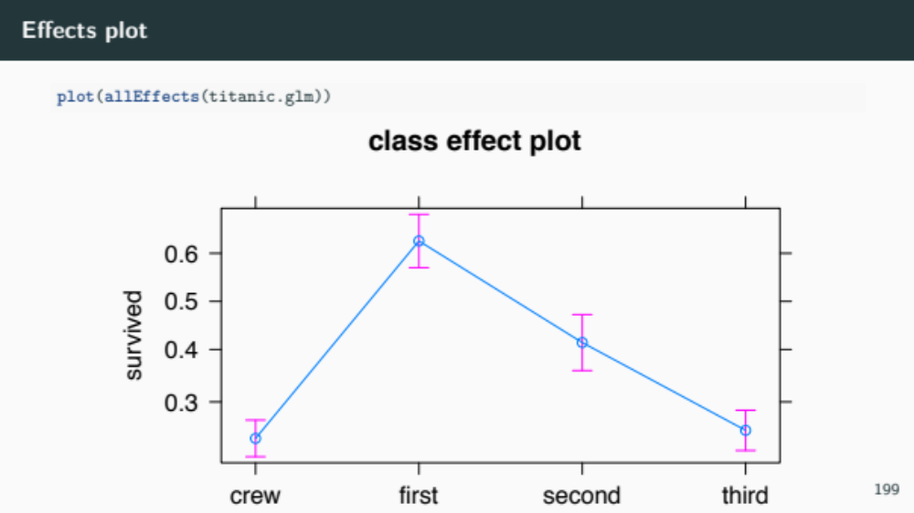

Slide 28
Did males have higher survival than females?

Slide 29
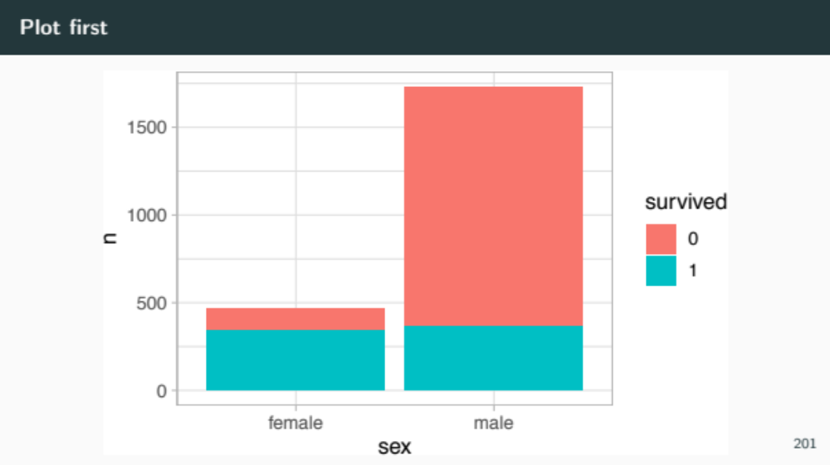

Slide 30
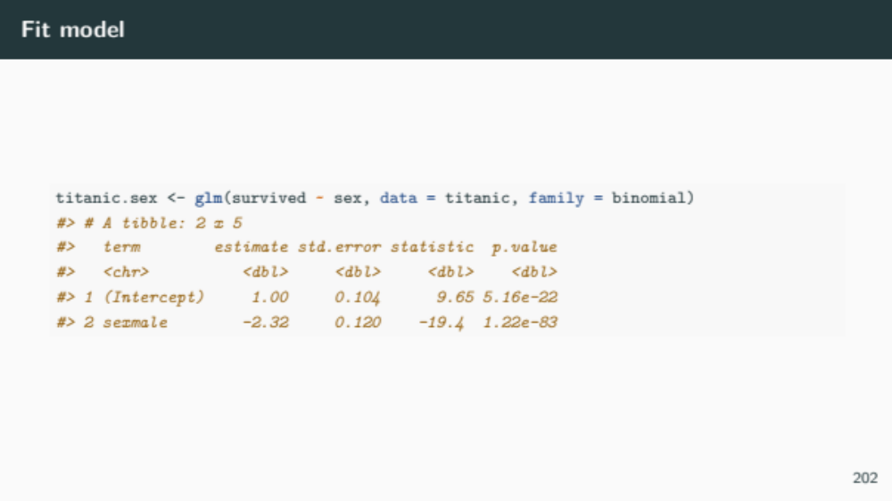

Slide 31
Did survival vary by class and sex?

Slide 32
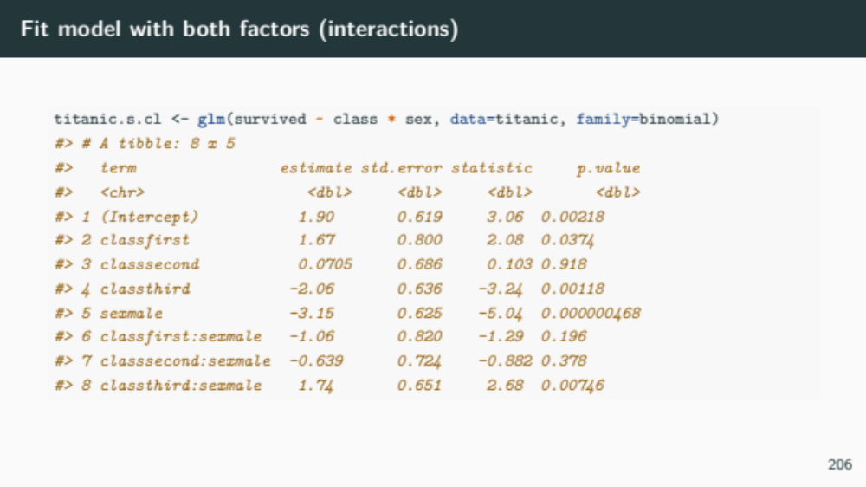

Slide 33
How do we interpret this?
Group Work
What are the log(odds) for first class males and females?
  What are the corresponding survival probabilities?
What are the log(odds) for male and female crew?
  What are the corresponding survival probabilities?

Slide 34
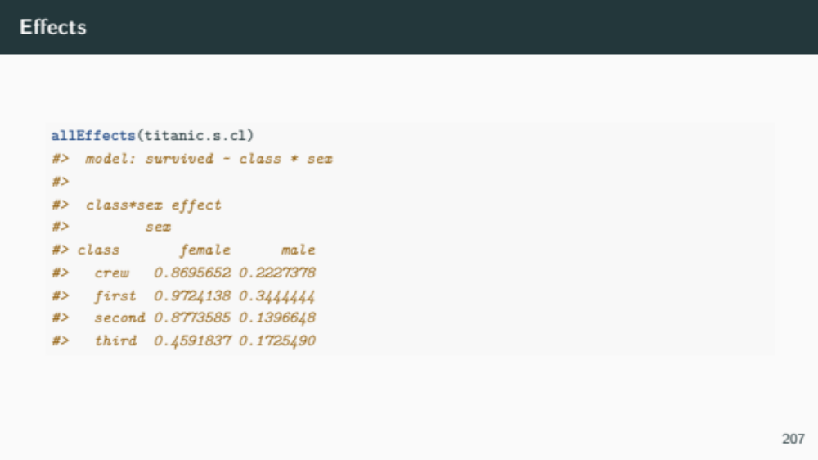

Slide 35
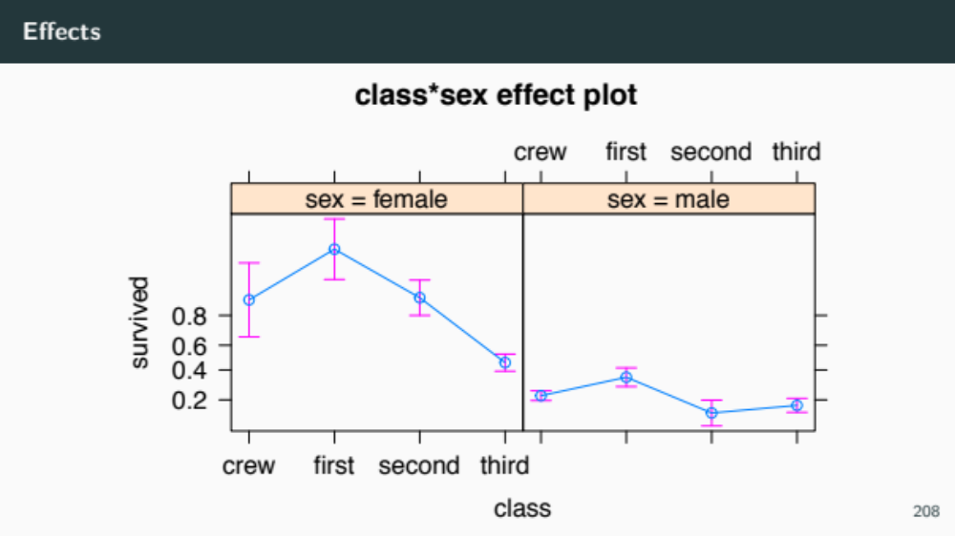

Slide 36
Instead of looking at individual passengers, can’t we look at proportion by group?

Slide 37
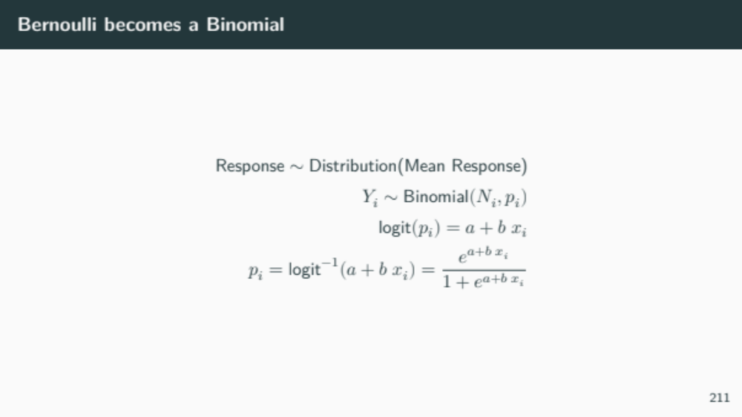
Not 1 anymore

Slide 38
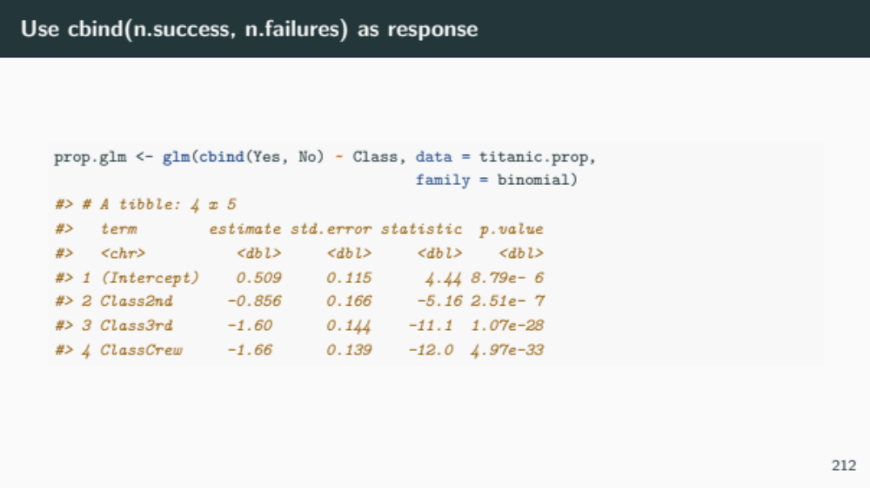
Check to make sure results are identical. I’ve made it not 100% easy to check

Slide 39
Models for count data
Poisson
Quasipoisson
Negative Binomial
Binomial
Unbounded
Bounded

Slide 40

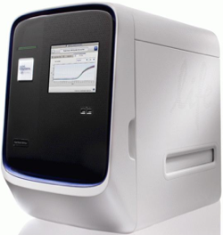
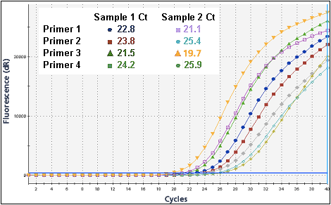
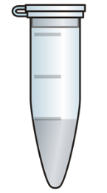
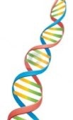

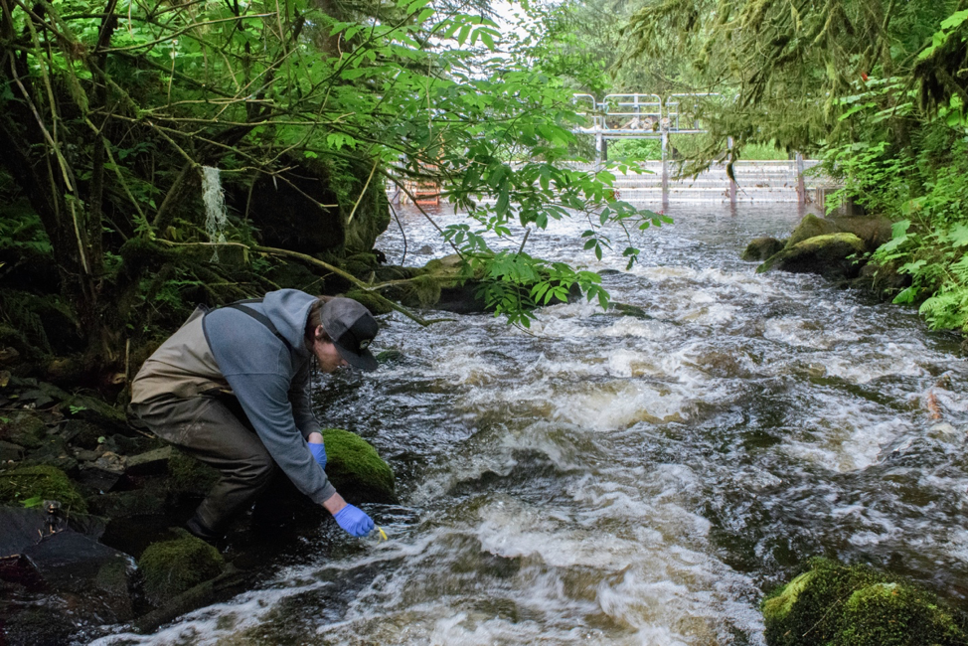
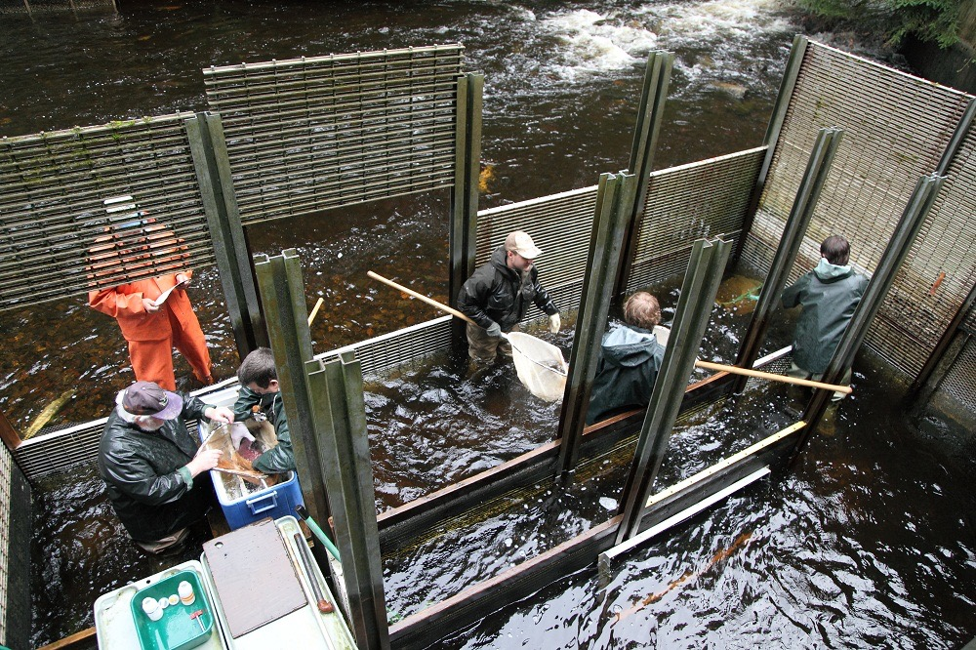
Does environmental DNA (eDNA) contain enough information to estimate salmon escapement and smolt abundance?
Oncorhynchus nerka (sockeye salmon)
=
One person, one sample /day
Several people, all day
Notes:
A minor revolution in ecology is using eDNA from water to sample aquatic species. I have started a project with He Daming of the Asian International Rivers Center at Yunnan University to use this technology to map fish populations.

Slide 41
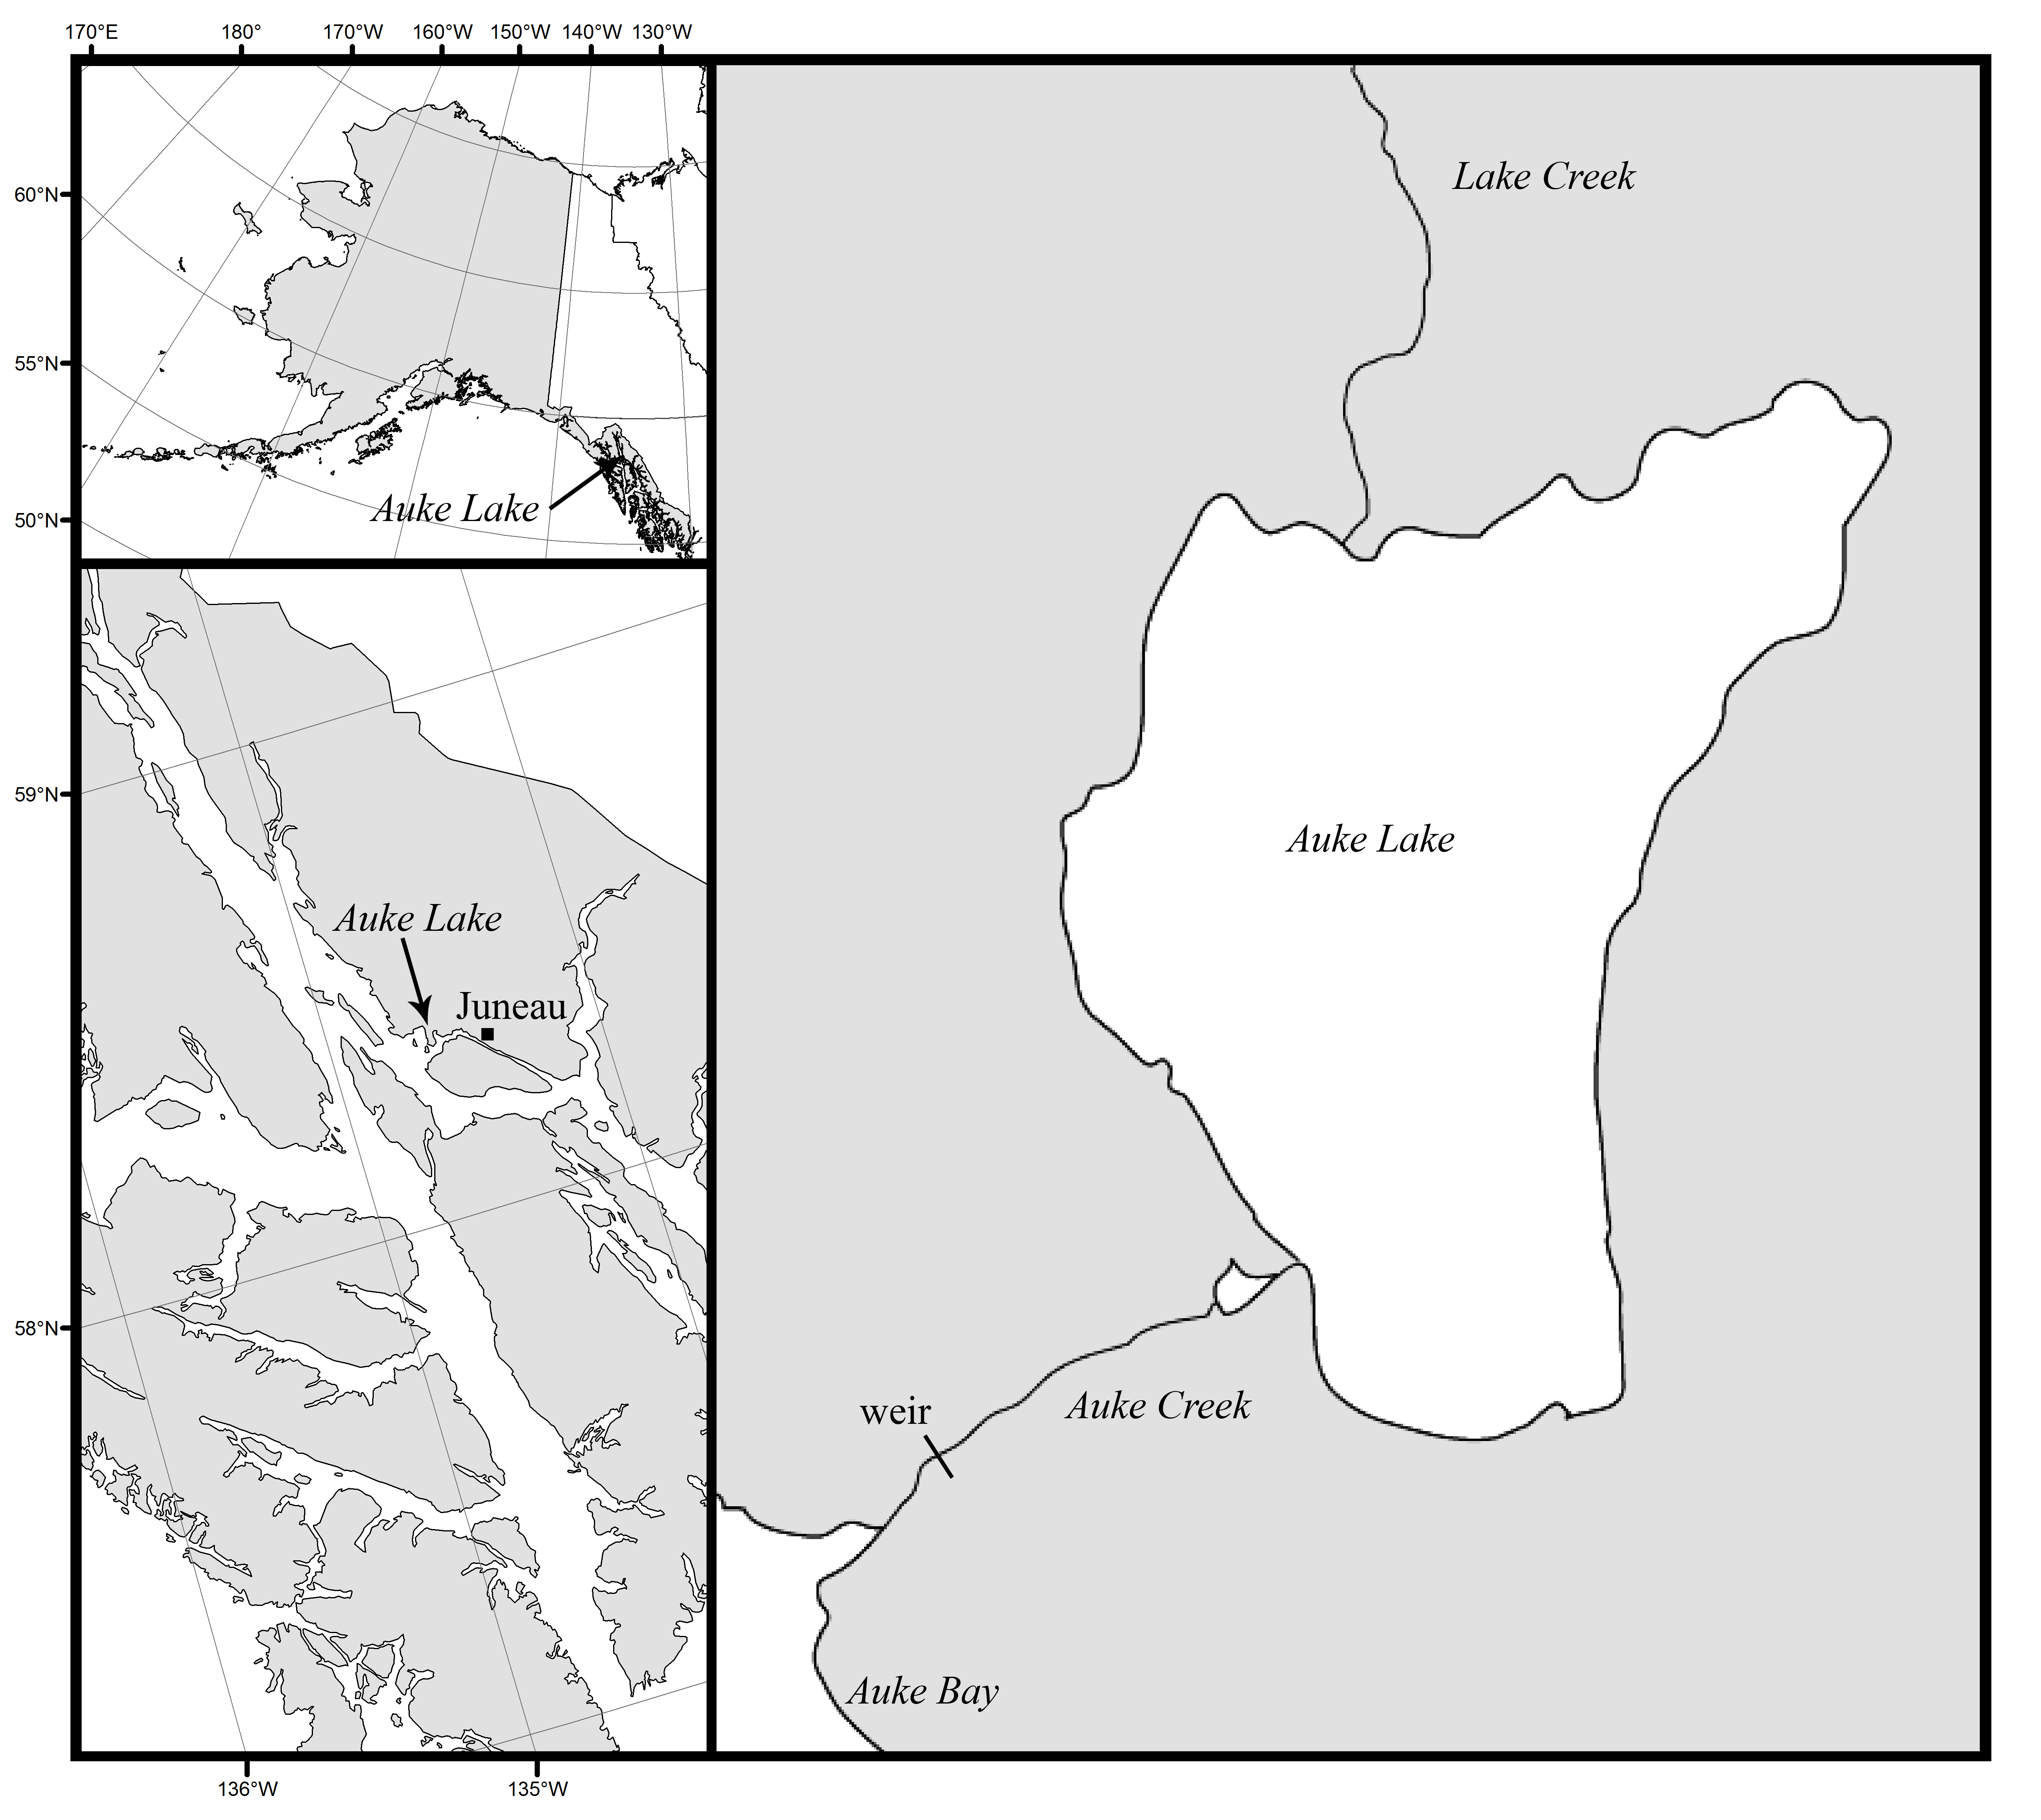
Levi. T., Allen, J. M., Bell, D., Joyce, J. Russel, J. R., Tallmon, D. A., Vulstek, S. C., Yahan, Y., Yu, D. W. 2019. Environmental DNA for the enumeration and management of Pacific salmon. Molecular Ecology Resources

Slide 42
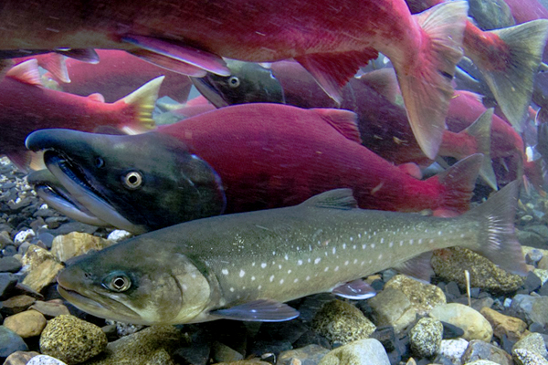
Validation data from Auke Creek Station in Juneau, Alaska
Daily counts of
returning Coho and Sockeye adults
out-migrating Sockeye smolts

Slide 43
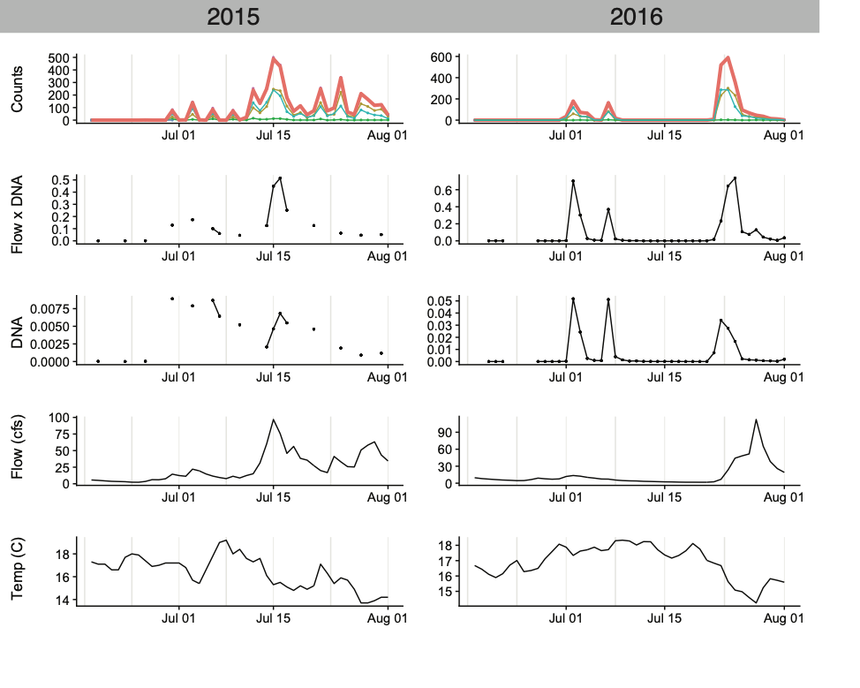
Sockeye returning adults

Slide 44
Sockeye returning adults

Slide 45
Sockeye returning adults

Slide 46

Sockeye returning adults
Water flux (cubic_ft/sec) X DNA concentration (ng/ul) = ng/sec X cubic_ft/ul
X
X
X
X

Slide 47
Sockeye returning adults
eDNA rate: ng/sec
X
X
X
X

Slide 48
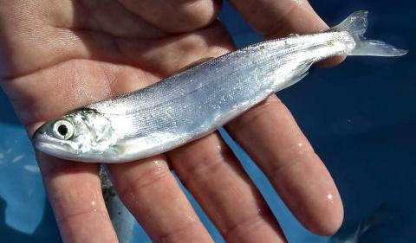
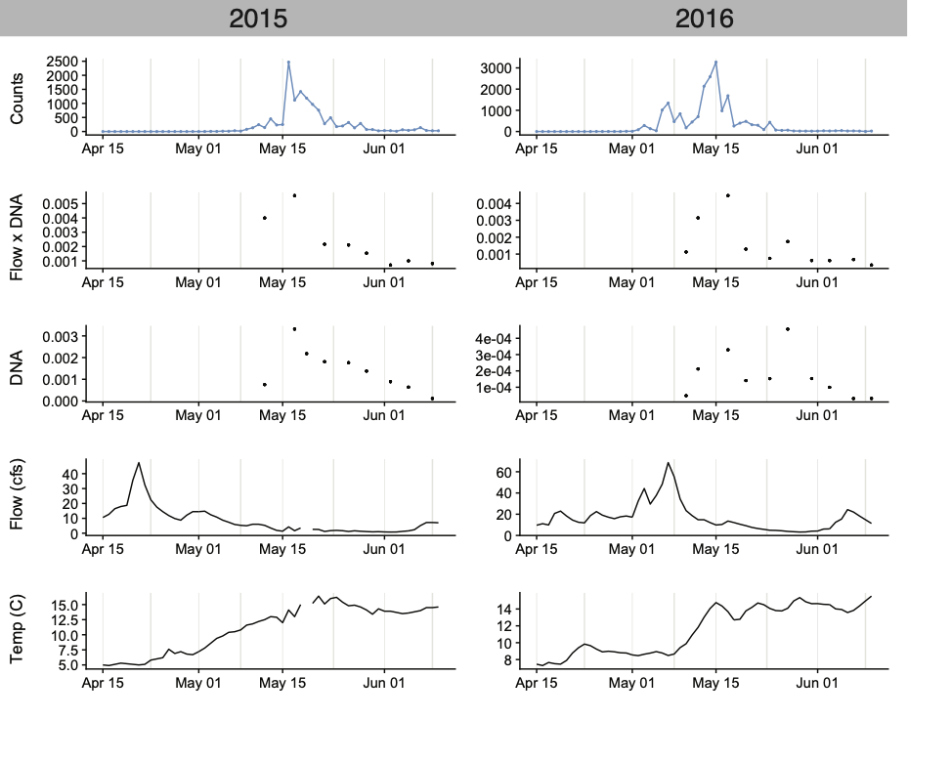
Sockeye out-migrating smolts

Slide 49
Can we predict salmon counts using eDNA
Let’s start with Poisson model using flow-corrected eDNA concentration as a predictor.

Slide 50
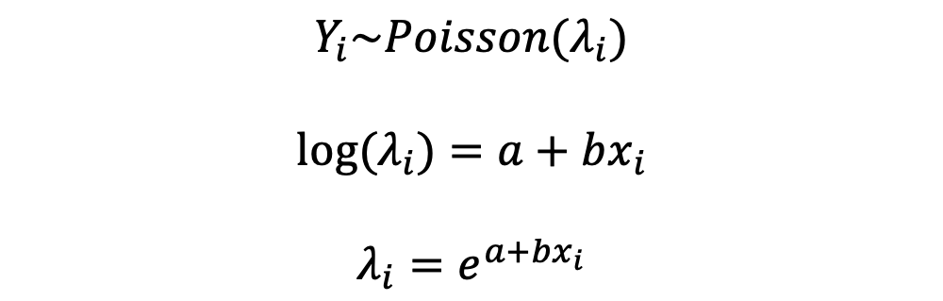
What is happening here?
Data are Poisson distributed with varying rate parameter
This parameter is the mean (and variance)
We model the mean as a linear function of predictors, but we need a link function
Why do we use log link here?
$$Y_{i}\sim Poisson(λ_{i})$$
$${log⁡(λ}_{i})=a+bx_{i}$$
$$λ_{i}=e^{a+bx_{i}}$$

Slide 51
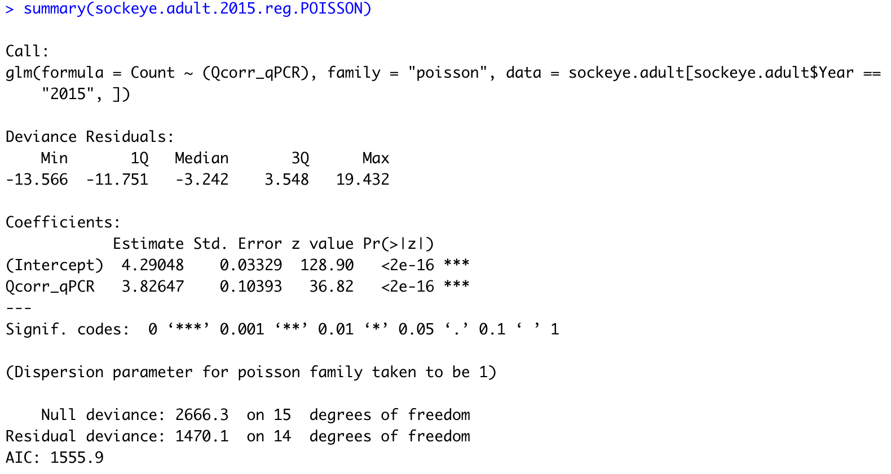
Model output

Slide 52
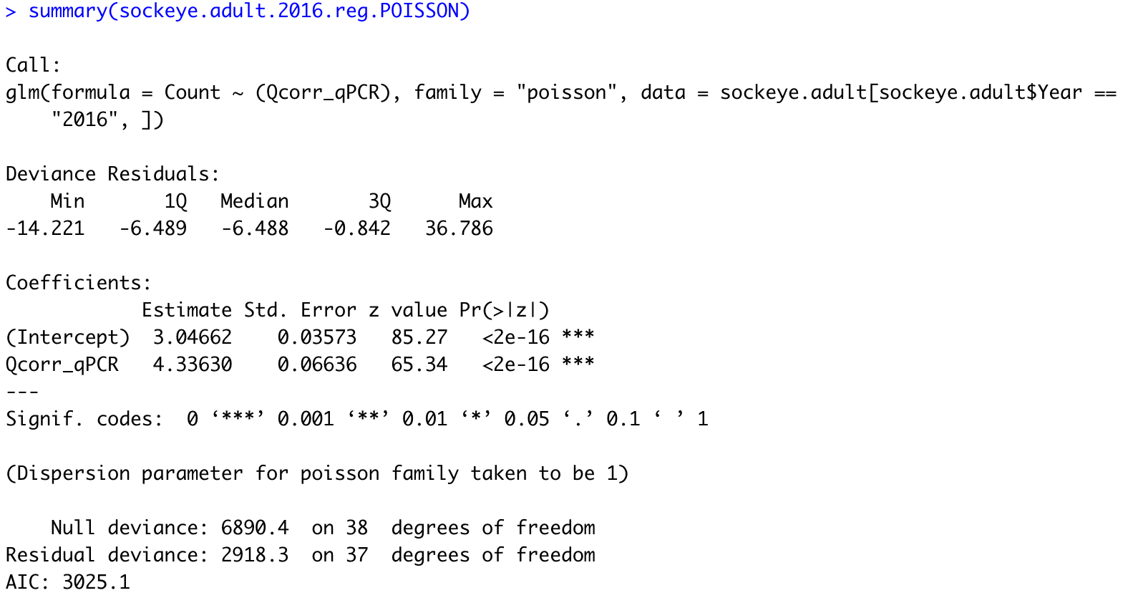
Model output

Slide 53
How does this look? Concerns?
What now? Are we done?

Slide 54
How does this look? Concerns?
What now? Are we done?
Poisson assumes variance = mean
Overdispersion evident if residual deviance > degrees of freedom
We clearly have overdispersion here because deviance is 100 times larger than degrees of freedom
Let’s deal with the overdispersion later.
Is the model otherwise ok?

Slide 55
We are not done!
Let’s plot the response
What are two ways we can do this? How?
  Reminder: We have daily flow-corrected qPCR (eDNA rate) and counts

Slide 56
1. X vs. Y
Why isn’t this a line if we fit
  glm(Count ~ Qcorr_qPCR , family = "poisson")
CI is far too narrow because of overdispersion (variance > mean)
Nothing else obvious

Slide 57
2. Good models make good predictions
Ah, look at that. We are consistently overpredicting the low/no counts!
Why? Let’s think more carefully
Is this model mispecified somehow?

Slide 58

What is being fit here exactly?
$${log⁡(Counts}_{i})=a+b{∗eDNA}_{i}$$
$${Counts}_{i}=e^{a+b∗{eDNA}_{i}}$$
What would eDNA rate have to be to match zero counts? Do you see it?
Yeah, that’s a problem! How do we fix it?

Slide 59
eDNA rate should be transformed from positive to the whole real line! How?
Log(eDNA) > 0 when eDNA > 1
Log(eDNA) = 0 when eDNA = 1
Log(eDNA) < 0 when eDNA = <1
Log(eDNA) = -Inf when eDNA = 0
Log transforming a positive variable stretches it to the real line.
But what functional form are we really fitting here?

Slide 60
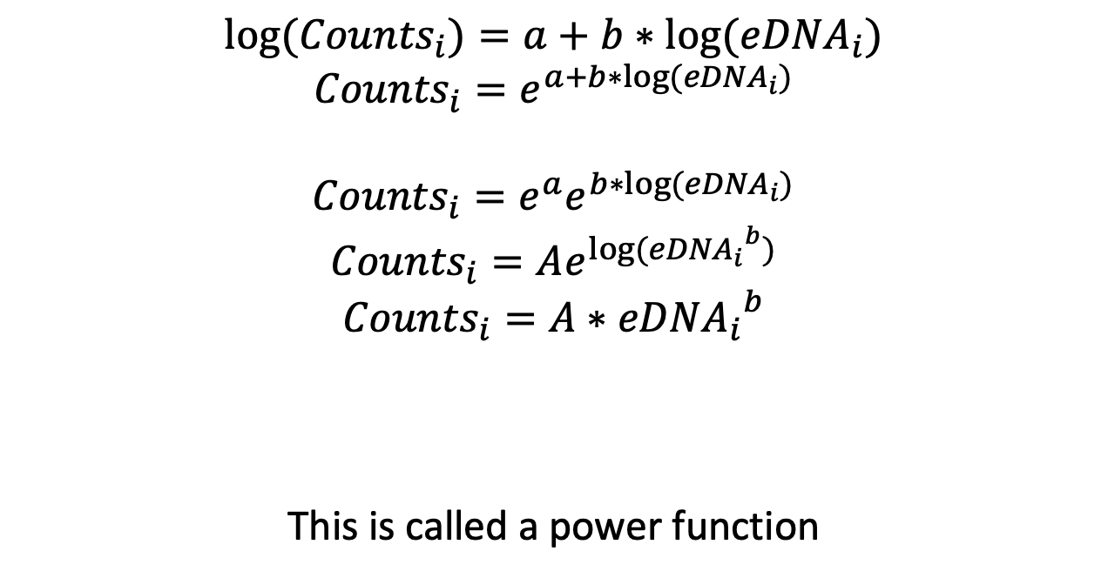
log(Y) = a + b*log(X)
$${log⁡(Counts}_{i})=a+b{∗log⁡(eDNA}_{i})$$
$${Counts}_{i}=e^{a+b∗{log⁡(eDNA}_{i})}$$
$${Counts}_{i}=e^{a}e^{b∗{log⁡(eDNA}_{i})}$$
$${Counts}_{i}=Ae^{{{log⁡(eDNA}_{i}}^{b})}$$
$${Counts}_{i}=A{{∗eDNA}_{i}}^{b}$$
This is called a power function

Slide 61
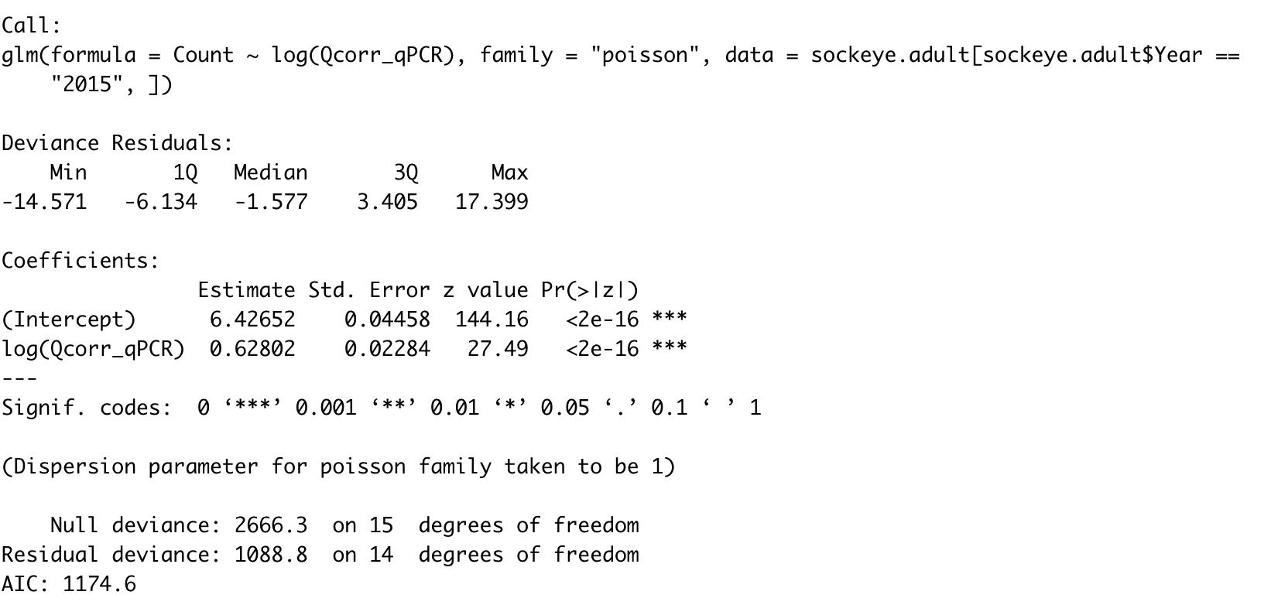
New model output

Slide 62

New model output

Slide 63
Good models make good predictions
Much better at predicting zeros now
But still very narrow confidence intervals that don’t make sense
Clear overdispersion because deviance >> degrees of freedom
Now let’s fix the overdispersion problem

Slide 64
Quasipoisson GLM
The Normal distribution has the mean and variance as separate parameters, but this is unusual
Poisson distribution has variance equal to the mean
Quasipoisson allows the variance to be proportional to the mean
This ”dispersion parameter” is the constant of proportionality that defines how much larger or smaller the variance is than the mean

Slide 65

Quasipoisson GLM
Larger p-value
Identical estimate
Variance 78 times larger than the mean

Slide 66

Quasipoisson GLM
Larger p-value
Identical estimate
Variance 39.5 times larger than the mean

Slide 67
Quasipoisson figures

Slide 68
Quasipoisson figures

Slide 69
This is great, but….
No AIC.
We’ll talk about AIC later, but if you need AIC then we need another distribution
Which one?

Slide 70
Negative binomial
Can’t use glm(). Need to use glm.nb() in the MASS package
sockeye.adult.2015.reg.NB <- glm.nb(Count ~ log(Qcorr_qPCR) ,
data = sockeye.adult[sockeye.adult$Year == "2015" , ])
sockeye.adult.2016.reg.NB <- glm.nb(Count ~ log(Qcorr_qPCR) ,
data = sockeye.adult[sockeye.adult$Year == "2016" , ])
Default log link
Still use logarithm here

Slide 71

Negative binomial
We now have AIC

Slide 72

Negative binomial
We now have AIC

Slide 73
Negative binomial

Slide 74
Negative binomial

Slide 75
Gamma
Another common GLM.
Useful for positive and continuous data
What is mean variance relationship?

Slide 76



Gamma
Another common GLM.
Useful for positive and continuous data
What is mean variance relationship?
Variance is proportional to the mean
As theta gets big or beta smaller, the variance increases relative to the mean

Slide 77


Interaction Terms
“Context dependence” – The effect of one predictor depends on the value of another predictor
$$y\sim N(β_{0}+β_{1}x_{1}+β_{2}x_{2}+β_{3}x_{1}x_{2},σ)$$

Slide 78



Interpretation and Symmetry of Interactions
$$y\sim N(β_{0}+β_{1}x_{1}+β_{2}x_{2}+β_{3}x_{1}x_{2},σ)$$
Let’s focus on deterministic part
$$y=β_{0}+β_{1}x_{1}+β_{2}x_{2}+β_{3}x_{1}x_{2}$$
Factor out x₁
Factor out x₂
$$y=β_{0}+x_{1}\left(β_{`1}+β_{3}x_{2}\right)+β_{2}x_{2}$$
$$y=β_{0}+β_{1}x_{1}+x_{2}\left(β_{`2}+β_{3}x_{1}\right)$$
Interpretation of $β_{3}:$
How does the effect of x₁ on y change depending on the value of x₂
How does the effect of x₂ on y change depending on the value of x₁

Slide 79




Interpretation and Symmetry of Interactions
$$y\sim N(β_{0}+β_{1}x_{1}+β_{2}x_{2},σ)$$
Vs.
$$y\sim N(β_{0}+β_{1}x_{1}+β_{2}x_{2}+β_{3}x_{1}x_{2},σ)$$

Slide 80


Interpretation and Symmetry of Interactions
$$y\sim N(β_{0}+β_{1}x_{1}+β_{2}x_{2},σ)$$
Vs.
$$y\sim N(β_{0}+β_{1}x_{1}+β_{2}x_{2}+β_{3}x_{1}x_{2},σ)$$

Slide 81


Dependence on scaling and transformation I
Simulate data with no interaction
Y = 200+3*x1 - 4*x2
lm(y~x1*x2)

Slide 82

Dependence on scaling and transformation II
Log transform dependent variable
lm(log(y)~x1*x2)
What is happening and why?!

Slide 83

Additivity not preserved across nonlinear transformations!
If log(y) is a function of additive x1 and x2, will y generate an interaction?
$\log\left(y\right)=β_{0}+β_{1}x_{1}+β_{2}x_{2}$
$y=e^{β_{0}+β_{1}x_{1}+β_{2}x_{2}}$
$y= e^{β_{0}}e^{β_{1}x_{1}}e^{β_{2}x_{2}}$
$y\sim e^{β_{0}}\left(1+β_{1}x_{1}\right)\left(1+β_{2}x_{2}\right) by e^{x}\sim 1+x for small x$
$y\sim e^{β_{0}}\left(1+β_{1}x_{1}+β_{2}x_{2}+β_{1}β_{2}x_{1}x_{2}\right)$
Equations for reference, work through on paper

Slide 84




Confusion in action with major policy implications!
Q: Deer are expanding, driving decline of caribou by supporting wolves. Is this due to logging or climate or both?
(2)
(1)
(3)

Slide 85


What was the point made by Barnas et al.?

Slide 86

What was the point made by Barnas et al.?
Weird. Why? Who is right?

Slide 87

Models, especially with interactions, require algebra and especially geometry. Interpret the predictions!
As they SHOULD, the two approaches produce IDENTICAL predictions.
-What are the predictions?
-Was there a transformation?
What lesson should we take from this?

