Slide 1
Likelihood Ratio Tests
And
Model Selection
Notes:
a

Slide 2
Model selection — Why?
Understand which explanatory variables are important
Find evidence of relationship(s) between variable(s) and response
Quantify the effects of explanatory variables on the response
Use model to predict response values
Predict response at another location or time

Slide 3
Inference, Estimation, Prediction
Understand which explanatory variables are important
Find evidence of relationship(s) between variable(s) and response
Quantify the effects of explanatory variables on the response
Use model to predict response values
Predict response at another location or time

Slide 4
Model selection — Why?
Q: Why not just include all explanatory variables?
A: Extra predictors cost precision, and they are almost always correlated.
Too many predictors relative to sample size…
fits noise as if it were signal (overfitting), so out-of-sample prediction gets worse;
spends degrees of freedom, inflating variance of estimates and predictions.
Correlation among explanatory variables (collinearity)…
inflates standard errors, so real effects are hard to detect;
makes individual coefficients unstable and hard to interpret — estimates are imprecise.

Slide 5
Fit?
Compare “fit” of different models
Define “fit” — (maximum) likelihood?
Increases when adding more variables
Need to penalise fit somehow (to avoid overfitting)
Choice between different approaches reflects choice of penalty
sometimes just strength of penalty
Three ways of comparing likelihoods…

Slide 6
Definitions: AIC, BIC, LRT
AIC — Akaike’s Information Criterion
AIC = −2 log ℓ(θ̂) + 2p
AIC_{C} — corrected for small samples
AIC_{C} = AIC + 2p(p+1) / (n − p − 1)
BIC — Bayesian Information Criterion
BIC = −2 log ℓ(θ̂) + p log n
LRT — Likelihood Ratio Test
−2 log ℓ(θ̂₁) + 2 log ℓ(θ̂₂) ~ χ² with df = p₂ − p₁
Reduced
(simpler)
Full
(complex)

Slide 7
Hypothesis Tests to Compare Models
(not parameters)
One can use the likelihood ratio test to compare two models when
  both are based on the same data
  one of the models is “nested” within the other
    That is, one model is a special case with a parameter equal to a specific value (usually zero) from the more general model.

Slide 8
Nested Models
The following models are nested:
y = Time + Depth * Region
y = Depth * Region
The following models are not nested:
y = Time + Depth * Region
y = Temp + Depth * Region

Slide 9
Hypothesis Tests for Models
Model A nested within more general model B can be compared as follows:
H₀: Model A fits the data as well as Model B
(with fewer parameters)
H_{A}: Model A does not fit the data as well as Model B
(you need those extra parameters)
Fit models A and B and record:
  the negative log-likelihood at the best fit
  the number of parameters in models A and B, p_{A} and p_{B}.

Slide 10
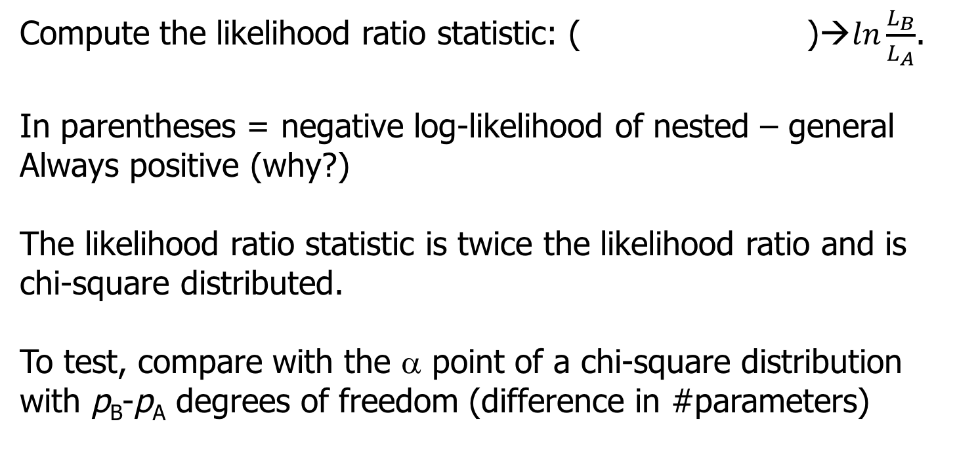

Hypothesis Tests for Models
Compute the likelihood ratio

Slide 11
When is this useful rather than just interpreting coefficients?
Interpret coefficients when you want to understand the effect of specific parameters. Use a likelihood ratio test (LRT) when you want to test whether a term (possibly involving multiple parameters) improves the model.
No Need for LRT, just interpret coefficients
glm(count ~ temperature + elevation, family = poisson)
Treatment has 5 levels (4 coefficients). Does treatment, as a whole, improve model fit? → LRT
Asking, is the model better with ALL the coefficients equal to zero?
glm(count ~ treatment, family = poisson)
Does adding the treatment × temperature interaction improve model fit? → LRT
glm(count ~ treatment*temperature, family = poisson)
m1 <- glm(count ~ treatment + temperature, family = poisson)
m2 <- glm(count ~ treatment * temperature, family = poisson)
anova(m1, m2, test = "LRT")

Slide 12
Usually the simpler model sets some parameters to zero, but null can be nonzero
You monitor an intersection for cars that run the red light. Based on 50 days of observation, you detect 30 days on which “light running” took place. You repeat the “experiment” after a red light camera is installed and now observe 10 days on which “running” occurred.
How do we know if there is a significant difference in the rate of running red lights after a camera is installed?

Slide 13
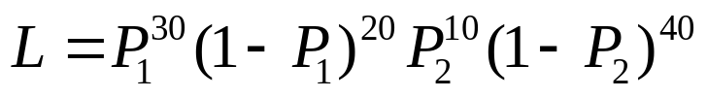
Example-I
Let us define P₁ as the probability of running the light before the
camera was installed and P₂ the probability after the camera
The Binomial likelihood function (ignoring the normalizing constant):
Model A: The probability of running the light has not changed
(P₁=P₂; The more specific model; you only need 1 parameter)
Model B: P₁ may differ from P₂.
(The more general model – more parameters)

Slide 14



Example-II
Summary for this example
Model A: 0.4 0.4 67.30
Model B: 0.6 0.2 58.67
The difference between the negative log likelihoods
67.3 - 58.7 = 8.6
Twice this difference is 17.2
Is this significant given the difference in parameters is 1?

Slide 15
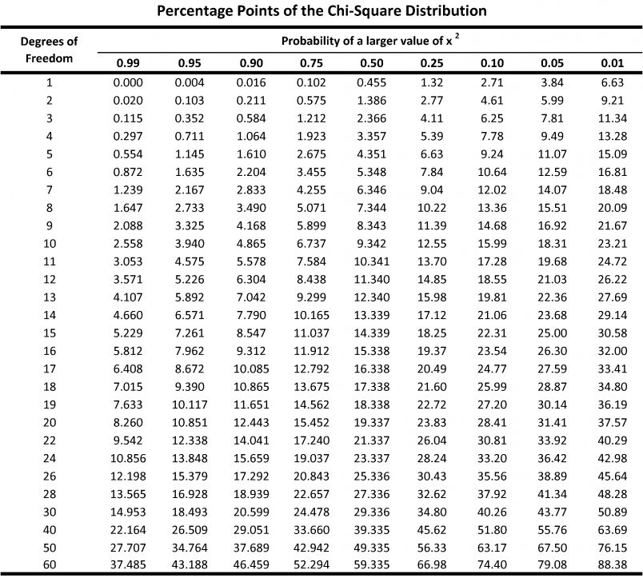
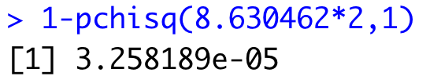
Example-II
The difference between the negative log likelihoods is 8.6 – is
this significant given the difference in parameters is 1?
2*8.6=17.2, compare to chisq distribution with one d.f
REJECT THE NULL
That the one parameter model fits that data. Much better to use two parameters, indicating that the probability of running the red light has changed!

Slide 16
Likelihood ratio test can typically only be applied to nested models
“Information theoretic” approaches (e.g. AIC, BIC) can be used to compare non-nested models.
Models with smaller values of AIC or BIC are “better”, or “have more support” or “are more parsimonious”, but we’ll dig into what this really means for AIC and BIC.

Slide 17
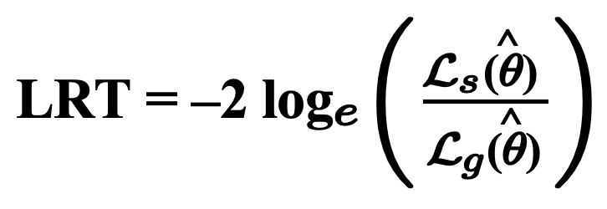
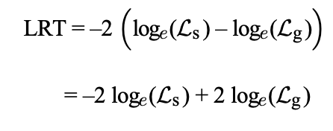
Information Theoretic Criteria for Model Selection (i.e. AIC, BIC, etc.)
The likelihood ratio statistic is twice the log of the likelihood ratio
Compare to chi.sq distribution with degrees of freedom = # parameters
Can also be written as difference in log-likelihoods or deviances

Slide 18
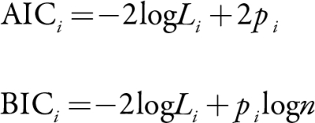
Information Theoretic Criteria for Model Selection
Compare to chi.sq distribution with degrees of freedom = # parameters
Look familiar?
AIC and BIC are meaningless on their own, but models with lower values are more parsimonious (i.e. supported). They balance better fit with more parameters. This is exactly what the likelihood ratio test does.

Slide 19
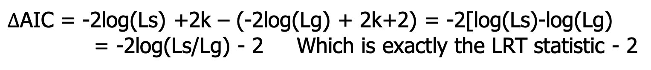


Information Theoretic Criteria for Model Selection
Compare to chi.sq distribution with degrees of freedom = # parameters
Say you compare two models with k parameters and with k+1

Slide 20
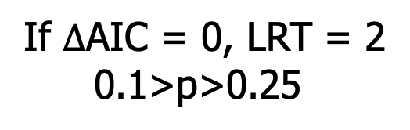
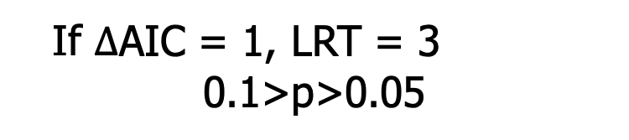
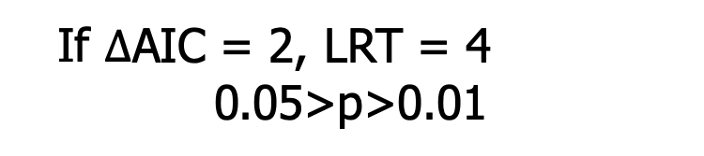
If 1 parameter separate the model. AIC likes bigger models
Convention within>2 AIC units are “considered competitive”, and this is approximately the same as frequentist model selection using LRT

Slide 21
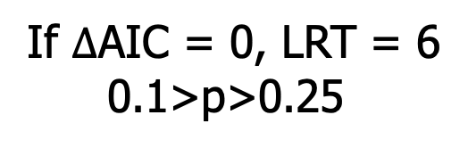
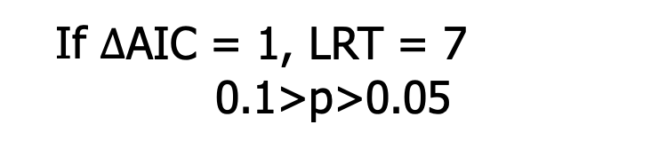
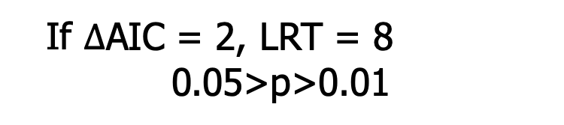
What if 3 parameters separate the model? AIC likes bigger models
(reject the null that the parameters equal 0)
2 deltaAIC still equivalent to p = 0.05

Slide 22
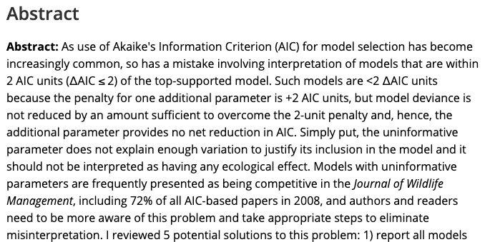

Most common mistake in ecology!
4400 Citations!
72% of all papers incorrectly interpret uninformative parameters!

Slide 23
AIC does not test whether a parameter matters
AIC asks: which model has better expected information/predictive performance?
LRT asks: does the added parameter improve the model enough to reject β = 0?
For nested model differing by one parameter
ΔAIC | What happened? | Approx. LRT p
> 0 but <2 | Adding the parameter increases AIC → uninformative by Arnold's criterion | > .157
0 to −2 | Parameter reduces AIC, but weakly → informative by Arnold's criterion, but weak evidence for the parameter | .157–.046
< −2 | Parameter substantially improves AIC → stronger evidence for the parameter | < .046
Notes:
Cue: Taal, show why with a simulation and math

Slide 24
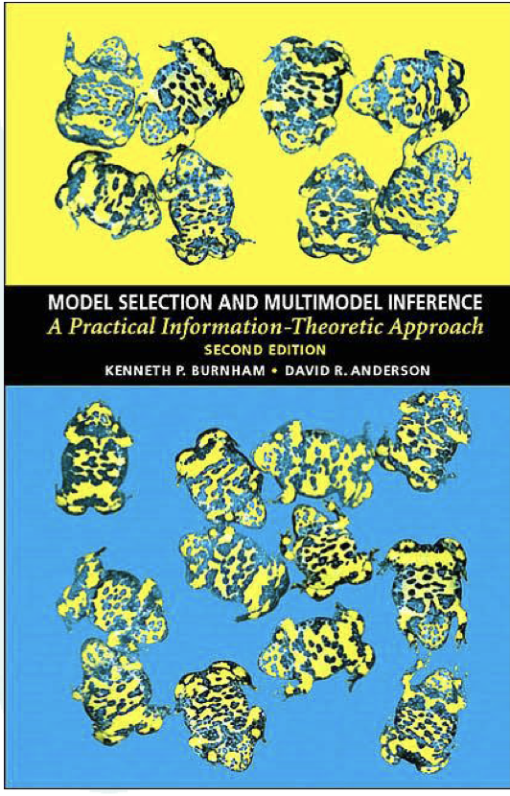
The Cult of AIC
Burnham & Anderson (2002)

Slide 25
Two key questions
“Always use AIC for model selection or model comparison”:
Is this instruction correct?
Why is it wrong?
From statisticians Mark Brewer and Adam Butler

Slide 26
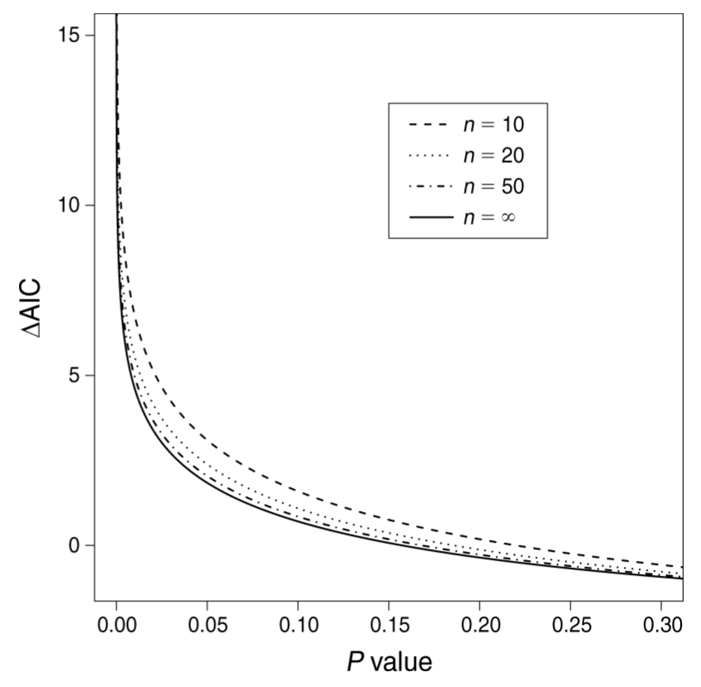
AIC and p-values
From Murtaugh Ecology (2014), Fig. 2:
Direct comparison
Two models, differ by one parameter

Slide 27
Why does the cult of AIC hate p-values?
P < 0.05 is an arbitrary threshold
  But ⍙AIC < 2 is as well
AIC doesn’t suffer from Type I error or problems with autocorrelation
  AIC is not a hypothesis test, but making inference by AIC includes MANY MORE false positives
P-values don’t tell us how important an effect is – i.e. whether the effect is biologically significant. Use effect sizes and confidence intervals instead
  AIC tells you neither the magnitude nor uncertainty of an effect. I see big tables of ΔAIC and model weights with no effect sizes or predictions. What if all the models are poor?
  We always need effect sizes and uncertainty for inference. These are the most important part of the science!
  But let’s remember how confidence intervals and p-values are related

Slide 28
Confidence intervals and p-values
Estimate and 95% CI. What is p?
Estimate and 99% CI. What is p?
-3 -2 -1 0 1 2 3
Effect sizes and p tell you the same thing as effect sizes and CIs!

Slide 29
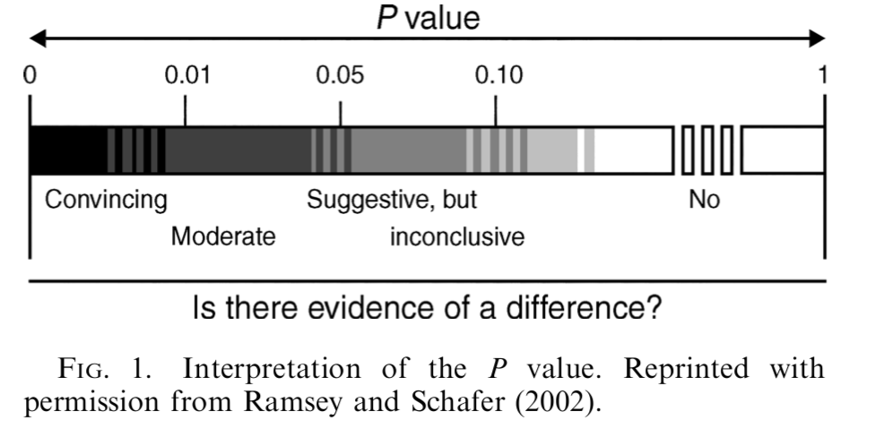
P-values should be interpreted on a continuum. Not a step function at 0.05.
AIC should be interpreted in the same way!
deltaAIC=2
deltaAIC=7

Slide 30
So why use AIC?
It is easy to assess non-nested models of highly variable structure.
It is good for selecting models for prediction
But it is widely used for inference, resulting in more Type I error
  Often used incorrectly, resulting in more error (more on this later)

Slide 31
Why did AIC take over wildlife science?
Aggressive marketing of the method by Burnham and Anderson, who were in Fisheries and Wildlife and “wrote the book”
People adopt new statistical methods, then find the holes, and then the pendulum swings back
It feels rigorous because you have to run so many models
People like ranking things

Slide 32
AIC in practice…
Var 1 | Var 2 | Var 3 | Var 4 | Var 5 | AIC | ΔAIC | Weight
 | -0.539 (± 0.244) |  | -0.602 (± 0.190) |  | 1789.73 | 0.00 | 0.26
 | -0.674 (± 0.336) |  | -0.609 (± 0.192) | 0.173 (± 0.295) | 1791.38 | 1.65 | 0.12
 | -0.544 (± 0.245) | 0.003 (± 0.008) | -0.566 (± 0.214) |  | 1791.60 | 1.86 | 0.10
-0.090 (± 0.333) | -0.541 (± 0.244) |  | -0.574 (± 0.217) |  | 1791.66 | 1.93 | 0.10
 |  |  | -0.641 (± 0.201) |  | 1792.23 | 2.50 | 0.08
-0.070 (± 0.335) | -0.670 (± 0.336) |  | -0.586 (± 0.220) | 0.167 (± 0.296) | 1793.34 | 3.61 | 0.04
 |  |  | -0.622 (± 0.198) | -0.212 (± 0.222) | 1793.34 | 3.61 | 0.04
 | -0.662 (± 0.344) | 0.001 (± 0.008) | -0.591 (± -0.591) | 0.155 (± 0.316) | 1793.35 | 3.62 | 0.04
Which is the top model? Which models are competitive?

Slide 33
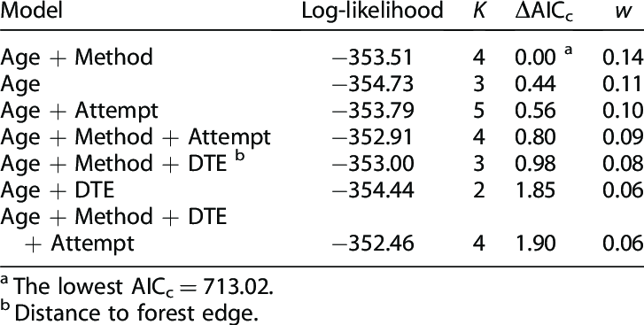
AIC in practice
For small sample sizes, AIC is biased and so people use AICc. AICc is treated as “corrected AIC” and converges to AIC for large n.
Model weights. Each model i of R is weighted based on its deltaAIC.
  Variables included with lots of model weight considered important.
  Model weight used for averaging across models for prediction
  Both deltaAIC and weights depend on model set
AICc = AIC + (2k² + 2k) / (n − k − 1)
w_{i} = exp(−0.5 Δ_{i}) / Σ_{r=1} ^{R} exp(−0.5 Δ_{r})
Why would I hate this table as the only presentation of results?

Slide 34

Best recent paper as a resource to stop doing dumb stuff with AIC

Slide 35
B & A recipe for modelling
Procedure for model selection:
Decide on scientific questions to answer
Define small candidate set of models
Fit models, calculate AIC, find “best” model
Use threshold on ΔAIC to determine set of “plausible” models
Calculate model weights via ΔAIC
(Assess variable importance using weights)

Slide 36
Burnham and Anderson did not advocate model dredging (fitting all/many combinations of predictors)
If you look at many models, you will have many Type I errors leading to “overfitting”.
But did ecologists listen to B&A and construct sensible model sets?
  Hell no
Do ecologists even think about whether the purpose of modeling is inference or prediction?
  Also no
“An investigator with, say, 10 explanatory variables cannot expect to learn much from his data and a multiple linear regression analysis unless there is some substantial supporting science that can be used to help narrow the number of models to consider. In this example, there would be 1,024 models (many more if transformations or interaction terms were allowed), and over-ﬁtting would surely be a serious risk. The analysis, by whatever method, should probably be considered exploratory and the results used to design further data gathering leading to a more conﬁrmatory analysis, based on some a priori considerations” (Burnham and Anderson 2002:85)

Slide 37


Slide 38
Then what about BIC?
Is it just a similar alternative?
The penalty in BIC increases with the sample size
AIC retains more complex models than BIC or p-values
AIC chooses the model that gives the best prediction. It is efficient for prediction.
BIC chooses the “correct” model if it is in the set.

Slide 39
AIC vs BIC
“Theoretically, AIC is optimal in the sense of minimizing the mean square error of predictions, whereas a competing metric, the Bayesian Information Criterion (BIC; Schwarz 1978), is consistent – that is, it will tend to select the ‘true’ model as the sample size increases to infinity.”
AIC is asymptotically equivalent to leave-one-out crossvalidation (prediction), and BIC is most similar to inference (p-values)

Slide 40
Method | Primary purpose | Requires nested models? | Complexity penalty | Produces p-value?
Likelihood Ratio Test (LRT) | Test a specific null hypothesis | Yes | compares improvement in likelihood to chi^2 distribution | Yes
AIC | Select the model expected to predict new data best | No | 2 AIC units per additional parameter | No
BIC | Select the simplest plausible data-generating model | No | Log(n) BIC units per additional parameter | No

Slide 41
Crossvalidation: Split data, train model, compare predictions to actual using test data. Repeat.
k-fold crossvalidation
Leave-one-out (n-fold crossvalidation)
Dataset
Train
Test

Slide 42
If the goal is prediction, is a linear model the right tool?
Cross-validation asks the right question: how well does this model predict data it has never seen?
But it can only compare the models you wrote down — and every one of them is a straight-line combination of the terms you chose.
Ecological responses are often nonlinear, full of thresholds, and full of interactions we would never think to write down.
When prediction is the goal, there are tools built for that job. You should know they exist.

Slide 43
Machine learning regression tree
Response: juvenile coho density (fish per 100 m²). Predictors: stream temperature, large wood, canopy cover.
Temperature < 16.5 °C
yes
no
Large wood ≥ 8 pieces
Canopy cover ≥ 45%
yes
no
yes
no
24.3
n = 31
11.6
n = 24
7.2
n = 38
2.1
n = 27
Every observation lands in one leaf; the prediction is the mean of the training data in that leaf.
The wood split applies only in cold streams — an interaction nobody had to specify.

Slide 44
From one tree to many
A single tree is easy to read, but unstable — change a few data points and the splits change.
So we use many trees instead of one. Two versions of this idea are everywhere in ecology:
  Random forests: grow hundreds of trees on resampled data, then average them.
  Boosted regression trees: add trees one at a time, each improving on the last.
What you get back is a prediction, not an equation to interpret.

Slide 45
Which one do you want?
Reach for trees when…
A map or a forecast is the actual deliverable.
You have many predictors and little idea which matter.
You expect thresholds or interactions you cannot specify.
You want a check on whether your GLM is missing something.
Stay with a GLM when…
You need an effect size with a confidence interval.
You have a hypothesis to test.
You are asking why, not just what.
You need to predict beyond the range of your data.

Slide 46
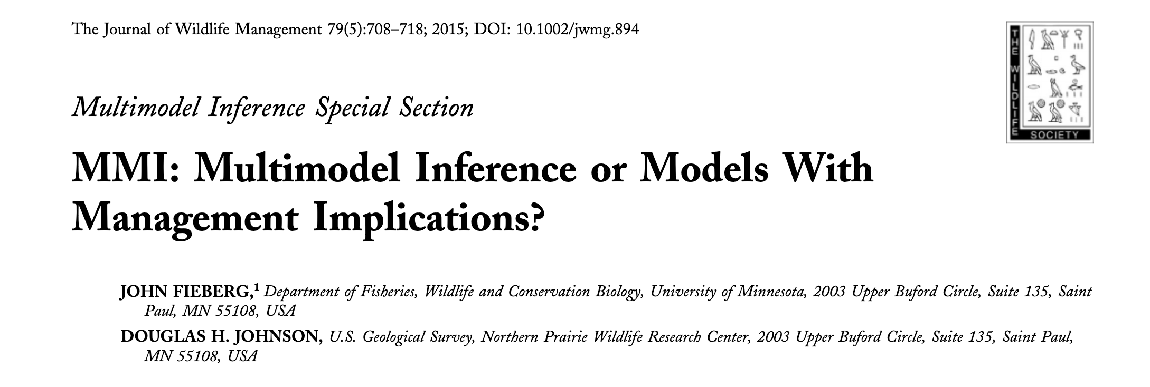
Don’t take my word for it…
One way to avoid some of the problems associated with model selection is to “just say no” to data-driven model selection—in other words, ﬁt a single pre-speciﬁed model, one in which all explanatory variables are chosen prior to looking at their relationship with the response variable, and then use this model for inference (Harrell 2001, Babyak 2004, Whittingham et al. 2006, Guidice et al. 2012).

Slide 47
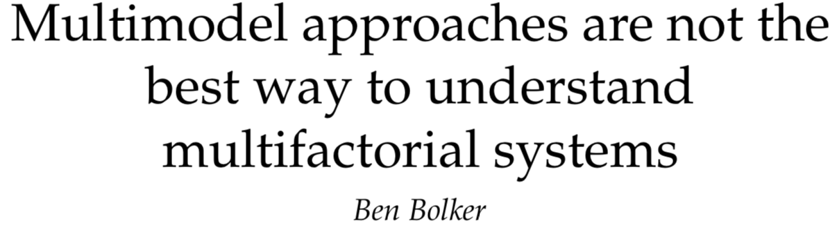
Don’t take my word for it…
“If researchers want to accurately estimate the strength of multiple competing ecological processes along with reliable confidence intervals, their best hope is to use full (maximal) statistical models after making principled, a priori decisions about which predictors to include. “
Bolker 2024 “Multimodel Approaches Are Not the Best Way to Understand Multifactorial Systems”. Entropy

Slide 48
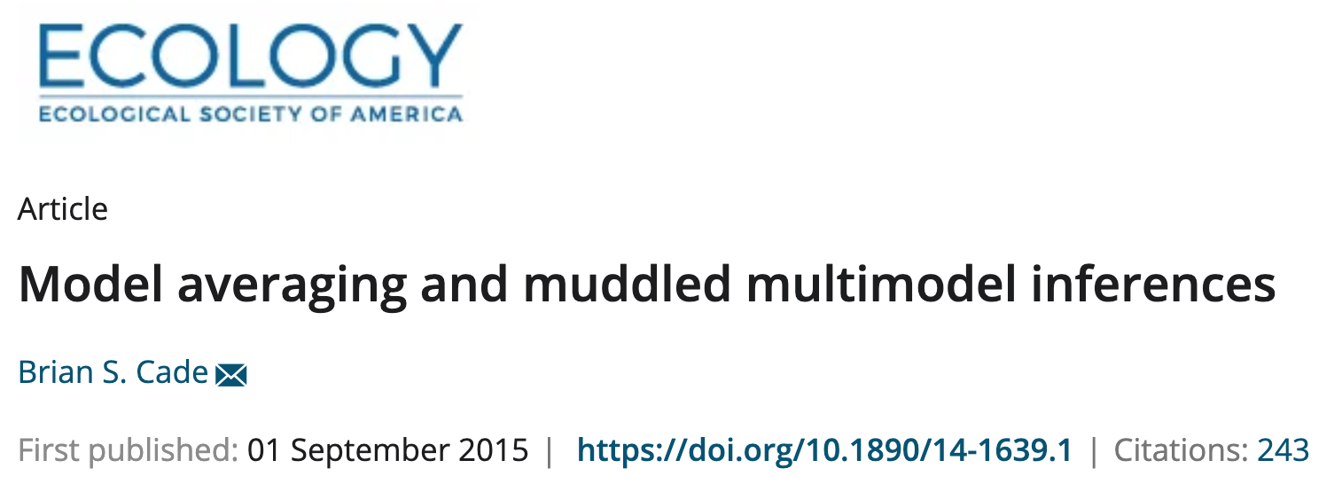
Don’t take my word for it…
The associated sums of AIC model weights recommended to assess relative importance of individual predictors are really a measure of relative importance of models, with little information about contributions by individual predictors compared to other measures of relative importance based on effects size or variance reduction.
The standardized estimates or equivalently the t statistics on unstandardized estimates also can be used to provide more informative measures of relative importance than sums of AIC weights. Finally, I illustrate how seriously compromised statistical interpretations and predictions can be for all three of these flawed practices by critiquing their use in a recent species distribution modeling technique developed for predicting Greater Sage‐Grouse (Centrocercus urophasianus) distribution in Colorado, USA. These model averaging issues are common in other ecological literature and ought to be discontinued if we are to make effective scientific contributions to ecological knowledge and conservation of natural resources.

Slide 49
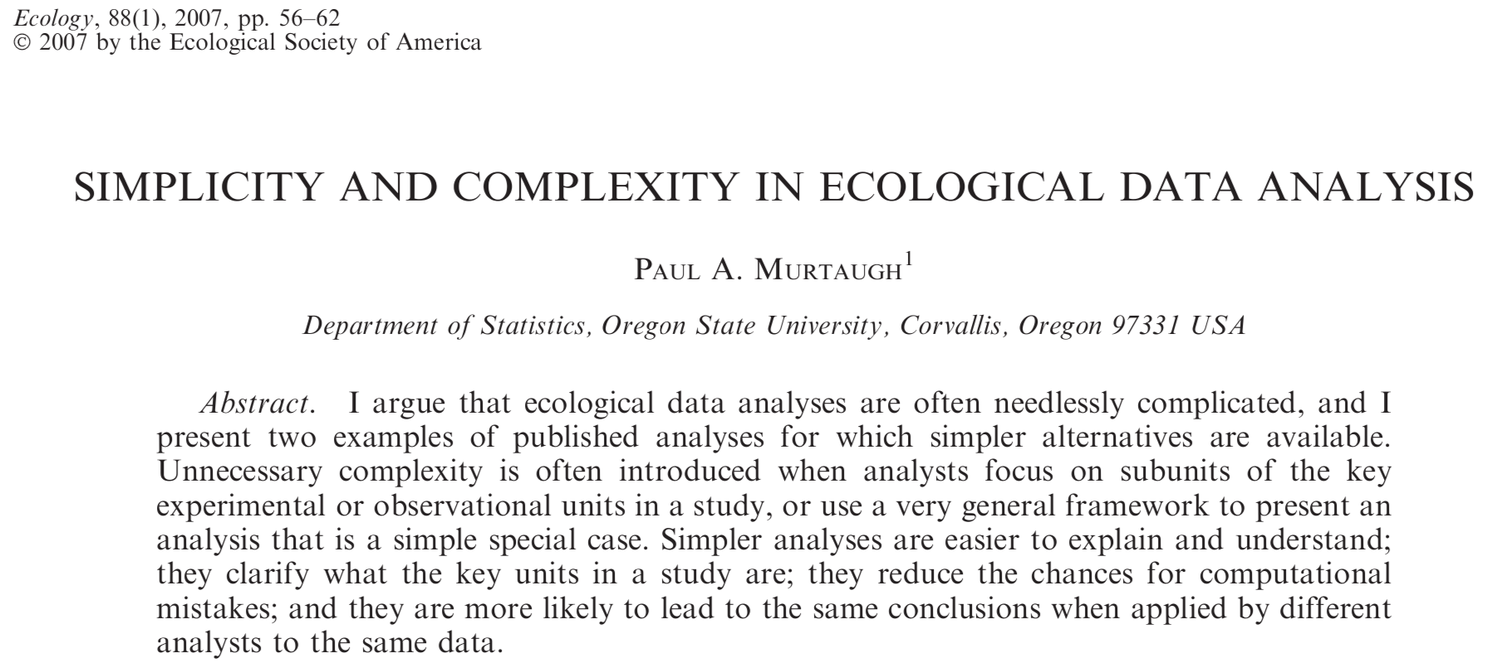
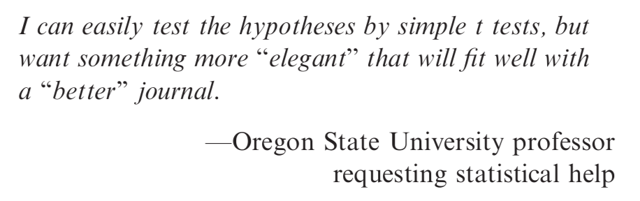

Slide 50
Recommended Readings
Aho et al. 2014 “Model selection for ecologists: The worldviews of AIC and BIC”. Ecology
Shmueli 2010 “To explain or to predict”. Statistical Science
Murtaugh 2007 “Simplicity and complexity in ecological data analysis”. Ecology
Arnold 2010 “Uninformative Parameters and Model Selection Using Akaike's Information Criterion” JWM
”Murtaugh 2014 “In defense of P-values”. Ecology
Fieberg and Johnson 2015 “MMI: Multimodel Inference or Models With Management Implications?”. Journal of Wildlife Management
Sutherland et al. 2023 “Practical advice on variable selection and reporting using Akaike information criterion. Proceedings B
Bolker 2024 “Multimodel Approaches Are Not the Best Way to Understand Multifactorial Systems”. Entropy

