Slide 1
Mixed Effects Modeling
Notes:
a

Slide 2
What are Fixed and Random Effects?
Fixed Effects:
  Parameters associated with the entire population or with certain repeatable levels of experimental units.
    The value for the vessel factor for the SS Titantic.
Random Effects:
  Parameters associated with individual experimental units drawn at random from a population.
    The value of the vessel factor for the 23rd vessel in a database.

Slide 3
Mixed Effects Models
A mixed effects model is a model that has both fixed effects and random effects.
Often a random effect is assigned to observations sharing a common classification factor.
  Goal is to model both variation within GROUPS and variation among GROUPS

Slide 4
A Simple Example
We select six streams at random and determine the density of fish at each stream three times.
The questions:
  What is the density in a typical stream?
  What is the variation in density among streams?
  What is the variation in density estimates within a stream?

Slide 5
Three Options for Structured Data
Your options are:
  1. Complete pooling: Pool density estimates from all streams for analysis
  2. No pooling: Include a factor for each stream. This will estimate a separate parameter for each stock.
  3. Partial pooling: Model the factor as a random effect with some variance around the mean among streams. This separates variation within streams (j = 3 observations) and variation among streams (i = 6 streams)

Slide 6
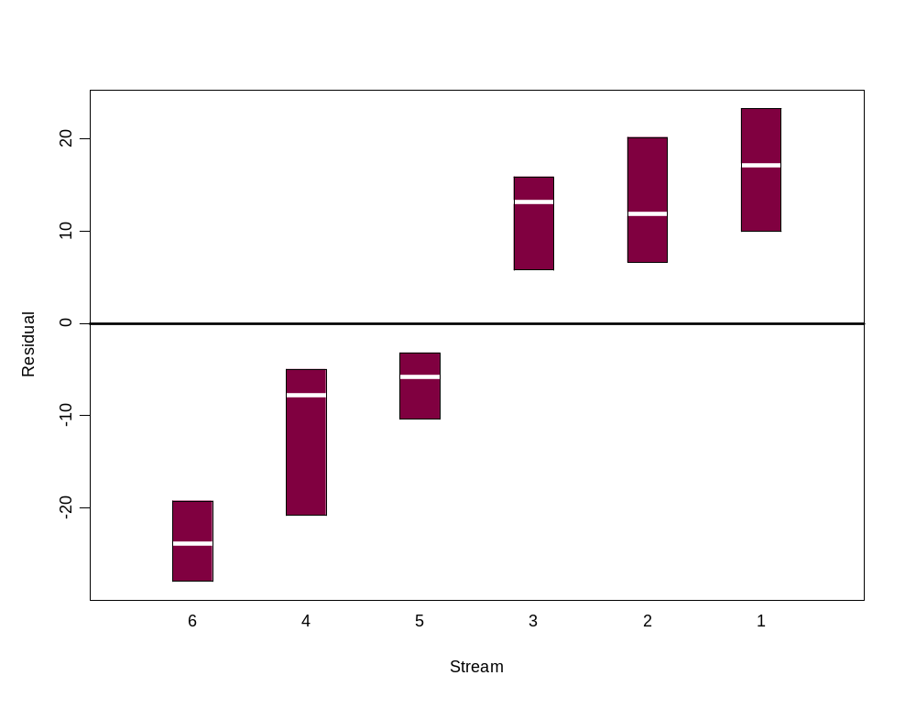
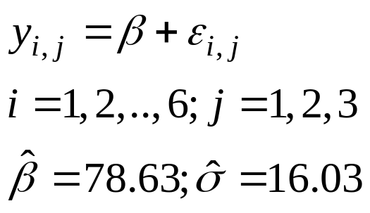
Complete pooling: Fit of the Standard Linear Model
(complete pooling of observations)
This analysis attributed all the error to within-stream variation. However, it is clear that there is between-stream variation in density but we have no way to comment on it.

Slide 7
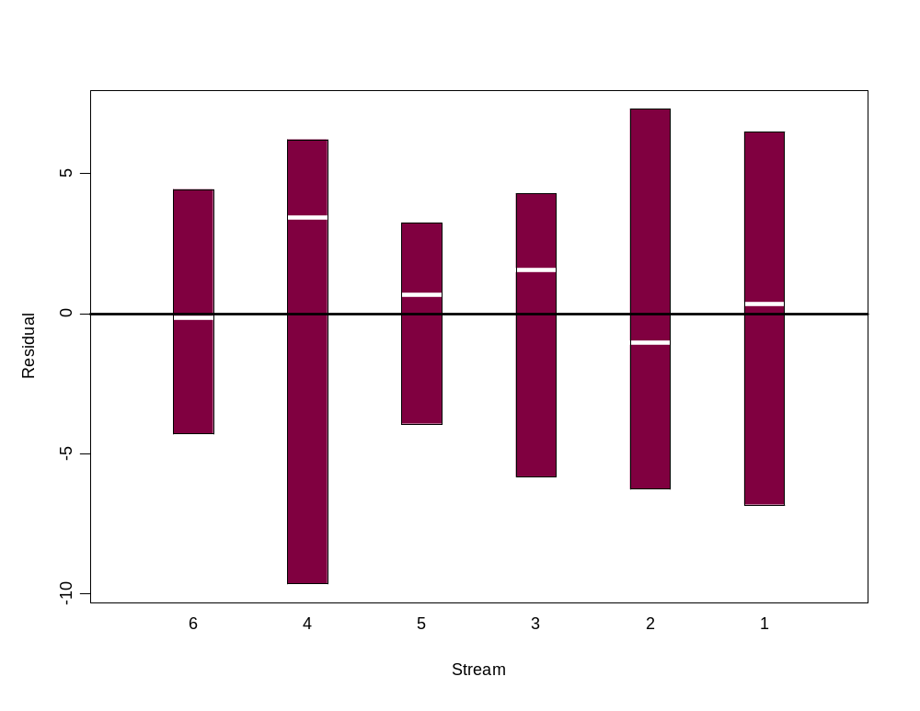
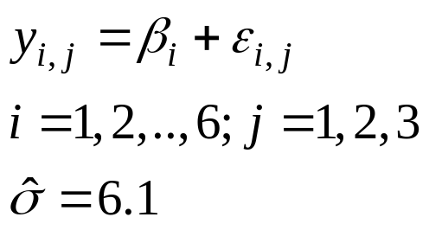
No pooling: Fit a Model with a “Stream-Effect”
The residual pattern has been removed with fixed effects, but we have no overall mean and no way to comment on between-stream variance, i.e. we cannot say anything about the population of streams.

Slide 8
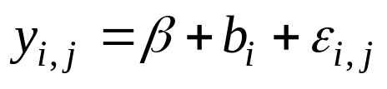
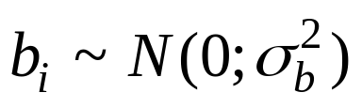
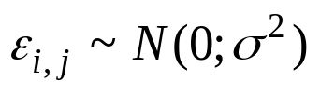
Partial pooling: A Mixed Effects Model
We construct a random effects model as follows:
β is the mean density across the population,
b_{i} is a random variable representing the deviation from the population mean:
ε_{i,j} is a random variable representing the deviation for observation j from mean density for stream i, i.e.
Variation in stream mean
Within stream variation relative to stream mean

Slide 9
Finally: A Mixed Effects Model
(Some notes-I)
The residuals are assumed to be independent, normally distributed random variables with constant variance.
The random effects are assumed to be normally distributed.
The number of parameters in this model is three (β, σ and σ_{b}) because stream is just another level of random variation (with fixed effects model, each stream gets a parameter).

Slide 10

Finally: A Mixed Effects Model
The results from fitting the mixed effects model are:
What can we learn from this?

Slide 11
Time for some R
What varies by group
Fitting the fixed effects models:
  lm1 <- lm(Density~1,data=Streams)
  lm2 <- lm(Density~Stream-1,data=Streams)
Fitting the mixed effects model:
  lm3 <- lme(Density ~ 1,data=Streams, random = ~ 1 | Stream)
  lme() is from the nlme package
The call to LME first gives the fixed effects (the intercept in this case), followed by the data set, and finally the random component of the model.
Group

Slide 12
Packages
The function lmer (in package lme4) also implements linear mixed models (including generalized linear models with glmer).
lmer doesn’t have all the functionality of lme – however, both should be considered in any application.

Slide 13
The LME Function
The full call is:
lme(fixed, data, random, correlation, weights, subset, method, na.action, control)
fixed – formula for the fixed effects;
data – must be a data frame;
random – the random effects (random effects can be nested);
correlation – correlation structure of the residuals (optional);
  For example “correlation=corAR1()” for autoregressive term
weights – variance structure of the residuals (optional);
subset – which rows of the data set to include (vector of boolean)
method – ML or REML
control – optional control specifications (some of these are pretty useful).

Slide 14
Linear Mixed Models (Notes)
The linear mixed model can be fit using Maximum Likelihood (ML) or Restricted Maximum Likelihood (REML). If you have many experimental units, this hardly matters, but if you have few replicates, this can make a major difference (use REML).
REML is default
The distinction is due to the fact that the MLE for the variance is biased (it has 1/n rather than 1/n-1)
REML uses an unbiased estimator for the variance
  This is nitpicky, but can matter with small sample size
Notes:
REML (Restricted Maximum Likelihood): Estimates variance components (random effects + residual variance) after removing the influence of fixed effects. This makes variance component estimates less biased, especially in small samples. However, because the likelihood is computed after conditioning out fixed effects, REML likelihood values are not comparable across models with different fixed effects structures. The “scale” of the REML likelihood changes with the fixed effects design matrix.
ML (Maximum Likelihood): Fits both variance components and fixed effects together. ML likelihoods are comparable across models with different fixed effects, so you can use AIC (or likelihood ratio tests) to decide among competing fixed-effects structures.

Slide 15
Linear Mixed Models
(Understanding the output)
AIC and BIC
for model selection
Linear mixed-effects model fit by REML
Data: Streams
AIC BIC logLik
133.7973 136.2969 -63.89865
Random effects:
Formula: ~ 1 | Stream
(Intercept) Residual
StdDev: 15.78877 6.083881
Fixed effects: Density ~ 1
Value Std.Error DF t-value p-value
(Intercept) 78.62872 6.60332 12 11.90745 0
Standardized Within-Group Residuals:
Min Q1 Med Q3 Max
-1.670431 -0.8239512 0.1256738 0.5295573 1.298799
Number of Observations: 18
Number of Groups: 6
The among-stream SD
The within-stream SD
The fixed effects

Slide 16
Fixed and Random Effects Together
Typically we will have cases in which there are some known sources of variability (the random effects) and some factors that may have different impacts.
These mixed models will have both fixed and random effects.

Slide 17
A guide to model selection with fixed and random effects (Zuur et al)
Set the fixed effects based on “as many explanatory variables as possible”.
Select a random effects structure using AIC (using REML) if variance structure unclear.
Fix the random effects structure and compare fixed effects options (using ML estimation). [Likelihood tests do not work with REML]
Compute the final model using REML because ML has biased variance for small sample sizes.

Slide 18
Rule of thumb
Compare random effects structures with REML.
Compare fixed effects structures with ML.
Report final results with REML.

Slide 19
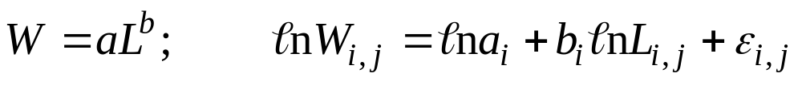
Example:
Fixed and Random Effects Together
(Length-weight regressions)
The Problem:
  We select 10 individual fish and measure the relationships between their lengths and weights as they grow. The relationship between length and weight is:
  We have repeated measurements from the same individual “Subject”.
  Should we use a fixed effect for “Subject” or a random effect?
  Modeling decision – do we care about estimate for each individual fish? Not at all. So let’s let intercept be random
  lme(Weight~Length,data=LenW,random = ~1 |Subject,method="REML")

Slide 20
Where does the variation in weight arise from?

Slide 21
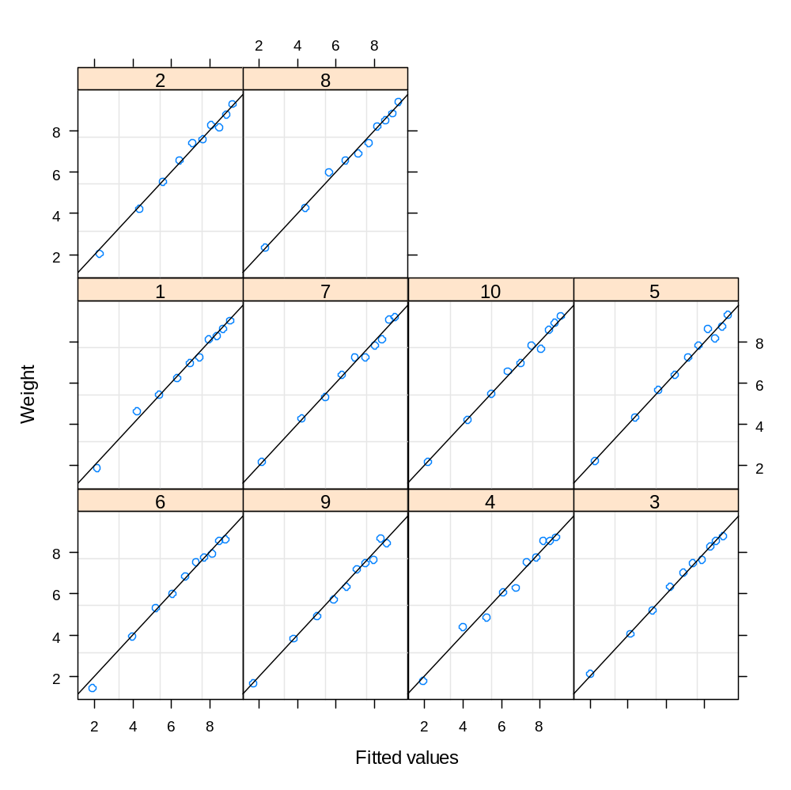
Fixed and Random Effects Together
(Length-weight regressions)

Slide 22
Fixed and Random Effects Together
(Length-weight regressions)
Linear mixed-effects model fit by REML
Data: LenW
AIC BIC logLik
6.72662 17.06649 0.63669
Random effects:
Formula: ~ 1 | Subject
(Intercept) Residual
StdDev: 0.2113517 0.205754
Fixed effects: Weight ~ Length
Value Std.Error DF t-value p-value
(Intercept) -0.026674 0.09560888 89 -0.2790 0.7809
Length 3.017151 0.02958709 89 101.9753 <.0001
Standardized Within-Group Residuals:
Min Q1 Med Q3 Max
-2.419116 -0.5799786 -0.05204277 0.5719096 2.320844
Number of Observations: 100
Number of Groups: 10

Slide 23
Tricks and Traps
If you use REML estimation, you can only compare models with the same fixed-effects structure.
The standard output does not provide:
  the “best estimates” of the group-level random effects - use coef(lmout) to find them.
  the confidence intervals for the variance parameters – use intervals(lmout, 0.95)

Slide 24
Mixed Effects Models
LOTS OF UNANSWERED QUESTIONS! ESPECIALLY FOR NON-NORMAL RESIDUALS, NONLINEAR MODELS, AND MODEL SELECTION!
Let’s let Ben Bolker help us:
https://bbolker.github.io/mixedmodels-misc/glmmFAQ.html

Slide 25
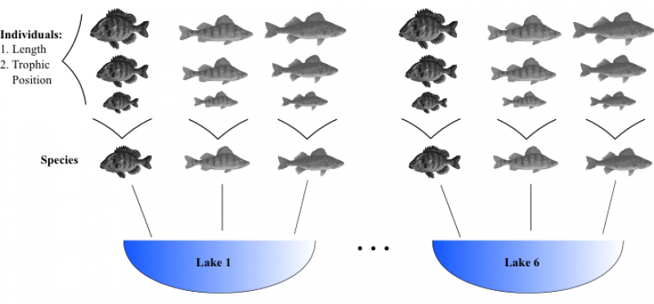
Another Mixed Model Example
Dataset: Measure fish trophic position = Dependent variable.
Individuals from 3 fish species in 6 lakes sampled over a range of body lengths.
10 individuals per species.
Question: Does trophic position increase with length?

Slide 26
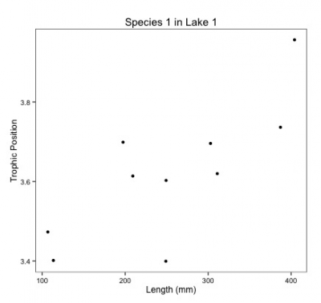
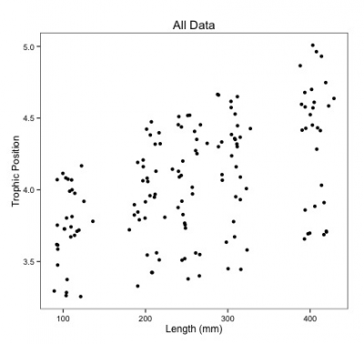
How we should not analyze this dataset
1. No pooling. Separate regressions for every species in every lake
  estimate a slope and intercept parameter for each regression (2 parameters x 3 species X 6 lakes = 36 parameter estimates) and the sample size for each analysis would be 10.
  We’re also not scientifically interested in variation among lakes.
2. Complete pooling
  Only need to estimate 2 parameters.
  Pseudoreplication? Measurements within same lake or species correlated.
  Noise – Surely some is due to interlake or species variation

Slide 27
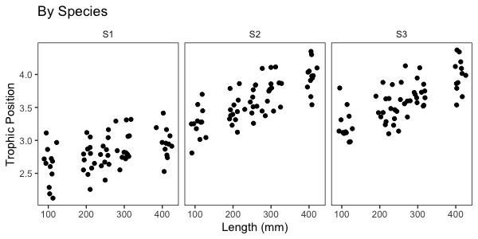
Data exploration

Slide 28
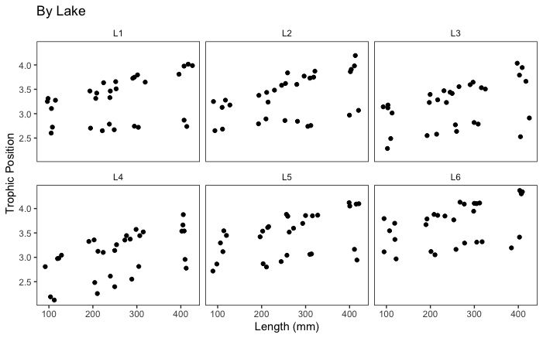
Data exploration

Slide 29
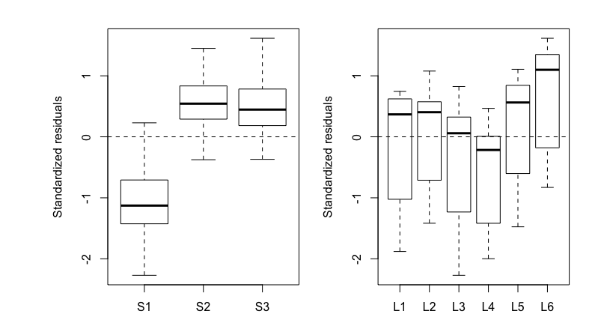
Let’s look for structure in residuals
Complete pooling
Trophic_Position ~ Length
Lots of structure in residuals grouped by species, but not as bad for lake
Notes:
Consequences if you ignore it
Biased standard errors and confidence intervals (typically underestimated).
Inflated type I error for tests of significance.
Wrong effect estimates if slope varies strongly between groups and you force a single slope.
Poor predictive performance.

Slide 30
Ignore structure in residuals?
Biased standard errors and confidence intervals (typically underestimated).
Inflated type I error for tests of significance.
Wrong effect estimates if slope varies strongly between groups and you force a single slope.
Poor predictive performance.
An lm() assumes independent, identically distributed residuals. If fish from the same species or lake are more similar, residuals will be correlated and lm() SEs and p-values will be wrong

Slide 31
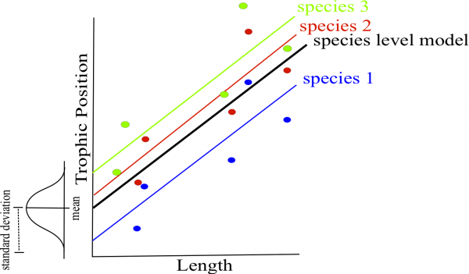
Allow intercept to vary by species
lmer(Z_TP~Z_Length + (1|Fish_Species))

Slide 32
Allow intercept to vary by species
lmer(Z_TP~Z_Length + (1|Fish_Species))
You might also use
  lm(Z_TP~Z_Length + Fish_Species)
  What’s the difference?

Slide 33
Should we use fixed or random effects for groups?
Ask yourself what you want to infer:
Do you want estimates/contrasts for the specific species or lakes in your dataset → Fixed effects.
Do you want to generalize to a larger population of species/lakes (i.e., treat species/lake as a random sample from a population and estimate between-group variance)? → Random effects, if you can estimate them reliably.

Slide 34
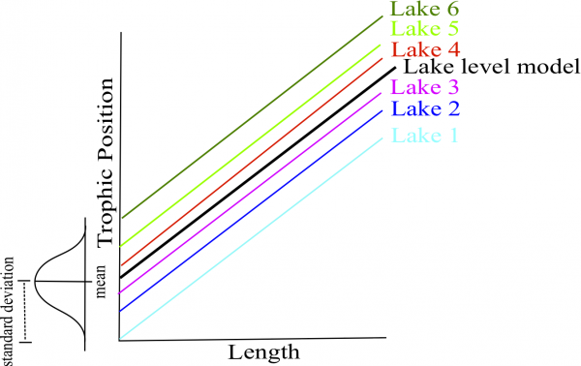
Allow intercept to vary by lake
lmer(Z_TP~Z_Length + (1|Lake))
  Can also do both species and length
  lmer(Z_TP~Z_Length + (1|Fish_Species)+(1|Lake))

Slide 35
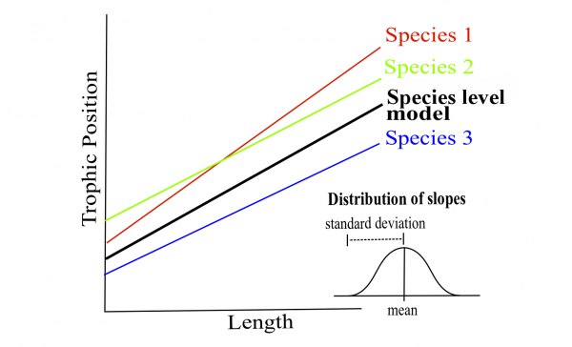
But what if the effect of length on TP varies by species or lake?
All our prior models were “random intercept” models. Now also “random slope”
lmer(Z_TP~Z_Length + (1+Z_Length|Fish_Species)+(1+Z_Length|Lake))

Slide 36
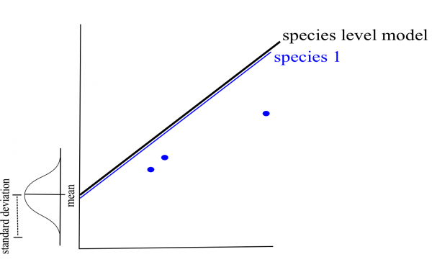
Borrowing strength
“Shrinkage” toward the mean
Species with few data rely more on average parameter values
Here we have balanced design, so not issue
Inappropriate use of random effects with unbalanced designs + shrinkage can lead to incorrect conclusions.

Slide 37
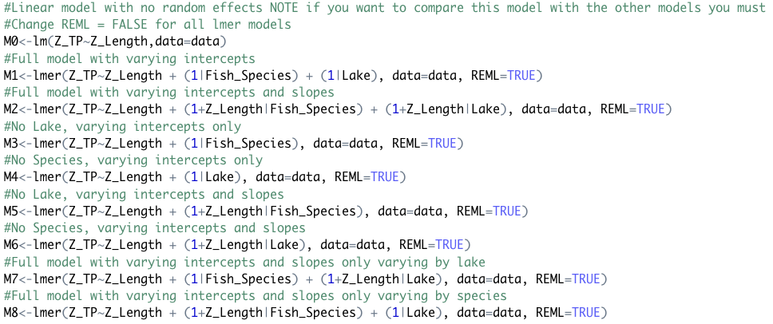
Which model to use for prediction?
REML to compare random effects
Model 8 (AICc=36.3) and Model 2 (AICc=39.6) much lower than others

Slide 38
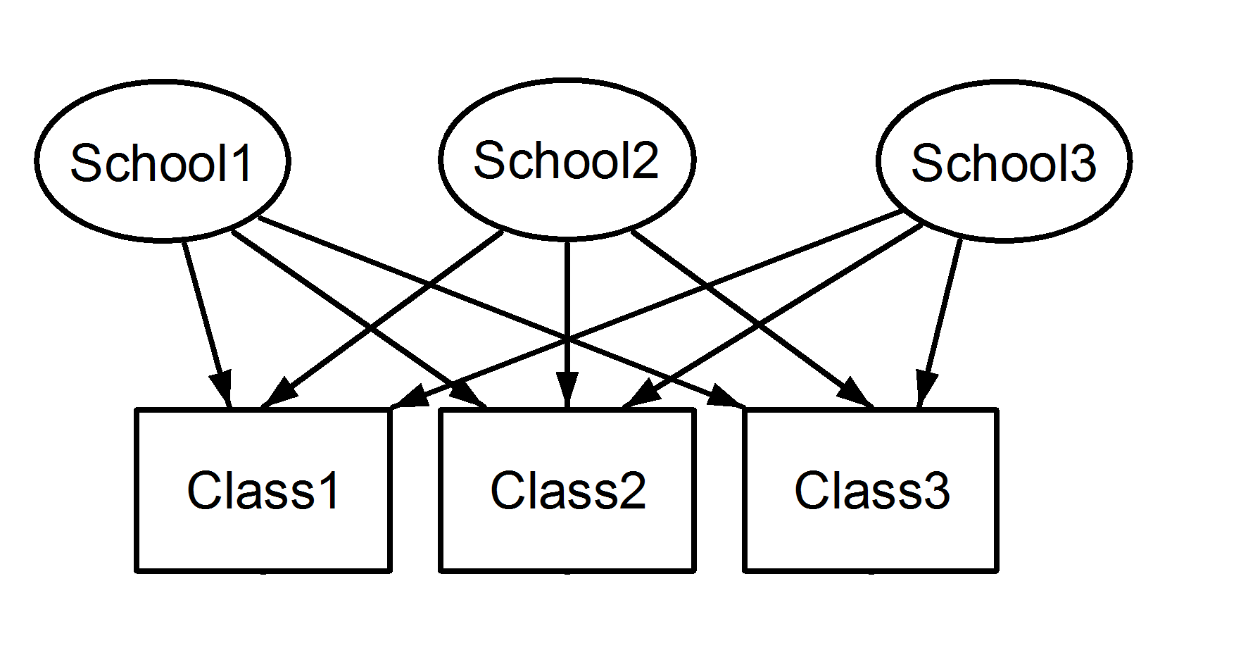
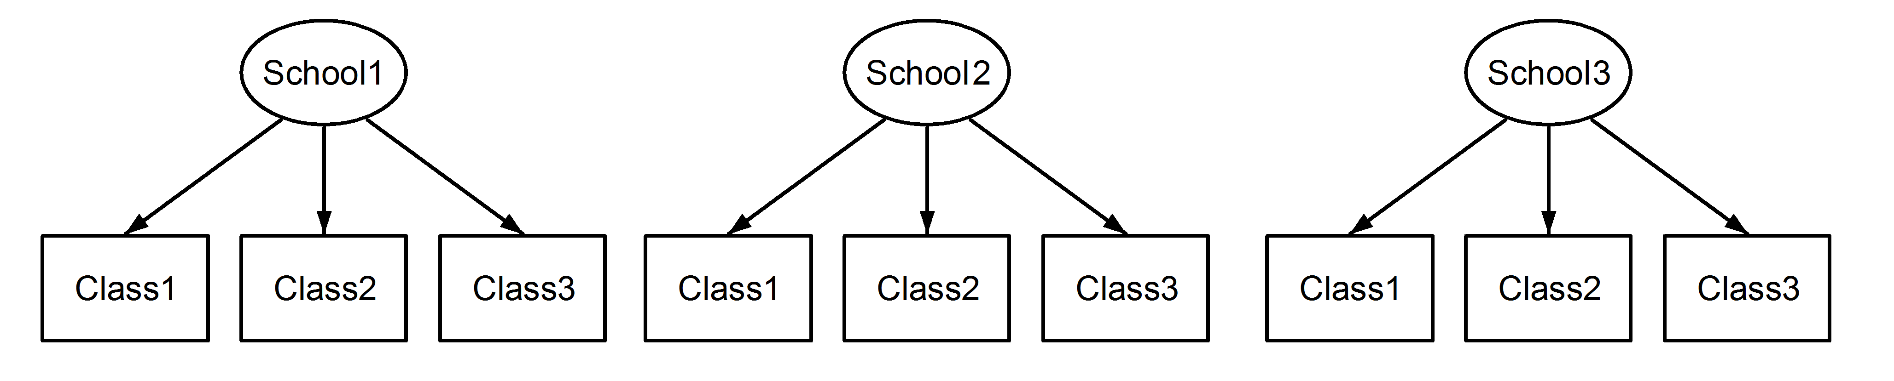
Crossed vs Nested random effects
Note that fish species appear in multiple lakes. This is a crossed random effect, but effects can also be nested
Consider measurements on student within classes within schools
  If the classes are “remedial”, “average”, and “gifted”, then they could be crossed among schools.
  But if they are just different teachers, then this would be a nested design, R uses different syntax for each.
Crossed
(1|School) + (1|Class)
Nested
Use (1|School/Class)

Slide 39
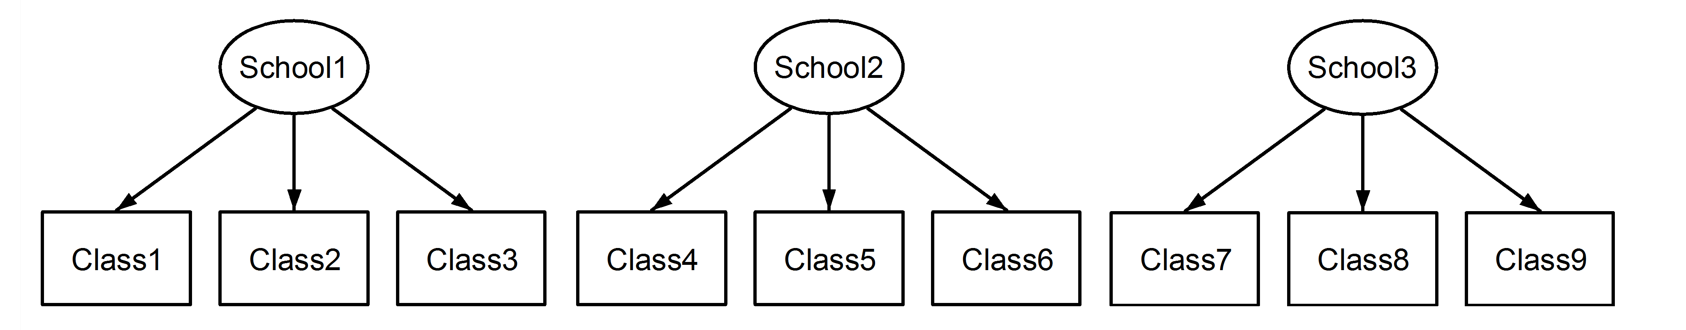
Labeling matters!
Remove ambiguity with distinct labelling
Crossed Specification
(1|School) + (1|Class)
Nested Specification
Use (1|School/Class)
SAME RESULTS
Both nested due to labelling

Slide 40

Glmer Example
Proportions are Rarely Proportions
Imagine 4 out of 10 observed animals survive, or contract disease, or give birth
Does this have the same information content as 40 of 100 animals?
Now imagine 4 of 10 in one study area, 60 of 100 in another, 2 of 9 in another, and so so. Within study area is a binomial process with probability partially determined by covariates.
Additional variation not explained by covariates can be modeled with random intercepts

Slide 41
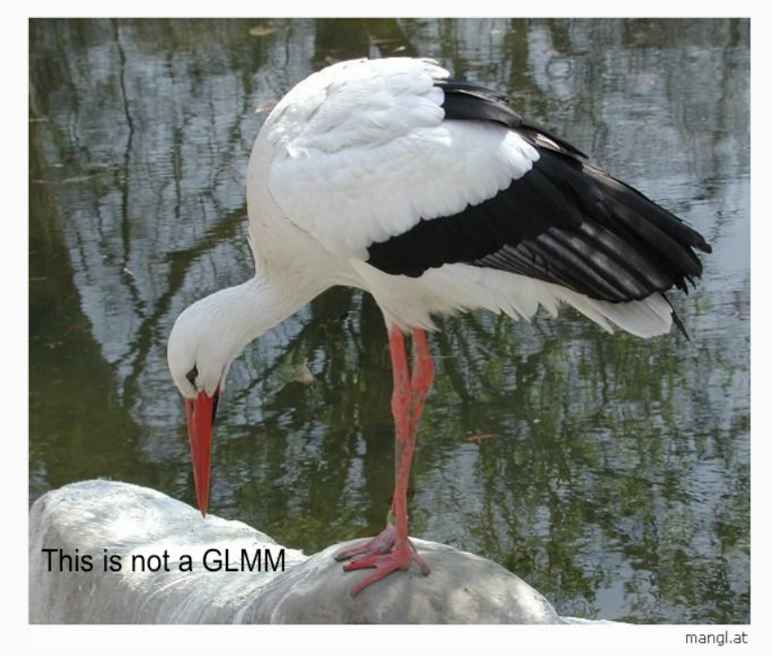
White Stork Example
Oliver Gimenez’s Example

Slide 42
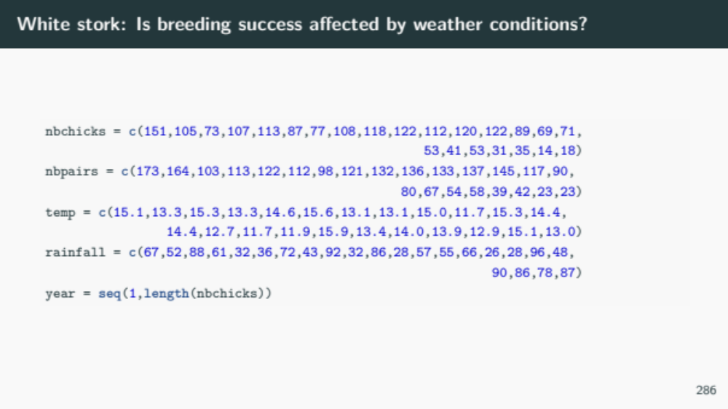

Slide 43
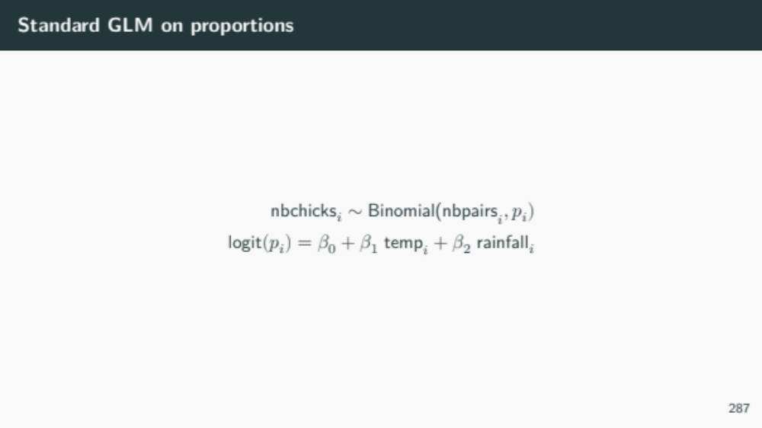

Slide 44
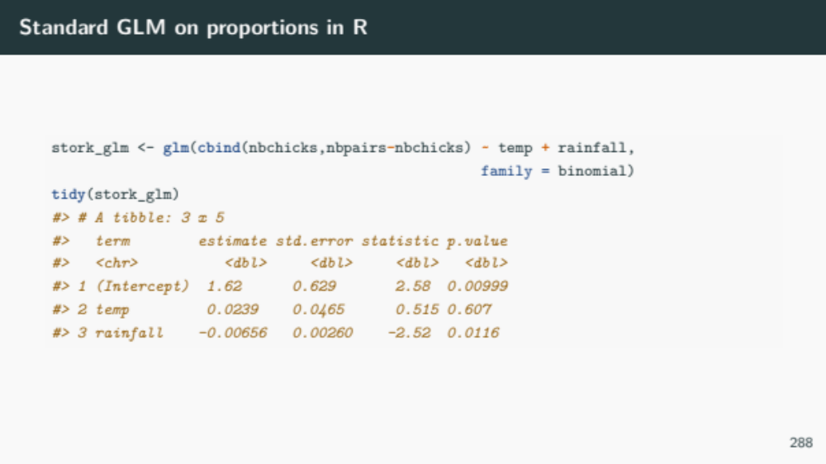
What if we have substantial additional interannual variation not explained by weather?

Slide 45
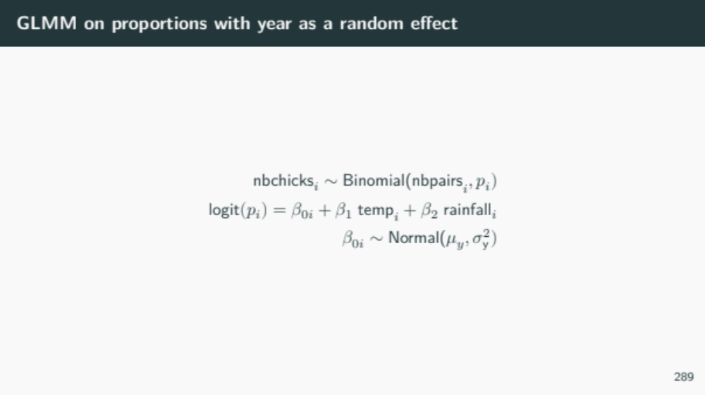

Slide 46
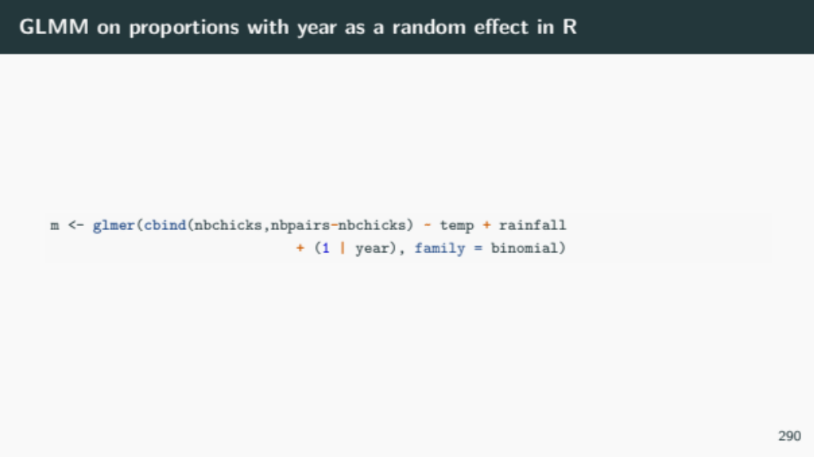

Slide 47
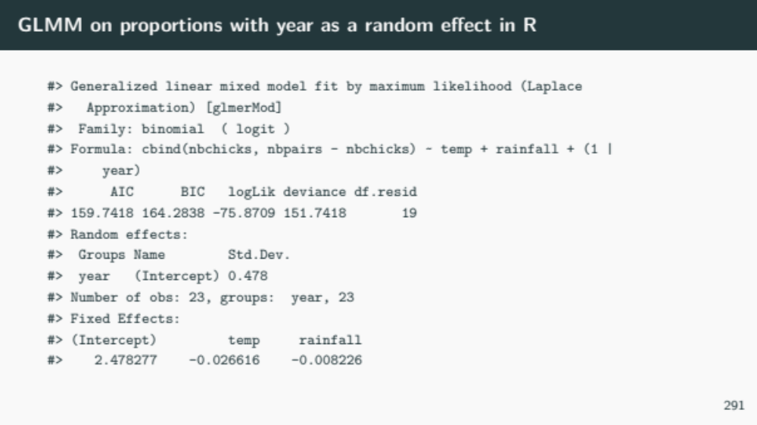

Slide 48
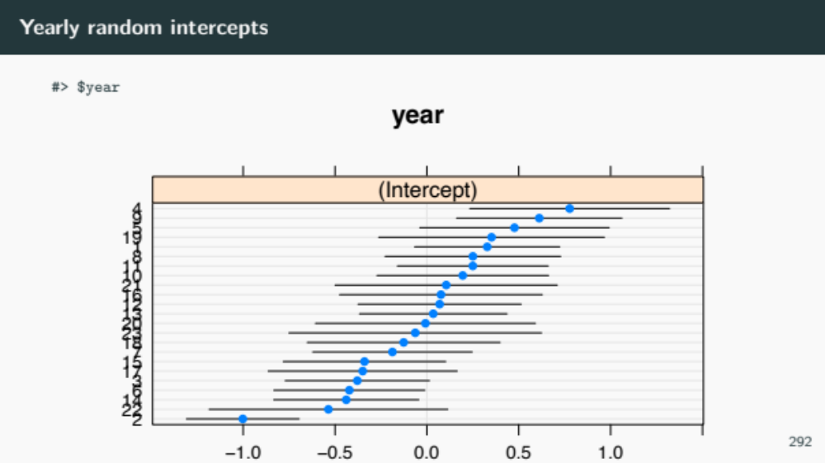

Slide 49
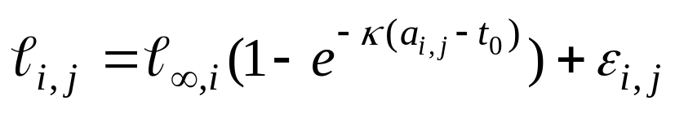
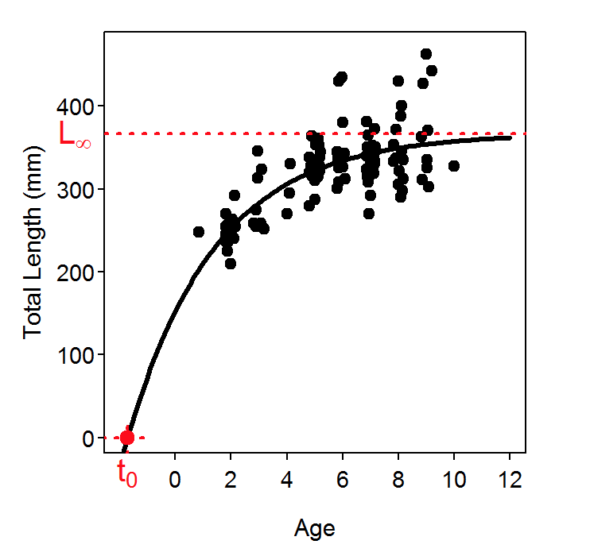
Example 2 – Nonlinear mixed model for length and age
We shall assume that:
  Growth follows a von Bertalanffy growth equation

Slide 50
Example – length and age
We shall assume that:
  Growth follows a von Bertalanffy growth equation
  t₀ and κ are the same for all animals in the population while the asymptotic size differs among individuals.
  There is normally distributed measurement error.
  R can be used to fit non-linear mixed effects models (function nlme).

Slide 51
Example – length and age
The response variable
The fixed effects
The random effect
The covariate

Slide 52
Fitting Length and Age Data
(Background)
We have 10 subjects (animals).
Each animal is measured 10 times between age 1 and age 10.
Growth follows a von Bertalanffy growth equation where the asymptotic size is subject-specific and the growth rate and age at zero size are the same across subjects.

Slide 53
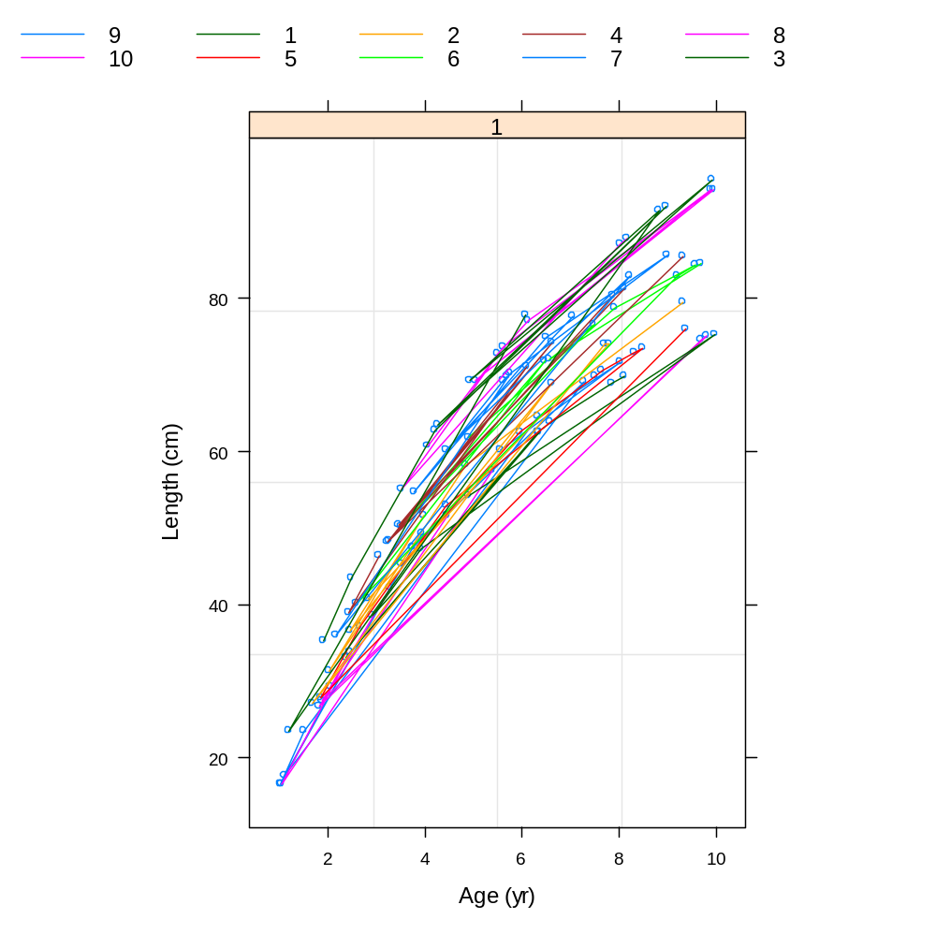
Fitting Length and Age Data
(The basic data)
Let L-inf (saturation) vary by individual

Slide 54
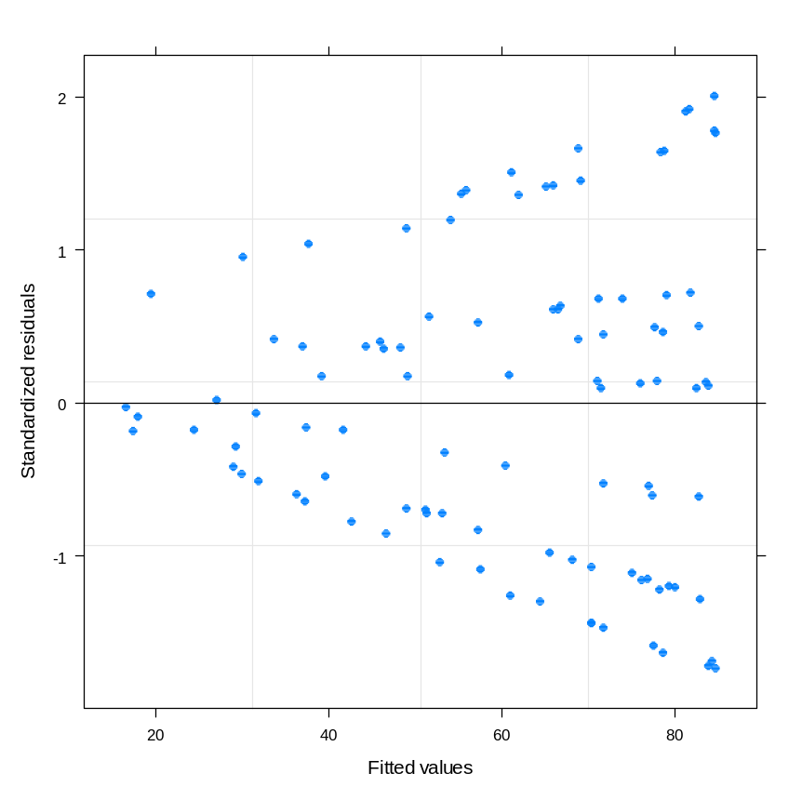
Fitting Length and Age Data
(Standard non-linear model-I)
lm1 <- nls(formula=Length~Linf*(1-exp(-1*Kappa*(Age-Tzero))),
data=AgeLen, start=c(Linf=100,Kappa=0.2,Tzero=0))
There is evidence in the
residuals for model-
mispecification. This is
not heteroscedastic errors
rather it is correlation
among observations for the
same animal.

Slide 55
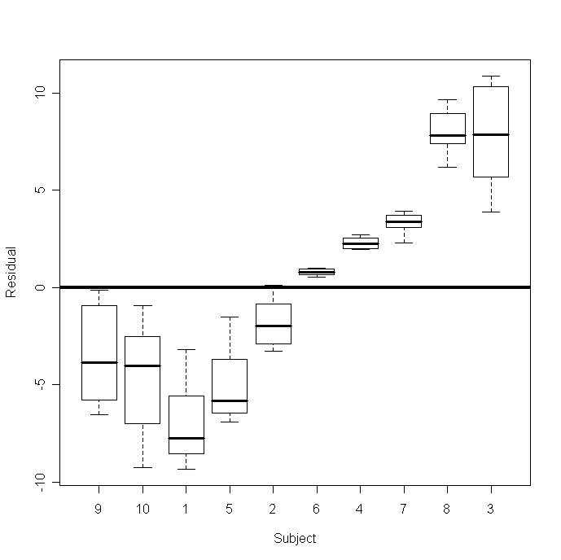
Fitting Length and Age Data
(Standard non-linear model-II)
boxplot(split(residuals(lm1),AgeLen$Subject),ylab="Residual",
xlab="Subject",csi=0.2)

Slide 56
The NLME Function-I
The NLME function has several options:
nlme(model, data, fixed, random, groups, start, correlation, weights, subset, method,na.action,naPattern, control,verbose)
model: “response ~ fn(fixed effects)”
fixed: “fixed = c(fix1~var1,fix2~var2)”.
  There are several ways to specify the fixed effects structure.

Slide 57
The NLME Function-II
random: “random=c(rnd1 ~ var1, rnd1 ~ 1)”. Leaving out a “random” specification implies all fixed effects have an associated random effect.
start: “start = c(fix1=x1,fix2=x2,..)” – the initial values for the fixed parameters of the model.
nlme(model, data, fixed, random, groups,
start, correlation, weights, subset, method, control)

Slide 58
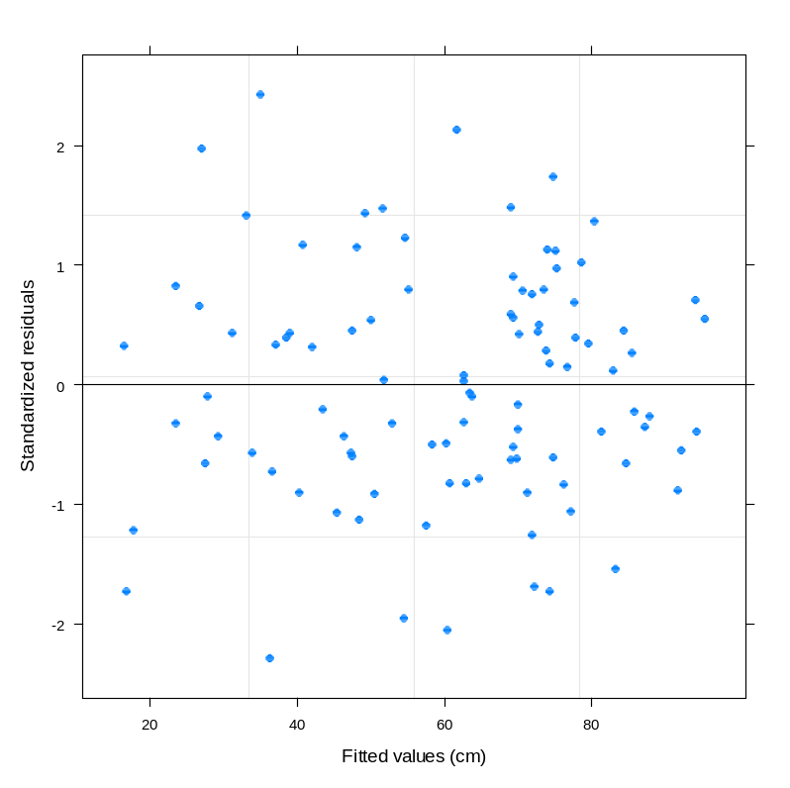
Fitting Length and Age Data
(Non-linear mixed model-I)
lm2 <- nlme(model=Length~Linf*(1-exp(-1*Kappa*(Age-Tzero))), data=AgeLen,
random=Linf~1, fixed=Linf+Kappa+Tzero~1,start=c(Linf=100,Kappa=0.2,Tzero=0))
Random effect:
Linf by subject
Fixed effects:
Linf population mean
Kappa
t₀

Slide 59
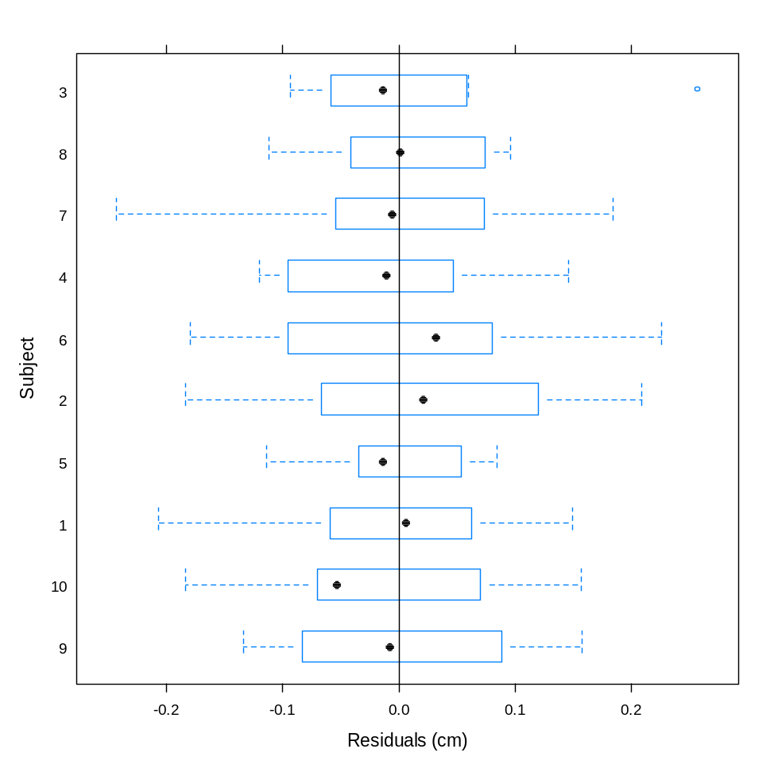
Fitting Length and Age Data
(Non-linear mixed model-II)
plot(lm2,Subject ~ resid(.),abline=0)
Try “intervals (lm2)” to see
the confidence intervals

Slide 60
Fitting Length and Age Data
(Non-linear mixed model-III)
Nonlinear mixed-effects model fit by maximum likelihood
Model: Length ~ Linf * (1 - exp(-1 * Kappa * (Age - Tzero)))
Data: AgeLen
AIC BIC logLik
-53.64647 -40.62062 31.82323
Random effects:
Formula: Linf ~ 1 | Subject
Linf Residual
StdDev: 8.28837 0.1060163
Fixed effects: Linf + Kappa + Tzero ~ 1
Value Std.Error DF t-value p-value
Linf 97.02240 2.6629267 88 36.4345 0.0000
Kappa 0.19960 0.0005324 88 374.8752 0.0000
Tzero -0.00453 0.0040570 88 -1.1176 0.2668
Correlation:
Linf Kappa
Kappa -0.034
Tzero -0.027 0.876

Slide 61
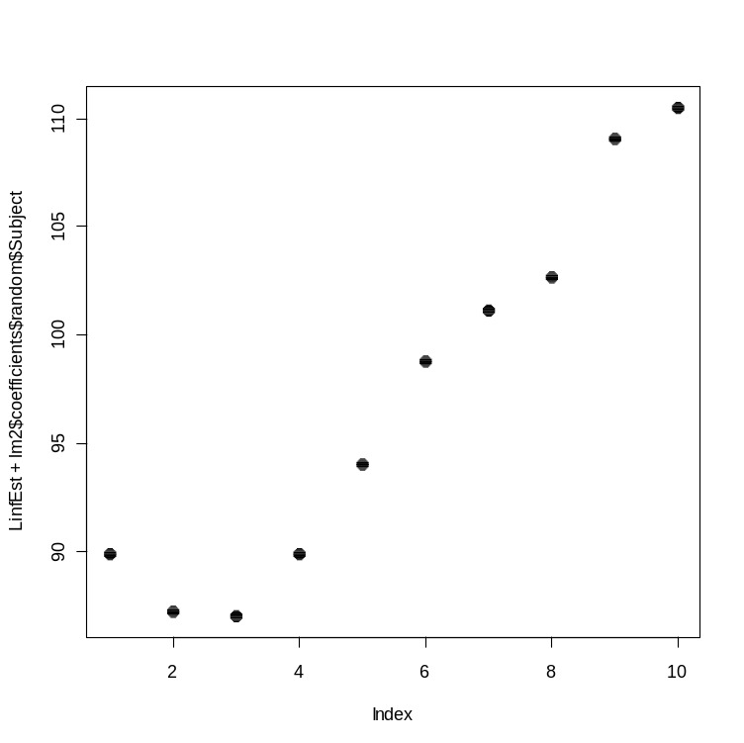
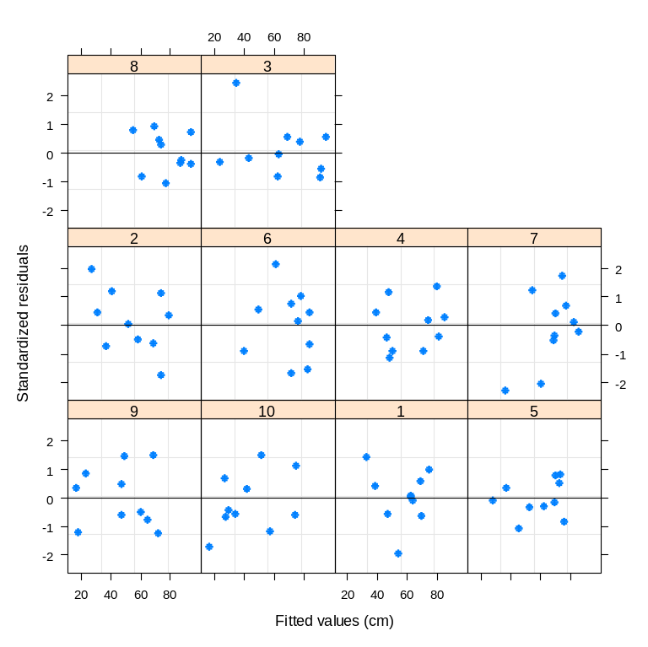
Fitting Length and Age Data
(Non-linear mixed model-IV)
plot(lm2, form = resid(., type = "p")
~ fitted(.) | Subject,
abline = 0,pch=16)
plot(LinfEst+lm2$coefficients$random$Subject,
pch=16,csi=0.3)

Slide 62
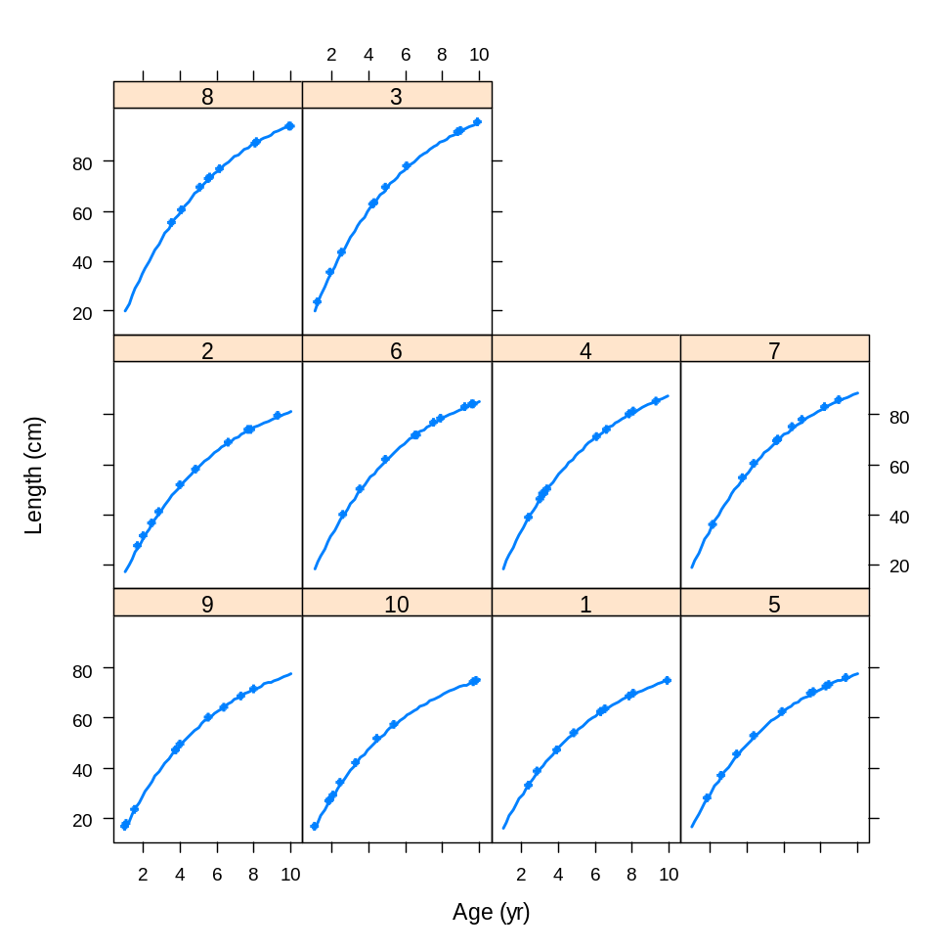
Fitting Length and Age Data
(Non-linear mixed model-V)
plot(augPred(lm2),csi=0.3,pch=16,lwd=2)
Plots the data and
the model
predictions

