Slide 1
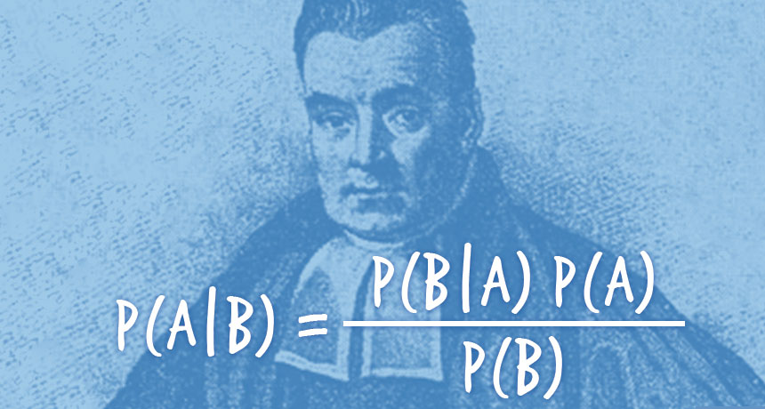
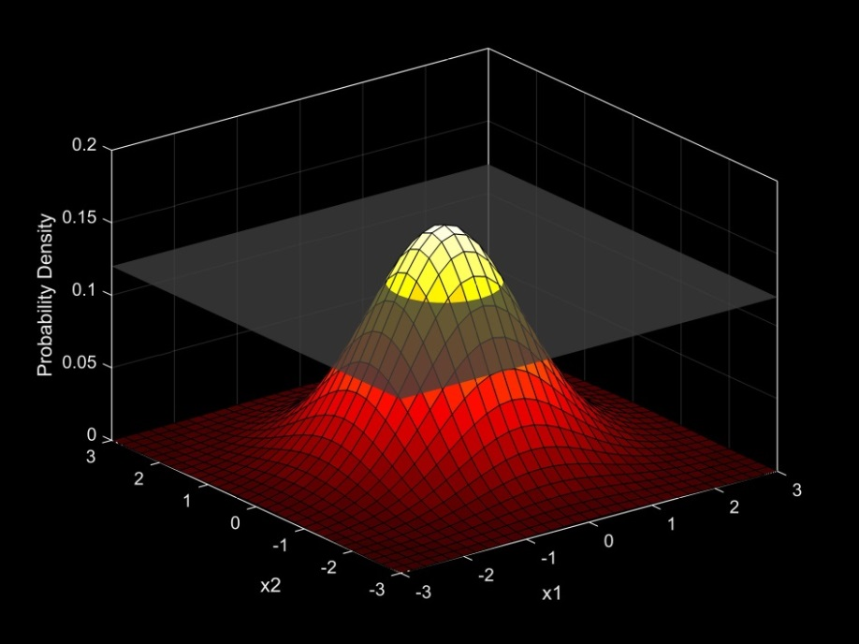
Introduction to Bayesian Analysis
Many slides adapted from Matt Falcy ODFW, and SESYNC course by Chris Che-Castaldo, Mary B. Collins, N. Thompson Hobbs (with permission)

Slide 2
Frequentist and Bayesian inference
“Frequentist” or classical inference
Probability is a long-run relative frequency.
Parameters are fixed and unknown constants.
Statistical procedures are judged by how they perform over hypothetical replications of data that are never actually observed.
Bayesian inference
Probability is a degree of belief.
Once data are observed, they are treated as fixed (not random) values.
Parameters are unknown, therefore treated as random variables
Rules of probability used to revise “prior” beliefs in light of data.

Slide 3
Remember Bayes Rule?
We derived this from simple rules of conditional probability
P(A,B) = P(A|B)P(B)

Slide 4
1% of women at age forty who participate in routine screening have breast cancer. 80% of women with breast cancer will get positive mammographies. 9.6% of women without breast cancer will also get positive mammographies. A woman in this age group had a positive mammography in a routine screening. What is the probability that she actually has breast cancer?
[ +|c ] * [c]
[+ |c ] * [c]
[c | + ] =
=
[ +| c]*[c] + [+ | not c]*[not c]
[ + ]
0.8 * 0.01
0.8*0.01 + 0.096*0.99
= 0.0776
95 out of 100 doctors put it at 0.70 to 0.80 (Eddy 1982, with replicated results)!!

Slide 5
We had complete information about medical testing probabilities
In almost all practical scenarios, we will just have data, y, and then want to make inference about parameters, θ.

Slide 6
Bayes Rule
L(θ|y) = [y| θ] ≠ [θ | y]
Posterior
[y | θ] [θ]
Prior
[θ | y] =
[y]
What is the marginal probability of the data?

Slide 7
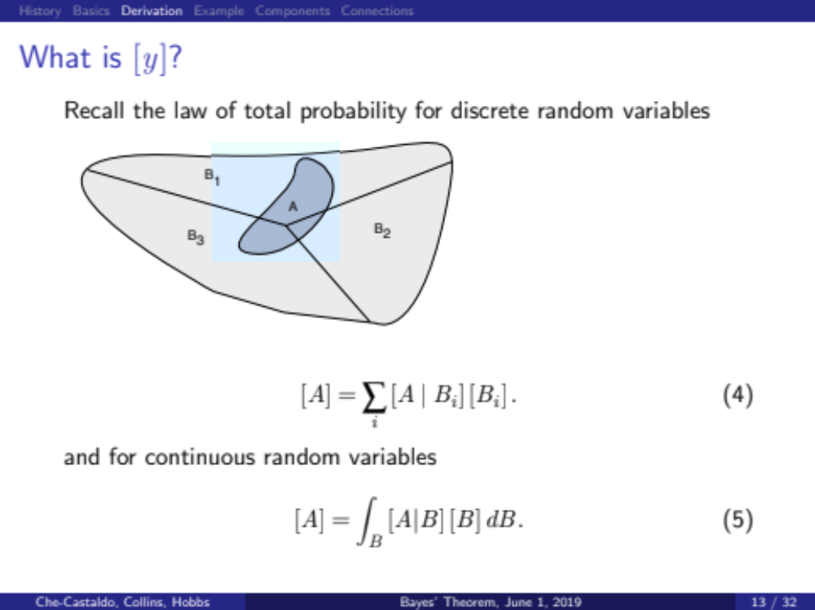
Integrating B out of the joint distribution

Slide 8
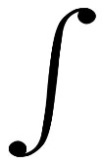

L(θ|y) = [y| θ] ≠ [θ | y]
[y | θ] [θ]
[θ | y] =
[y]
What is the marginal probability of the data?
We call this a normalizing constant
[y] = [y| θ] [θ] dθ
It’s the integral (or sum) of the numerator!
This “scales” the numerator so that it integrates to 1.

Slide 9
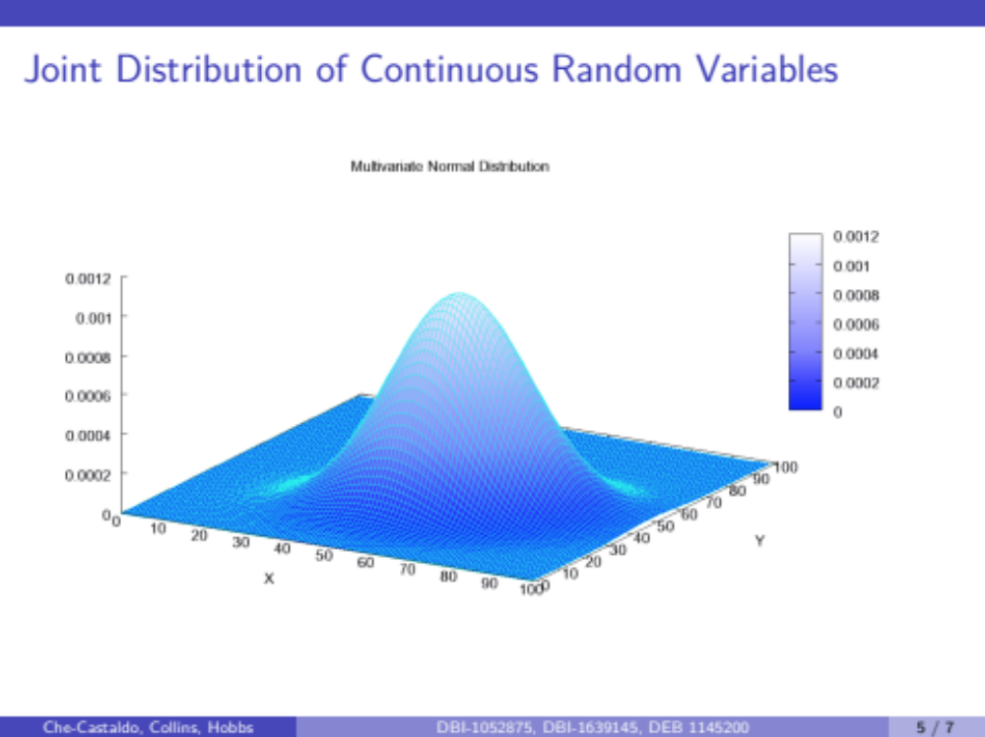
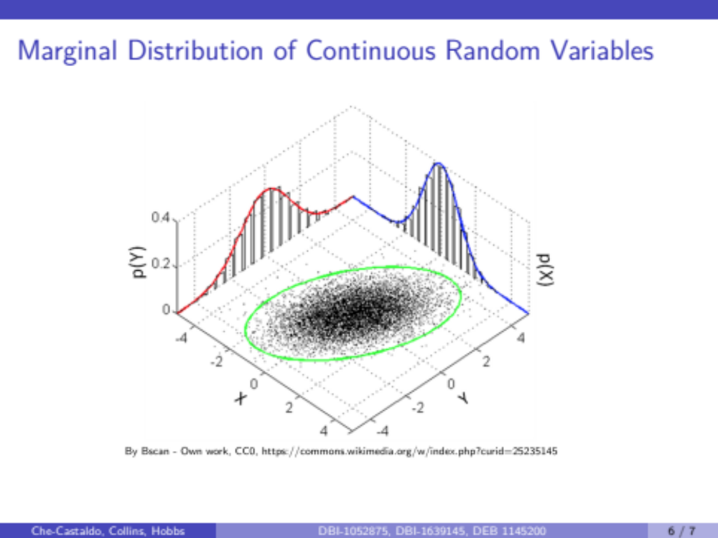
P(X) or [X], and P(Y) or [Y]
P(X, Y) or [X,Y]
Sum or integrate over all values of the random variable you DON’T care about
Or if you’ve sampled from the joint distribution, just take the values of the variable of interest

Slide 10
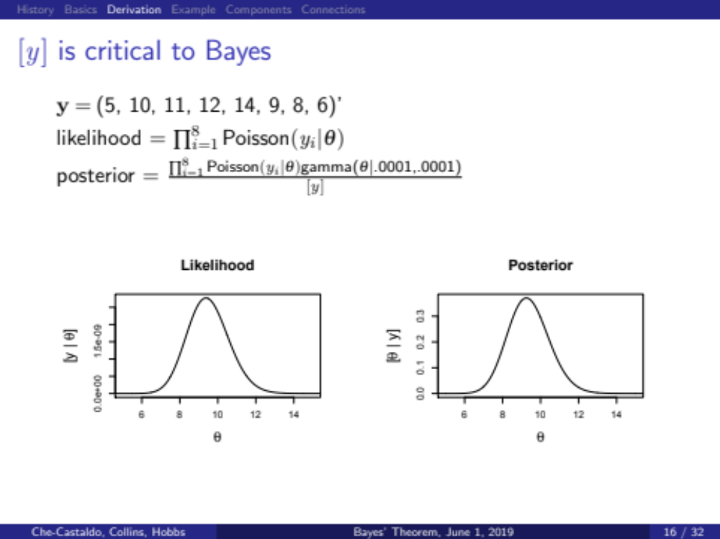
E.g. Number of chocolate chips observed in cookies
For simple problem, can use numerical integration (what would we integrate)

Slide 11
E.g. Number of chocolate chips observed in cookies
For simple problem, can use numerical integration (what would we integrate)
fun = function(x){
dpois(5,x)*dpois(10,x)*dpois(11,x)*dpois(12,x)*dpois(14,x)*dpois(9,x)*dpois(8,x)*dpois(6,x) #The likelihood
*dgamma(x,0.0001,0.0001)} #The prior
integrate(fun,0,20) #[y]; Integral of the numerator = 8.010413e-14
integrate(fun,0,20)$value/8.010413e-14
x=seq(0,20,0.1)
plot(x,fun(x),type="l")
plot(x,fun(x)/8.010413e-14,type="l")

Slide 12
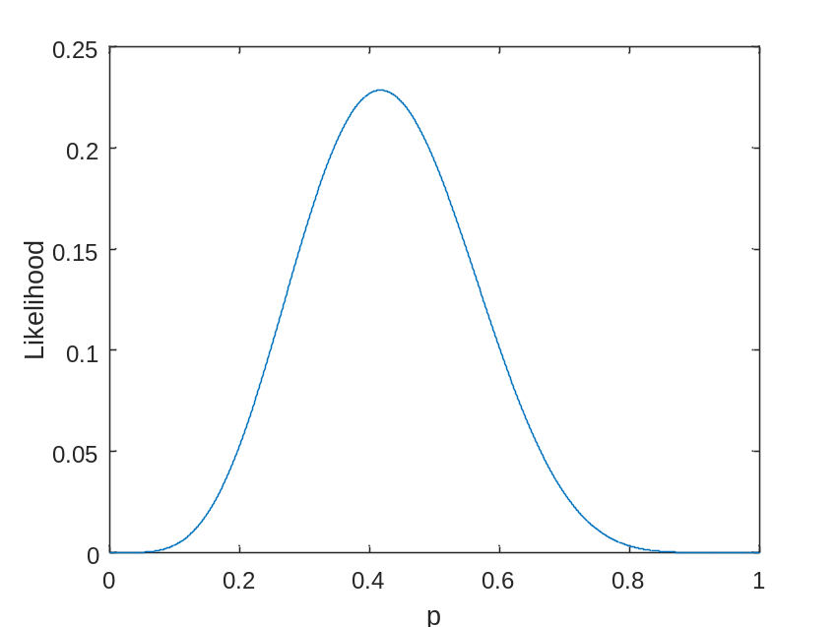
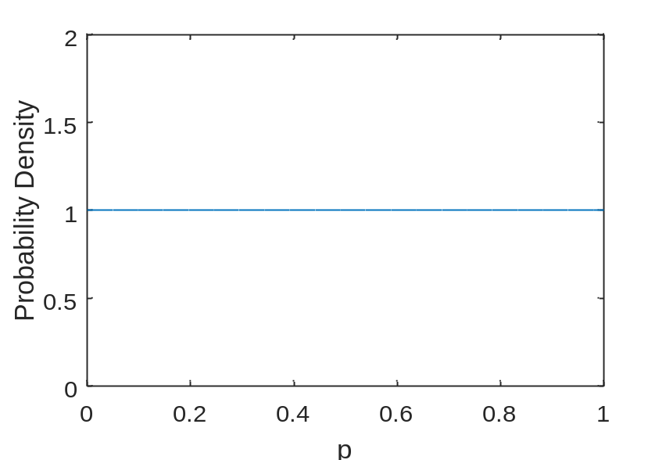
Binomial Example
Data: We get 5 heads out of 12 flips. Binomial process. Make inference on p.
How would we have done this with maximum likelihood?
[y| θ] “likelihood”
[θ]
“vague prior”
Beta_pdf(1,1)

Slide 13
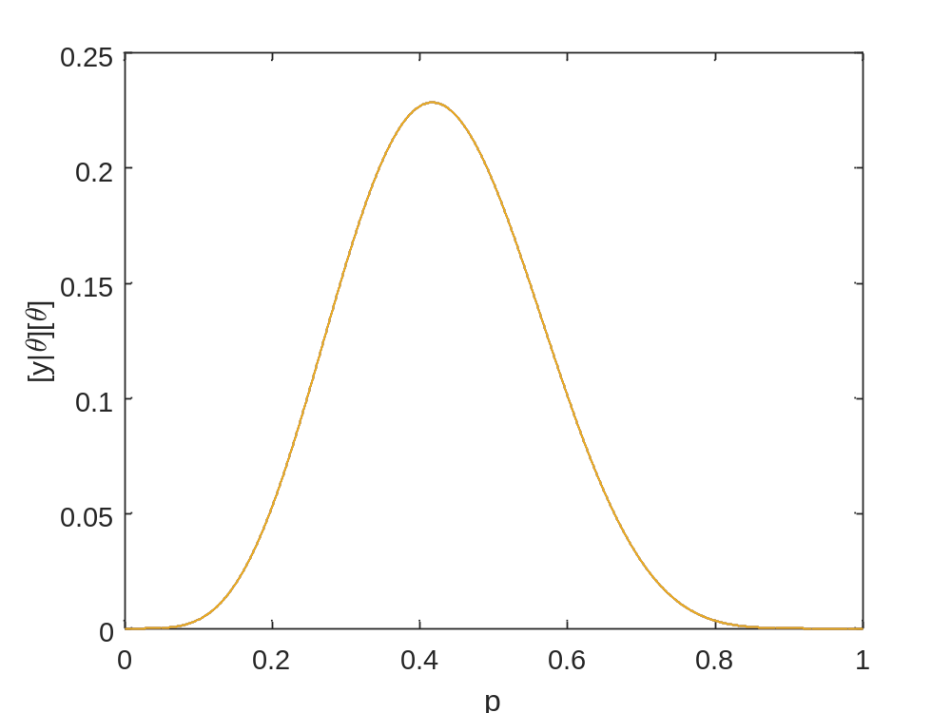
[y|θ][θ] Still doesn’t integrate to 1
How would we scale this so that it integrates to 1 and becomes a “real distribution”?

Slide 14
Divide [y|θ][θ] by the area under its curve ([y])
AKA “integral”
The integral is 0.077.
So lets divide every number on the y-axis by 0.077

Slide 15
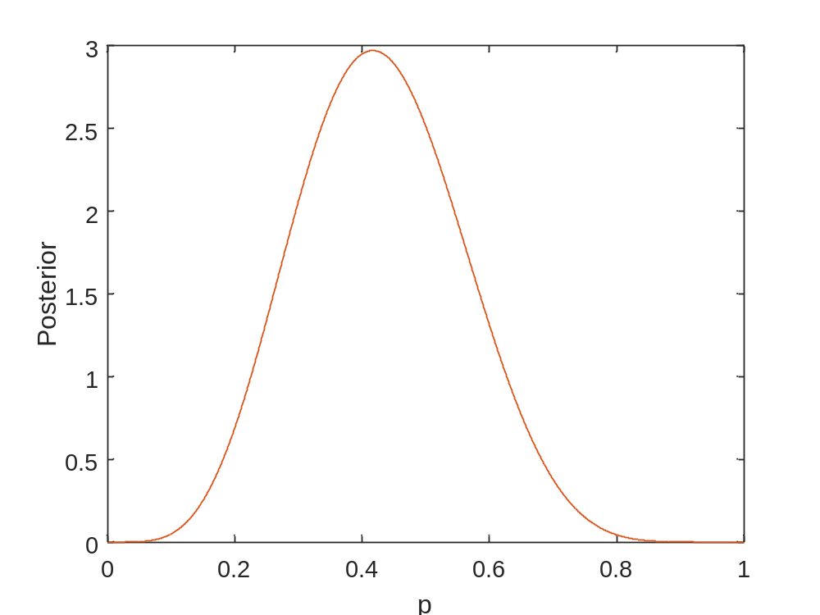
Notice new scale on y-axis. NOW this integrates to 1 and is a proper distribution
> fun1<-function(x){dbinom(5,12,x)}
> integrate(fun1,0,1)
0.07692308 with absolute error < 8.5e-16
> fun2<-function(x){dbinom(5,12,x)*dbeta(x,1,1)/0.07692308}
> integrate(fun2,0,1)
1 with absolute error < 1.1e-14
Divide by marginal distribution of the data,
Which is just a “normalizing constant”

Slide 16

The Bayesian inferential paradigm requires subjective prior beliefs!

Slide 17
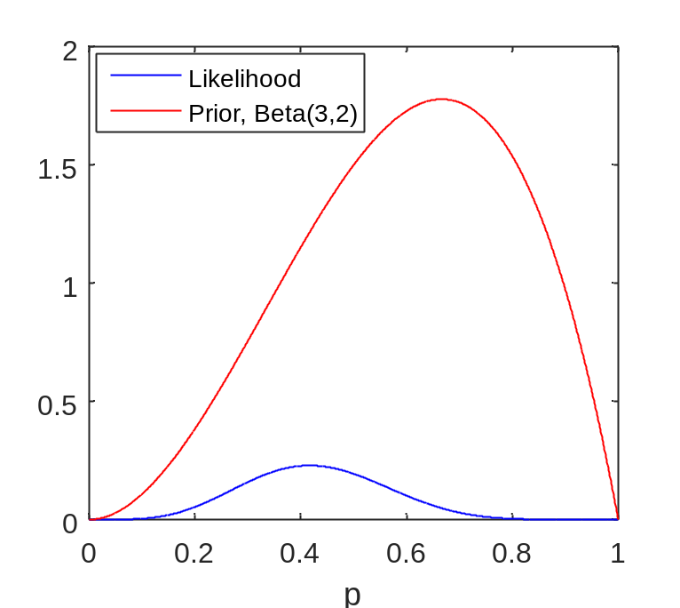
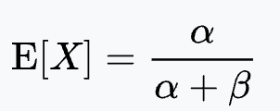
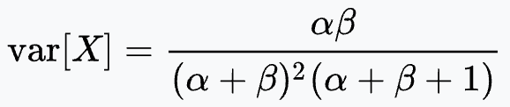
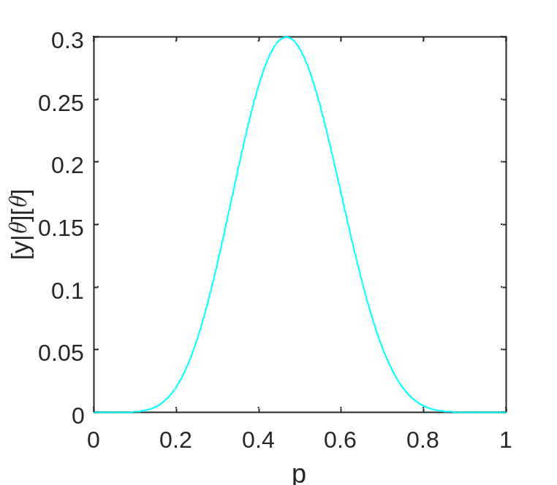
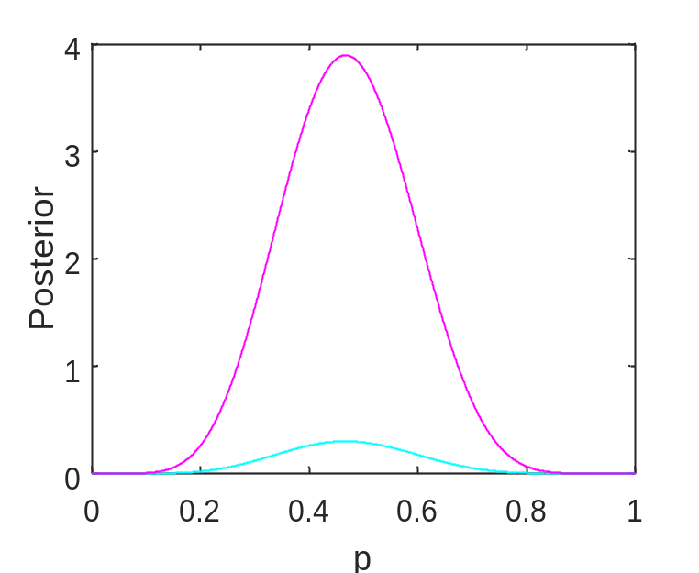

We have 5 heads out of 12 flips – 5/12 = 0.417. Now let’s use an informative prior, Beta(3,2).
Question: What is the mean of a Beta(3,2)? What are we saying with this?
Why is posterior mean larger than 0.417?
The integral of this thing is 0.092308
The integral of this thing is 1
$$μ_{p}=0.47012$$

Slide 18
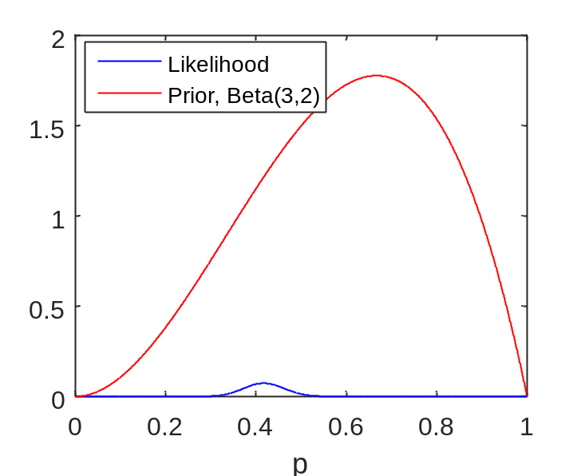
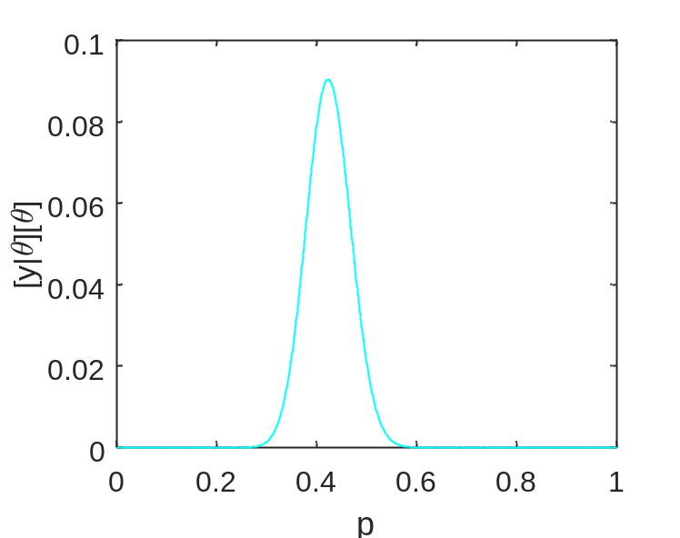
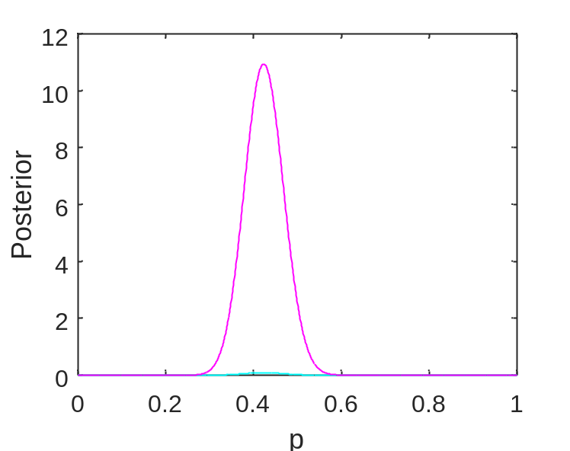

Instead of 5 heads out of 12 flips, lets see what happens with 50 heads out of 120 flips (50/120 = 0.417)
The more data you have, the lower the likelihood.
(Think here. Why? Likelihood of datum vs. data)
Much closer to data mean than posterior mean now
The integral of this thing is 0.010036
The integral of this thing is 1
$$μ_{p}=0.42358$$
50/120=0.41667
Look at uncertainty

Slide 19
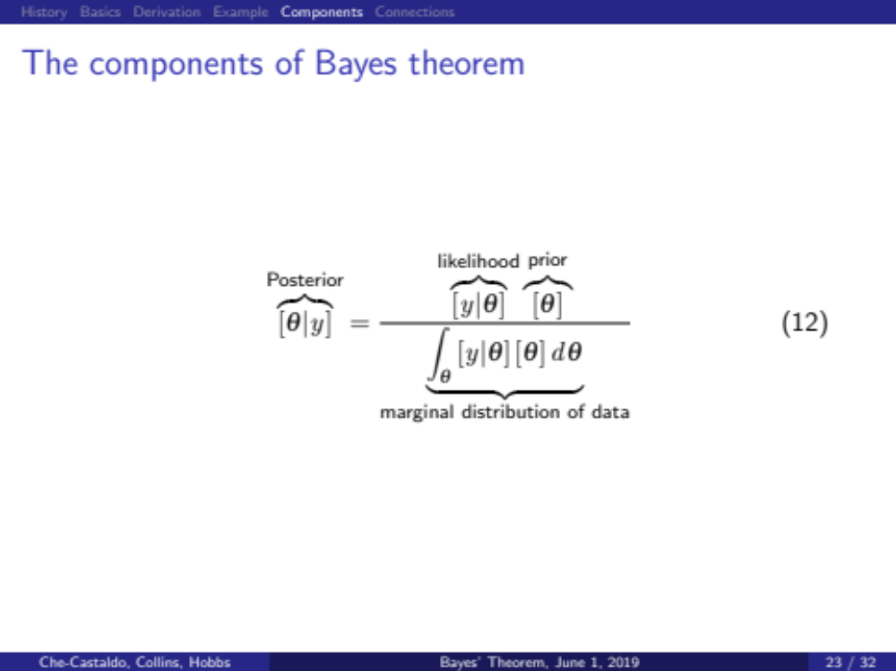
Think about what we just did
We multiplied the prior and likelihood
Each value was divided by the integral of the prior*likelihood, to “normalize” or scale so that it integrates to 1 (thereby satisfying a definition of probability).
This gave us a posterior for p to make probabilistic inference

Slide 20
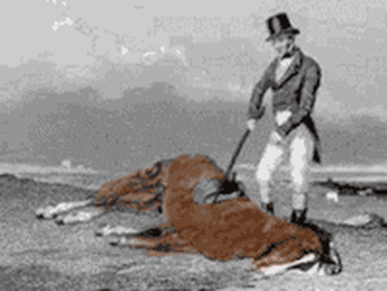

Slide 21
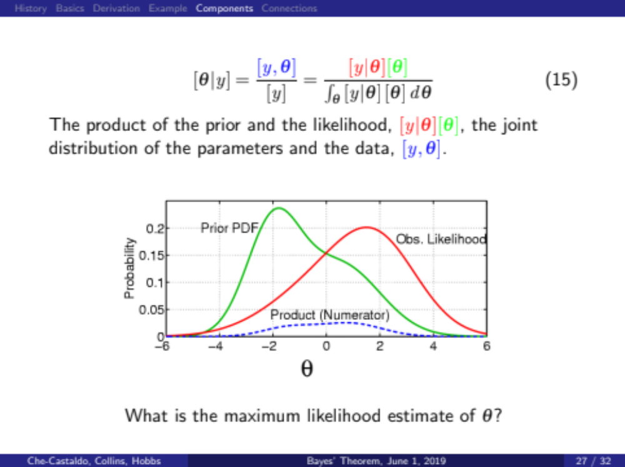

Slide 22
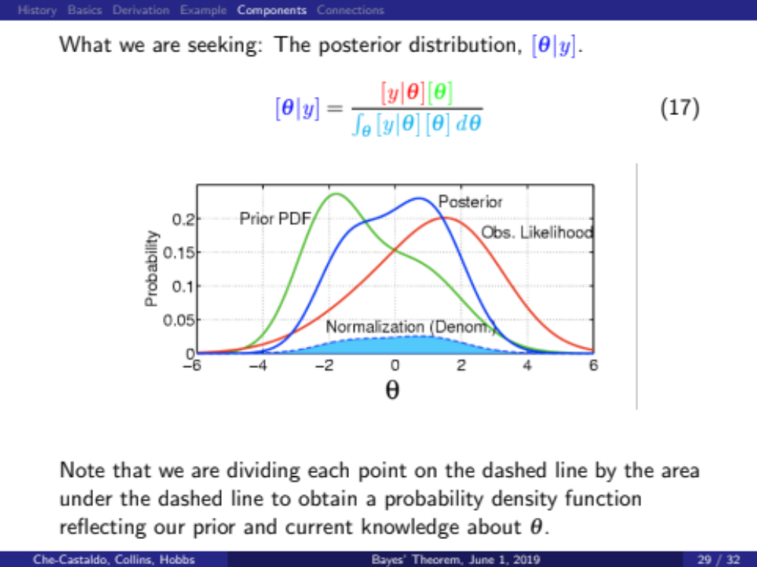

Slide 23
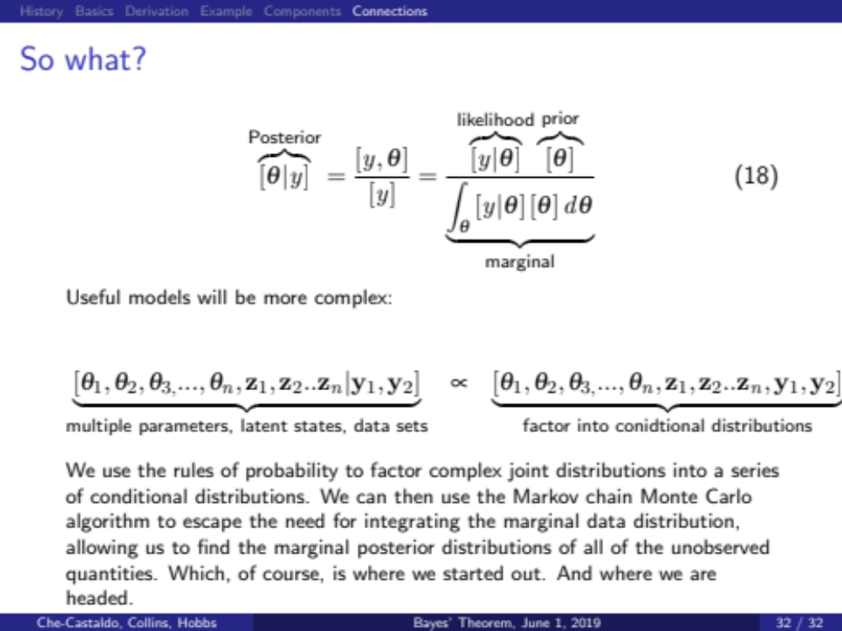
If we transform this into many conditional distributions, then we can sample from it

Slide 24
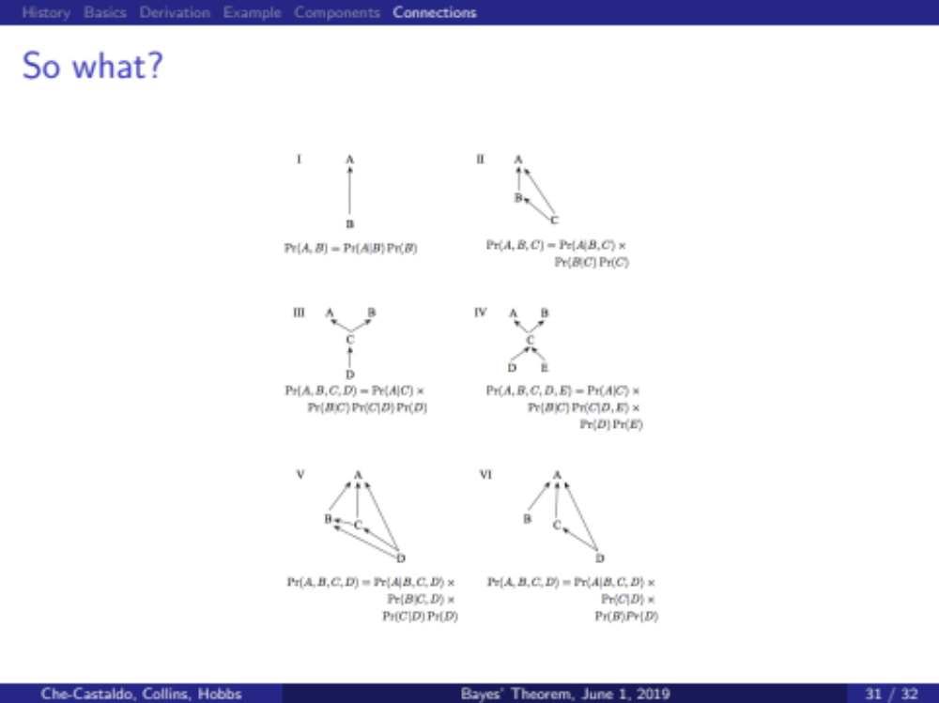
The conditional distributions can be represented by a Directed Acyclic Graph (DAG) based on the dependencies of the process
Variables with arrow heads should be on LHS of conditionality. They depend on tails of arrows, which go on RHS of conditionality. Variables without arrow pointing to them need a prior.

Slide 25
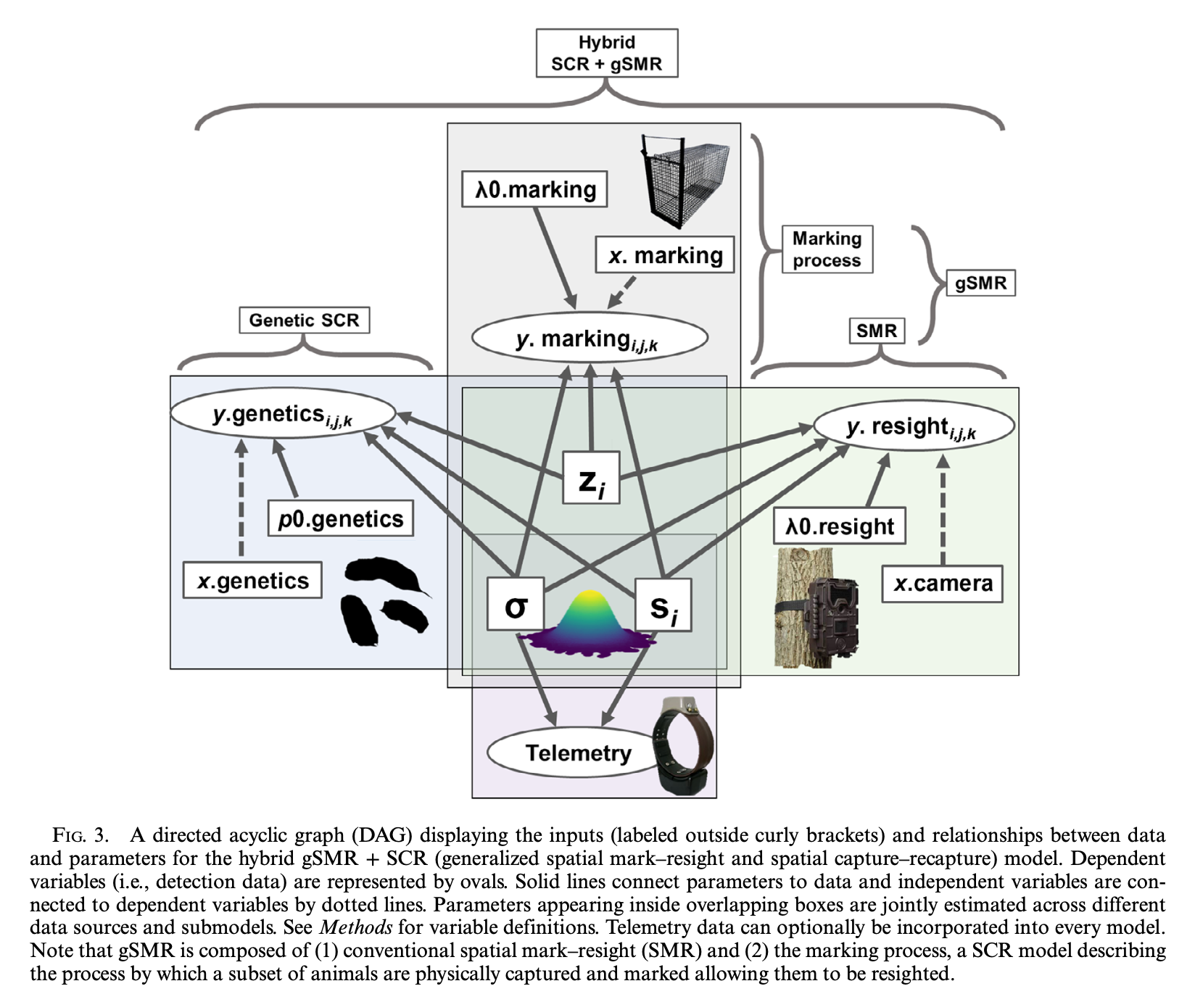
Complex models are now in widespread use in fisheries and wildlife
E.g. Joel Ruprecht’s 2021 density estimation paper using spatial capture recapture and spatial mark resight. Can incorporate GPS data, marking process, integrate multiple datasets, etc.

Slide 26
But let’s start simpler!
Back to coin flip problem

Slide 27
Instead of 5 heads out of 12 flips, lets see what happens with 50 heads out of 120 flips.
The more data you have, the lower the likelihood.
(Think here. Why? Likelihood of datum vs. data)
Much closer to data mean than posterior mean now
The integral of this thing is 0.010036
The integral of this thing is 1
$$μ_{p}=0.42358$$
50/120=0.41667
Look at uncertainty

Slide 28

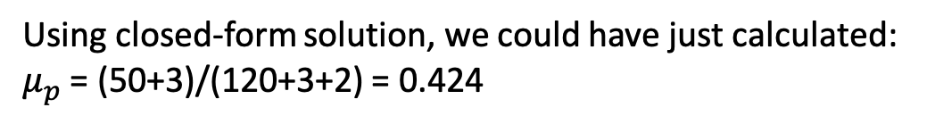
Funny thing is that the beta distribution is the “conjugate prior” to the binomial distribution.
“conjugate priors” have the special property that the posterior follows the same distribution as the prior. This gives us a ‘closed-form’ solution for the posterior
Using closed-form solution, we could have just calculated: $μ_{p}$ = (50+3)/(120+3+2) = 0.424
Note: 3 and 2 come from the beta prior

Slide 29
The new Beta distribution for the posterior of p
=
Mean of the NEW Beta distribution is
+
+
Now we can see precisely how much information the prior adds!
A Beta(1,1) prior is like observing 1 more success and 1 more failure because y increases by 1 and n increases by 2
A Beta(3,2) prior is like observing 3 more success and 2 more failures because y increases by 3 and n increases by 5
Large datasets typically swamp priors, but how would you minimize information in this prior?
That is called the Haldane prior – an “improper prior”. What is its functional form here?

Slide 30
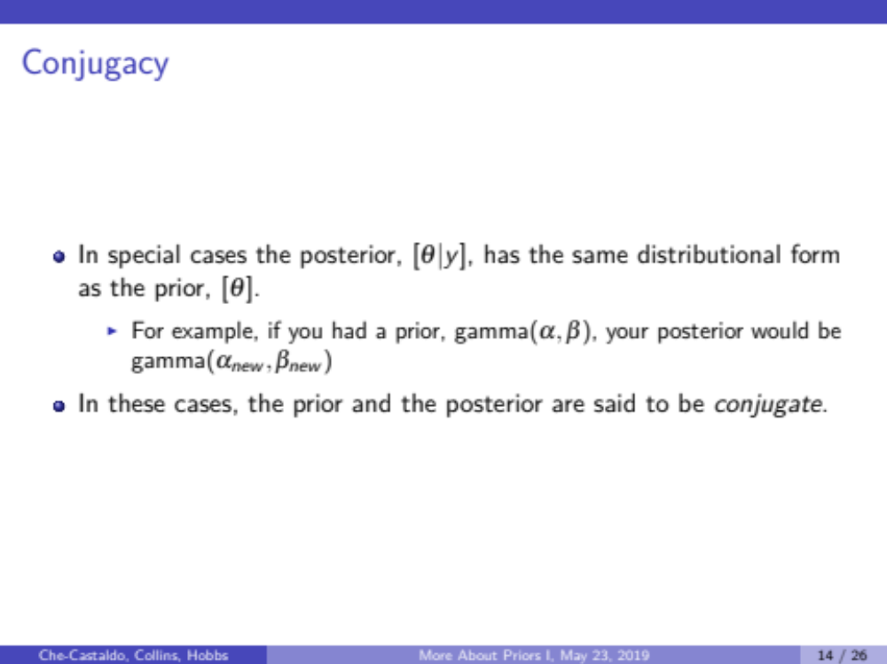
To reiterate: Conjugacy
“The beta is the conjugate prior for the binomial distribution”
“The gamma is the conjugate prior for the Poisson distribution”
  So what does that mean about our Poisson problem from earlier?
  Let’s derive this together

Slide 31
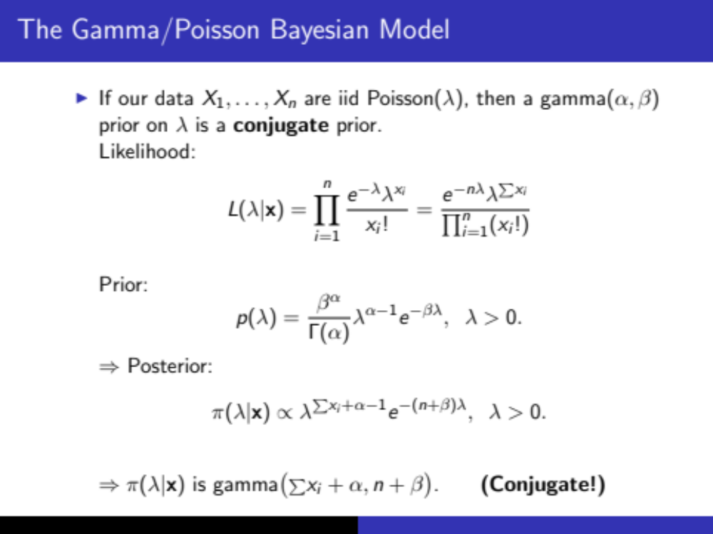

Slide 32
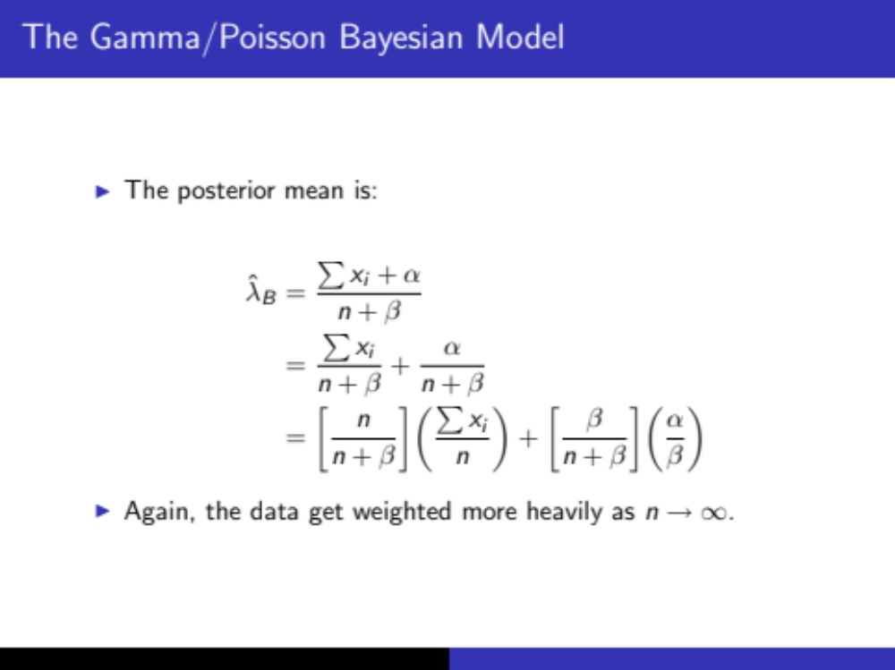

Slide 33
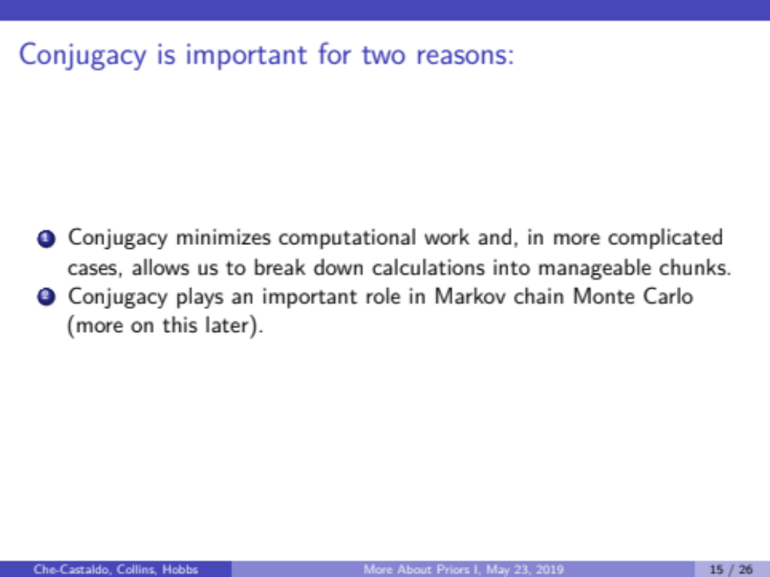

Slide 34
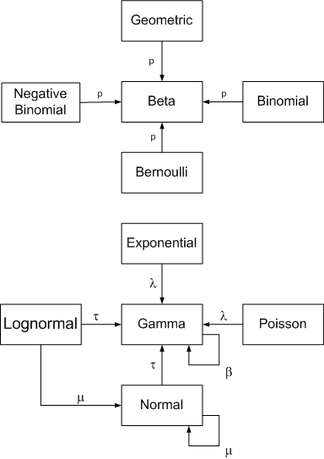
Conjugacy relationships
Note this is the “precision” or inverse of the variance

Slide 35

Unfortunately…
The elegance of conjugate priors is not available except for simple models.
Symbolic calculus usually not possible when extended into multiple dimensions (models with many parameters) and more complex probability distributions.
The numerical integrations we did earlier…
can’t be done for high-dimensional (many parameters) problems
  http://math.stackexchange.com/questions/425782/why-does-monte-carlo-integration-work-better-than-naive-numerical-integration-in
  https://en.wikipedia.org/wiki/Numerical_integration
> fun1<-function(x){dbinom(5,12,x)}
> integrate(fun1,0,1)
0.07692308 with absolute error < 8.5e-16
(We did them to illustrate concepts. Not advice on solving real Bayesian problems)

Slide 36
Because we couldn’t solve high-dimensional integrals, Thomas Bayes’ (1702-1761) approach to inferential logic languished for two centuries!
In the mean time, Ronald Fisher and others developed an alternative approach that did not use priors and did not attempt to characterize parameters probabilistically.

Slide 37
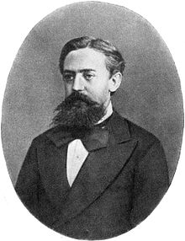
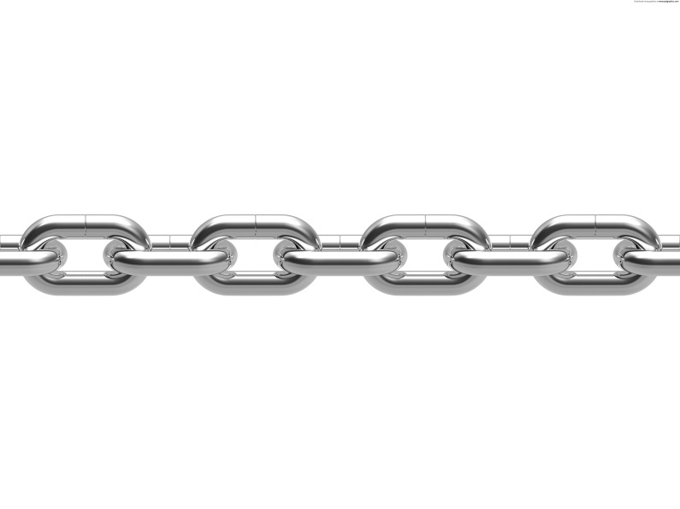
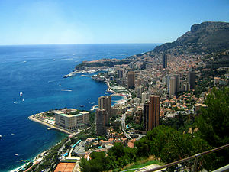
Then comes WWII and some mathematical physicists at Los Alamos needed to evaluate high dimensional integrals.
Note: like Newton’s invention of calculus to study gravity/orbits
Markov chain Monte Carlo (MCMC)
“Markov” means dependence only on the previous sample
“Monte Carlo” means estimation of properties of a distribution by random sampling from the distribution. Apparently named for the Grand Casino in Monte Carlo

Slide 38
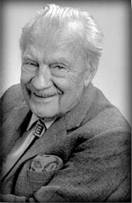
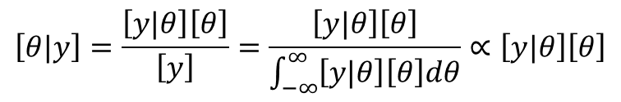
The Metropolis Algorithm
We’re going to sample from the numerator
$$\left[θ|y\right]=\frac{\left[y|θ\right]\left[θ\right]}{\left[y\right]}=\frac{\left[y|θ\right]\left[θ\right]}{\int_{−∞}^{∞}{\left[y|θ\right]\left[θ\right]dθ}}∝\left[y|θ\right]\left[θ\right]$$
We say: ”The posterior is proportional to the likelihood times the prior”
Nicholas Metropolis
(1915-1999)
Pick values of p. Keep them in the chain at a rate proportional to the relative value on the y-axis.

Slide 39
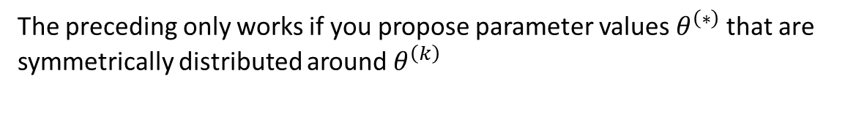

The Metropolis Algorithm
The preceding only works if you propose parameter values $θ^{\left(∗\right)}$that are symmetrically distributed around $θ^{\left(k\right)}$
For example
$$θ^{\left(∗\right)}\sim Normal(θ^{\left(k\right)},σ_{tune})$$
Nicholas Metropolis
(1915-1999)
If this is too big, then you propose lots of values that don’t get accepted, which is inefficient. If too small there is too much autocorrelation and it takes forever to sample the full posterior
The symmetry requirement can be problematic if θ is constrained (e.g. standard deviations and proportions must be positive).
A small modification:
The “Metropolis-Hastings” algorithm allows for asymmetric proposals

Slide 40
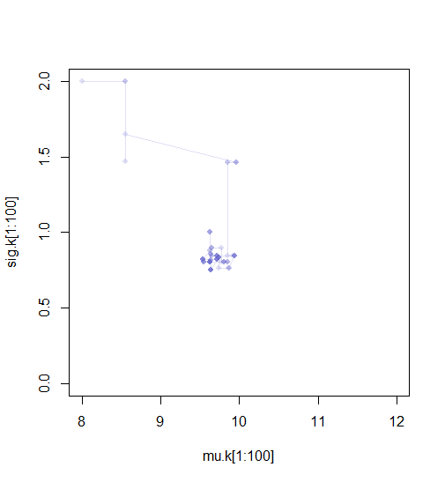
Time series of an MCMC

Slide 41
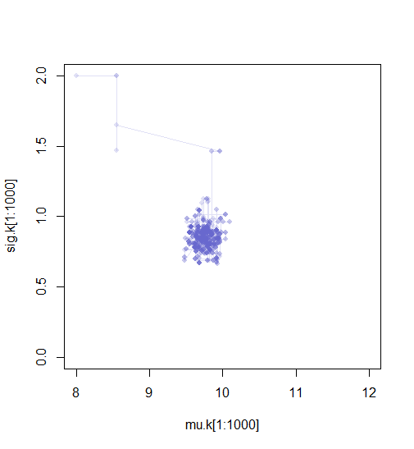
Time series of an MCMC

Slide 42
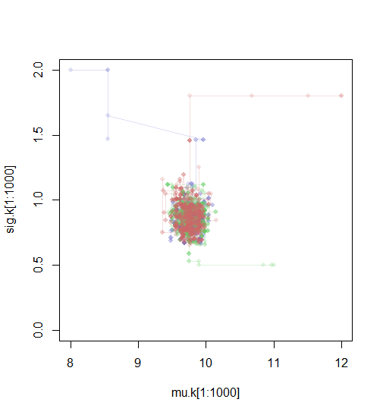
Time series of 3 MCMCs

Slide 43
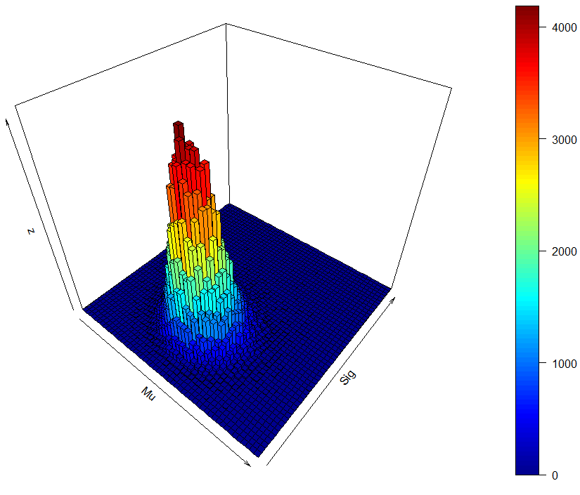
Here is the posterior of the joint distribution (both parameters) from which we also have the marginal distribution for each
count
count

Slide 44
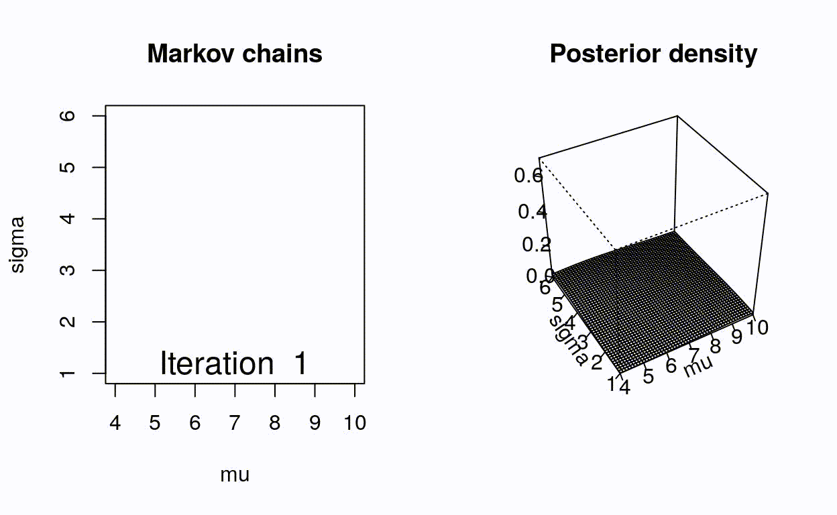
https://mbjoseph.github.io/posts/2018-12-25-animating-the-metropolis-algorithm/

Slide 45
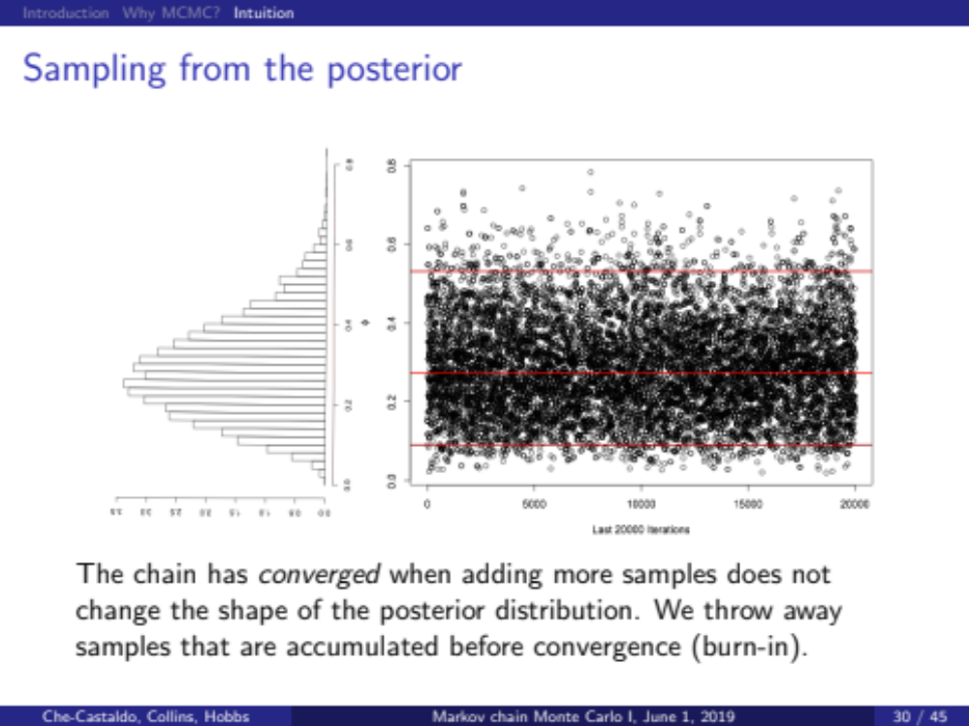

Slide 46
There are now many algorithms to solve this problem
Click on an algorithm below to view interactive demo:
Random Walk Metropolis Hastings
Adaptive Metropolis Hastings [1]
Hamiltonian Monte Carlo [2]
No-U-Turn Sampler [2]
Metropolis-adjusted Langevin Algorithm (MALA) [3]
Hessian-Hamiltonian Monte Carlo (H2MC) [4]
Gibbs Sampling
Stein Variational Gradient Descent (SVGD) [5]
Nested Sampling with RadFriends (RadFriends-NS) [6]
  https://chi-feng.github.io/mcmc-demo/

Slide 47
BUGS, JAGS, Nimble, STAN, and INLA oh my!
In 2008, my first Bayesian professor, Herbie Lee, thought WinBUGS shouldn’t be taught because it would make it too easy so that incompetent people would implement poorly specified models
Now BUGS (Bayesian Analysis Using Gibbs Sampling) is very common
OpenBUGS and WinBUGS needs Windows. JAGS was designed to work on multiple platforms.
Unlike OpenBUGS and WinBUGS, which have a graphical user interface, JAGS works on the command line and interfaces nicely with R. It can be run on UNIX clusters like OSU’s CQLS.
Nimble is similar to JAGS, but is more flexible and faster for many problems in Ecology!
STAN uses the very fast Hamiltonian MCMC algorithm, but doesn’t use BUGS language. Brms package in R can make this very accessible.
INLA is extremely fast because it approximates the posterior instead of sampling. Used for a restricted subset of problems.

Slide 48
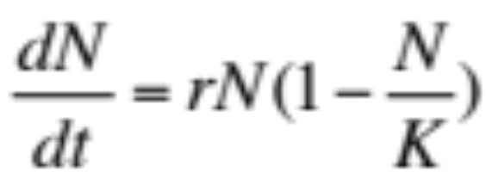
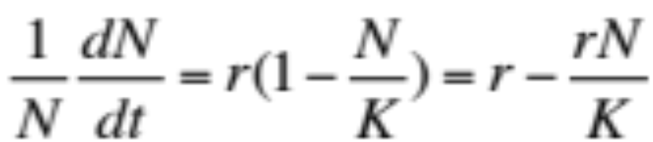
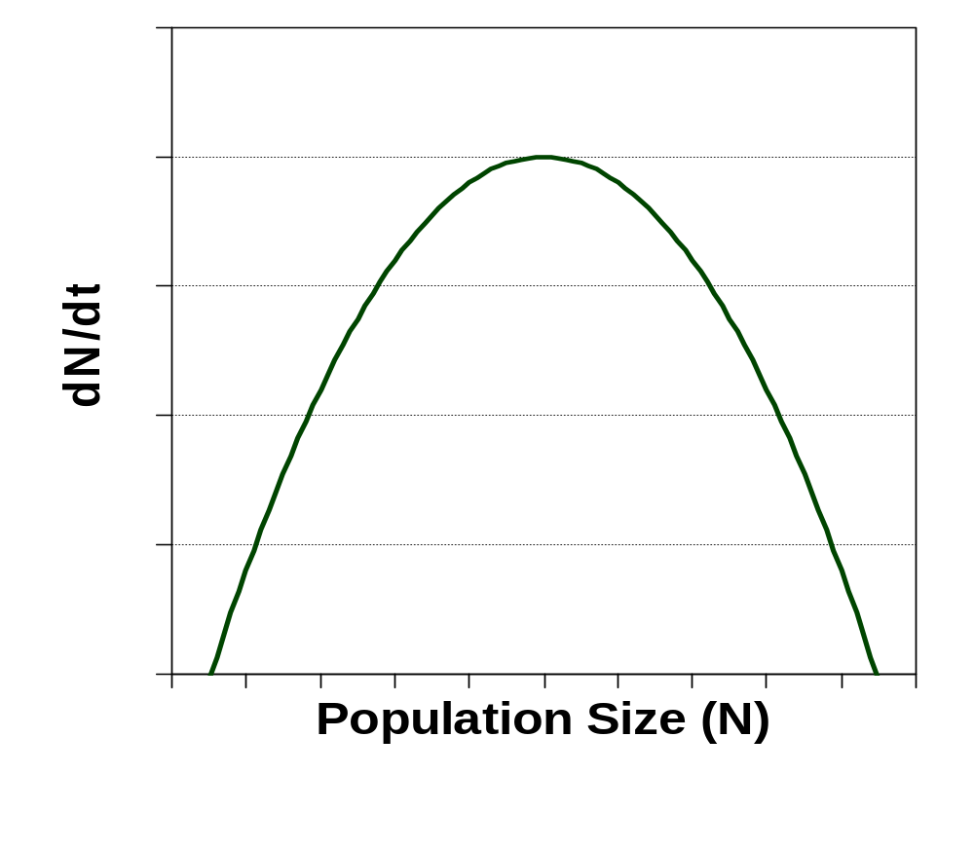
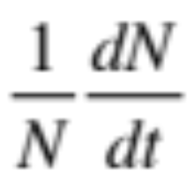
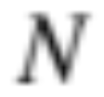
Estimating parameters in logistic population growth
K
2
r
MSY = rK/4
Greatest per-capita growth rate
Greatest population growth rate
K
0
K
“Negative density dependence”

Slide 49
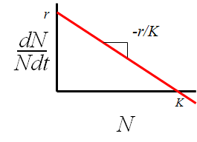

Estimating parameters in logistic population growth
Observations of per-capita growth rate paired with population size
Ah ha, our scientific model is a line! We know what to do with lines!
  Let’s try it with our standard tools.

Slide 50


Good Ole Regression Approach
reg=lm(GrowthRate~PopulationSize,data=Logistic)
But what can we say about K, K/2 or MSY?

Slide 51

Bayesian fit
“Precision” = 1 / variance
Joint posterior distribution of parameters is proportional to likelihood*prior
We want positive continuous values for r and K. Bring on the gamma!
The gamma is the conjugate prior for the precision term in Normal distribution
But why gamma(0.001, 0.001)

Slide 52

“Bayesian Network” or
”Directed Acyclic Graph”

Slide 53

Nimble PRIMER
BUGS Code is written in a nimbleCode() function.
Models compiled into C++ and are more customizeable
Can be much faster than JAGS
Can produce MCMC output in one line with nimbleMCMC()
  No separate adaption phase to tune MCMC
  Can also compile model first and then run nimbleMCMC
BUGS is not a procedural language like R. It is not a set of instructions to be executed sequentially. It is a way to translate a mathematical statement into syntax that determine the MCMC sampler that JAGS uses behind the scenes

Slide 54
Estimating derived quantities
Unlike with least squares or maximum likelihood, with Bayesian statistics it is easy to derive chains for other quantities of interest and their posterior distributions.
These are called “derived quantities”
For example, K/2, rK/4, N as a function of time, dN/dt as a function of N with uncertainty, or incorporate errors in the observations of population growth rate or population size.
This is a BFD!

