Slide 1
Nonlinear Models
Maximum Likelihood Primer
Notes:
a

Slide 2
What is Maximum Likelihood-I?
Maximum likelihood is a method for fitting a mathematical model to some data. “Fitting” involves estimating the values for the parameters of the model. This is what is happening under the hood when you fit a glm, lmer, glmer, etc.
For some problems, you may not have canned functions, but this has become increasingly uncommon.

Slide 3
What is Maximum Likelihood-II?
- Given a set of data, and a probability model, maximum
likelihood chooses the values for the parameters that were most likely to have produced the data
L(p|x) = Prob(x|p)
Probability: knowing parameters -> predicting data.
Likelihood: knowing data -> parameter estimation.

Slide 4
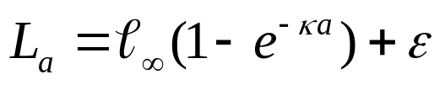

What is Maximum Likelihood-II?
Parameters, data and error distributions:
Data
Parameter
Error
What are the data, parameters, and incorporation of error?

Slide 5
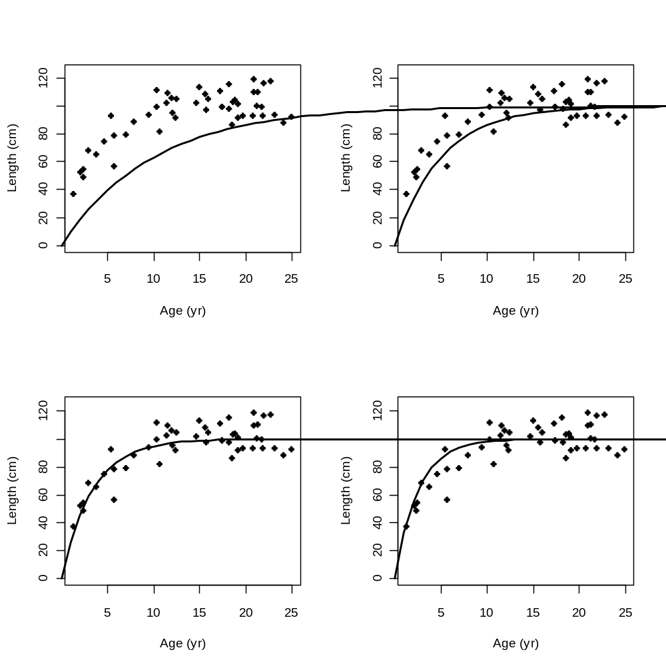
What is Maximum Likelihood-III?
Which of these curves
are ”most likely” to have
generated the data?
These two seem pretty
similar – is one better?

Slide 6

Basics of Likelihood
The likelihood of the data is the product of the likelihoods of each data point
The set of data X_{i}
Product of the PDF/Likelihood across all data points
Notation often inconsistent, but IMO better to put parameters conditional on data

Slide 7
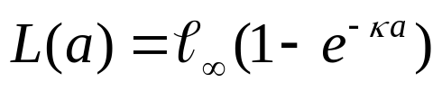
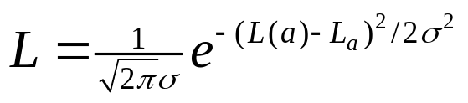
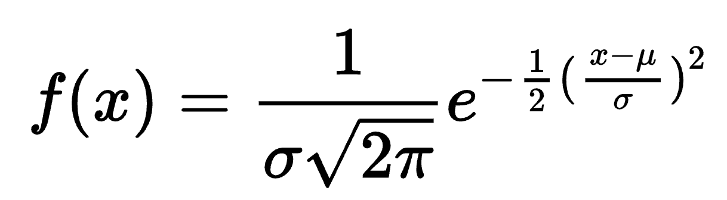
Further Likelihood Considerations-I
To compute the likelihood for a given set of parameters we need:
The deterministic (model) relationship between the input
variables (covariates) and the (expected) data:
The probability model for how the data pertain to the model prediction – in this case normal
Model prediction
(Q: why here?)
Data

Slide 8
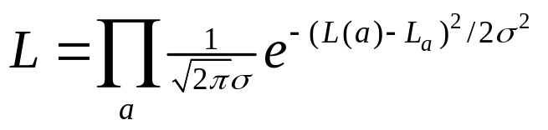
Further Likelihood Considerations-II
In R, the term:
is evaluated using the expression
dnorm(observed, expected, sigma)
The full likelihood is the product over all the data points:
or in R:
prod(dnorm(observed_vector, expected_vector, sigma))
Note: The function dnorm returns the value of the normal distribution PDF given x, μ, and σ.

Slide 9
Back to our original problem
We can compare the four parameters choices using the following code (open R code):
pred_vec <- Linfs[II]*(1-exp(-Kappa[II]*age_vec))
likelihood <- prod(dnorm(len_vec, pred_vec, sigma))
print(likelihood)
Results:
4.82e-149
2.74e-87
2.744-80
3.64e-82
Best (so far)
How do we know?

Slide 10
Overview
Given a data set:
Select a model for the underlying process.
Select a model for the uncertainty of the data.
Write the likelihood for one data point.
Multiply the likelihoods across all data points.
Find the values for the parameters that maximize the likelihood.
  Do this by minimizing negative log likelihood

Slide 11
We’ll explore numerical methods later
For now, let’s apply this to a simpler problem
You monitor an intersection for cars that run the
red light. Based on 50 days of observation, you detect
30 days on which “light running” took place. You repeat the “experiment” after a red light camera is installed and now observe 10 days on which “running” occurred.
Questions
What is the probability of “light running” before the camera was installed?
2. Has the probability of “light running” changed significantly?

Slide 12
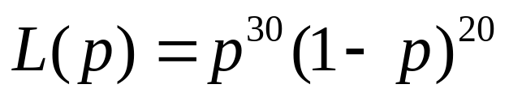

Let the probability of “running” be p (and hence the
probability of not “running” be (1-p)). The probability of
30 “runs” and 20 “non-runs” is then p³⁰(1-p)²⁰
(assuming “runs” and “non-runs” are independent).
This leads to the following likelihood function from the Binomial:
Is something missing? Why is this ok?
We refer to the value for p that maximizes the likelihood function as the maximum likelihood estimate and denote it as .

Slide 13
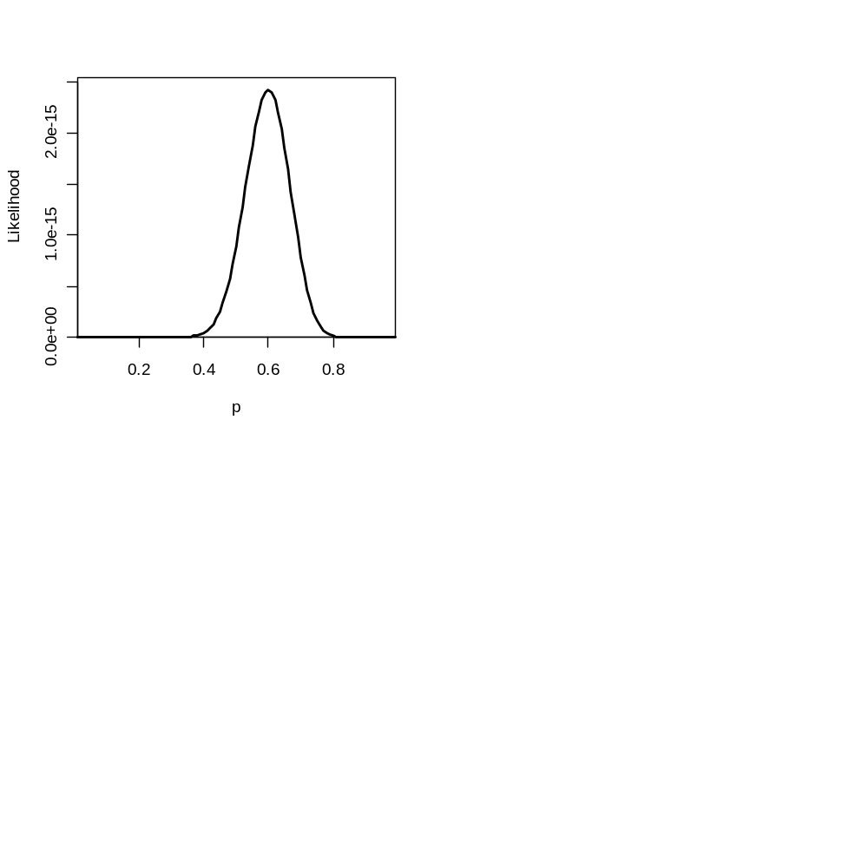
In R:
Prob <- seq(from=0.01,to=0.99,by=0.01)
Like <- Prob^30*(1-Prob)^20
plot(Prob,Like)
We can find the MLE in R:
Ibest <- which(Like==max(Like),arr.ind=T)
print(Prob[Ibest])
See why normalizing constant doesn’t matter here?

Slide 14
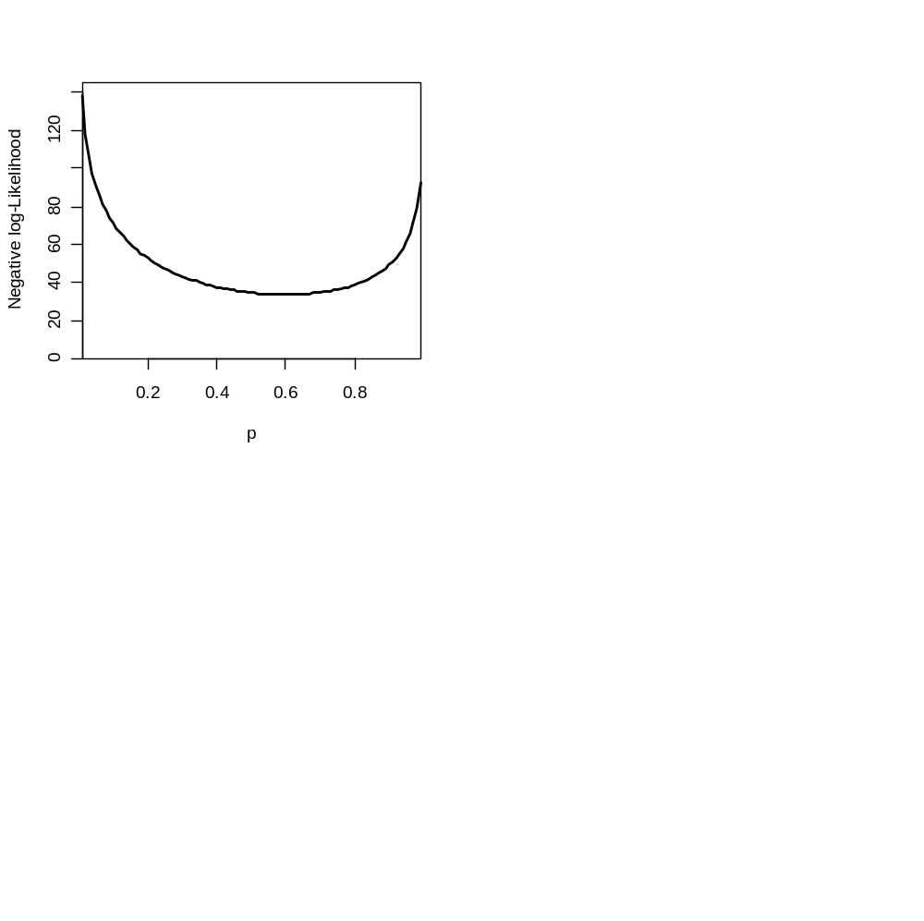

Negative log-likelihoods
Rather than working with likelihoods we often work with negative log-likelihoods. Therefore, rather than maximizing the likelihood, we minimize the negative log-likelihood – this leads to same point estimates.
The estimate of p, , is again 0.6.
Logs help with the tiny number problem, and negative works for numerical optimizers

Slide 15
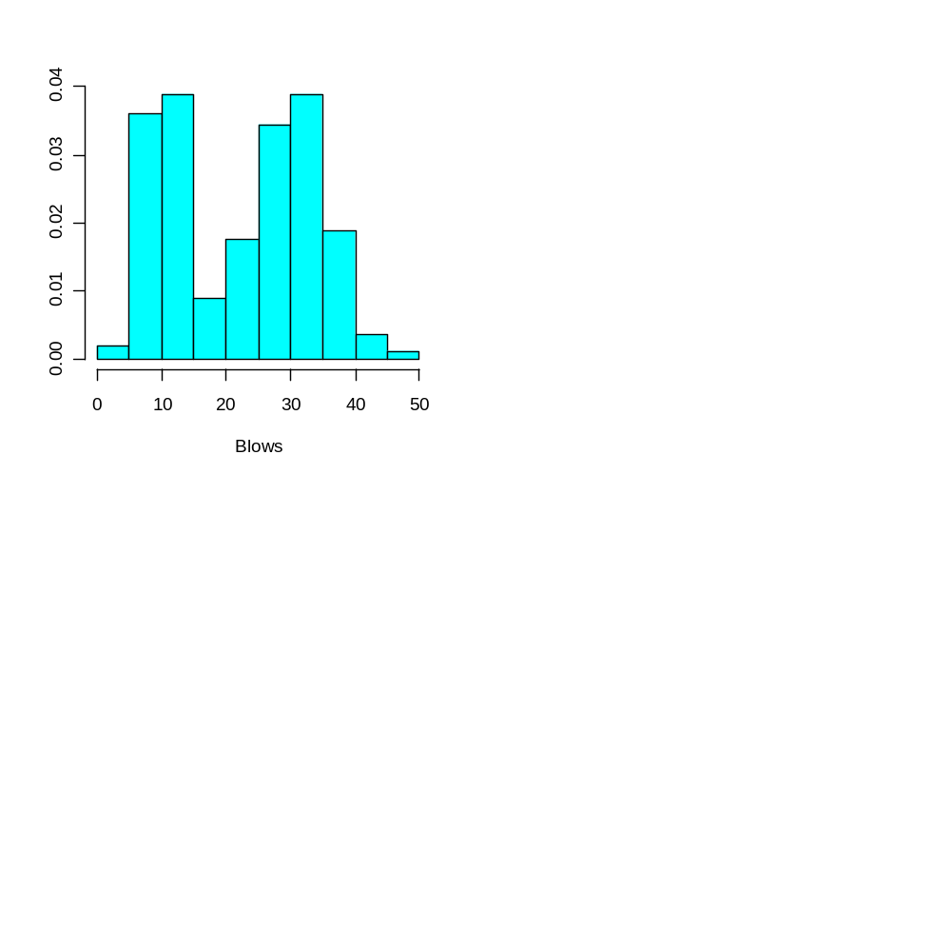
A Poisson mixture problem
The blow rate for a given whale species is Poisson-distributed and it is “known” that the average number of blows in an interval for males and females is different. We monitor a population and find the following distribution of blow times.
Questions
What is the fraction of females in the population (females have
higher blow rate)?
Can we conclude that females and males really do differ in mean blow rate?

Slide 16
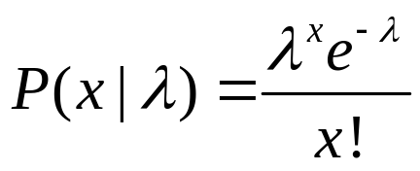
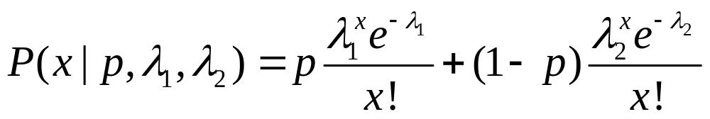
The Poisson distribution is:
Now, an animal is either male or female and letting the
mean blow rate for males be λ₁ and that for females be λ₂,
and assuming that the proportion of males is p:
How would you do this with linear models?

Slide 17
In English:
An animal is selected at random; the probability it is male is p.
A blow rate is generated given the appropriate Poisson distribution.
This type of model is called a mixture model. In this case there are two mixture components.

Slide 18
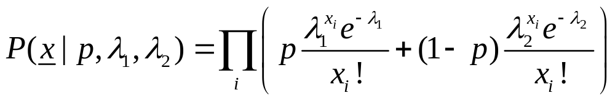
The likelihood function is then:
This looks pretty complicated but R is there to help us:
dpois(x,lambda) =

Slide 19
Start by assuming we know Propn
We now have a three dimensional likelihood surface
TheData <- matrix(scan("Whale.dat",skip=1),byrow=T,ncol=2)
TheData <- TheData[,2]
Blow1 <- seq(from=1,to=40,by=1)
Blow2 <- seq(from=1,to=60,by=1)
Likes <- matrix(0,nrow=length(Blow1),ncol=length(Blow2))
for (ii in 1:length(Blow1))
for (jj in 1:length(Blow2))
{
LikeOut <- Propn*dpois(TheData,Blow1[ii])+(1-Propn)*dpois(TheData,Blow2[jj])
Likes[ii,jj] <- -1*sum(log(LikeOut))
}
par(mfrow=c(1,2)); persp(x=Blow1,y=Blow2,z=Likes);contour(x=Blow1,y=Blow2,z=Likes,120)
Ibest <- which(Likes==min(Likes),arr.ind=T)
cat(Propn,Blow1[Ibest[1]],Blow2[Ibest[2]],min(Likes),"\n")
GIVEN
a value for Propn

Slide 20
Notes on the code:
dpois is taking a vector and returning a vector.
persp is producing a 3d plot, contour is similar.
Ibest is now a vector and not a scalar.
We are computing the negative log-likelihood.
Function in grid search lab takes “propn” and returns the lowest value of the negative log-likelihood.

Slide 21
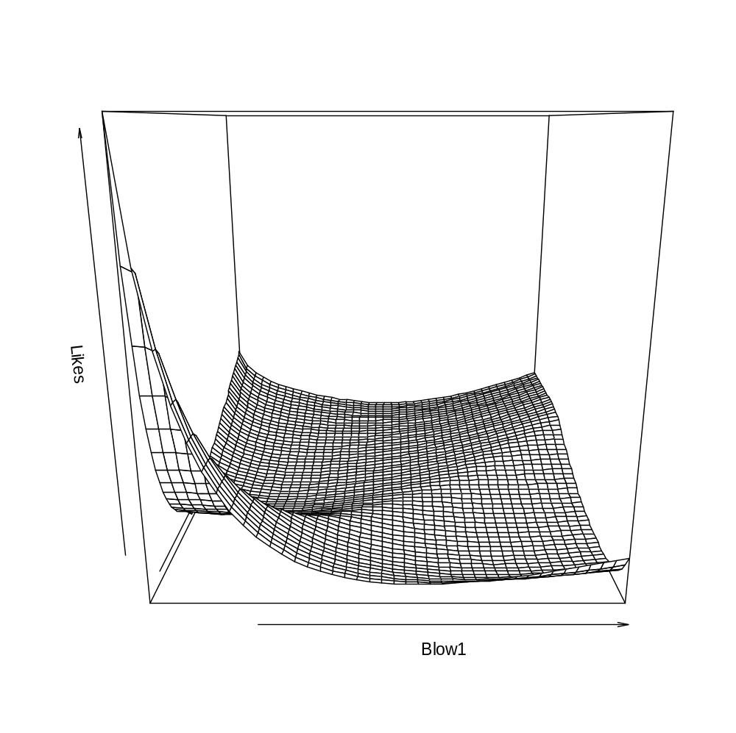
The minimum negative
log-likelihood
This is a plot of the negative log-likelihood surface

Slide 22
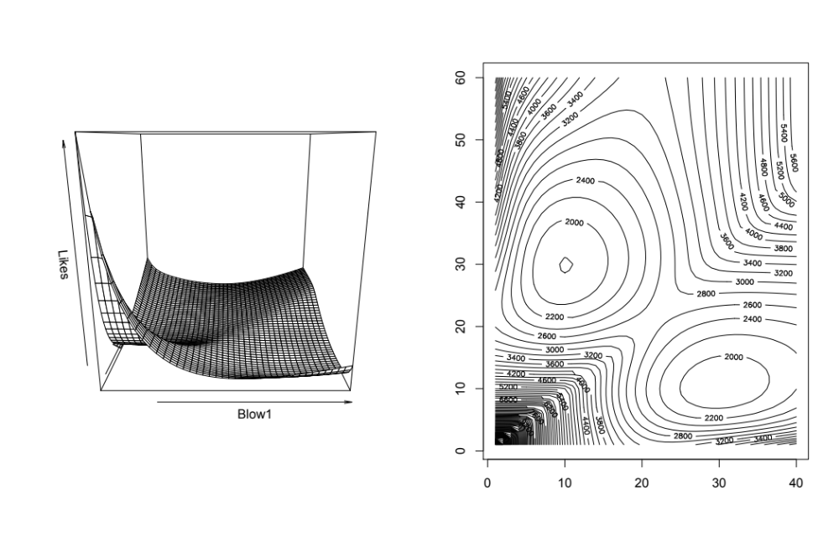
Notice anything interesting about this likelihood surface?

Slide 23
The Optim/MLE routines
The optim function is in the base package and the mle
function is in the stats4 package – We will focus on mle
ll1 <- function(x) {
obj <- (x-0.3)^2
return(obj)
}
ret1 <- mle(ll1,start=list(x=1))
print(summary(ret1))
Function to be minimized
Initial values for the
parameters

Slide 24
Some options for MLE-I
mle(Func, start=list(), method, lower, upper)
Func – function to be minimized
start – initial values for the parameters
method – method for minimization (e.g. “L-BFGS-B”,
“Nelder-Mead”, “BFGS”).
lower – lower bounds for the variables (including –Inf)
upper - upper bounds for the variables (including Inf)
Note, “L-BFGS-B” allows you to bound the parameters

Slide 25
Question-1
You monitor an intersection for cars that run the
red light. Based on 50 days of observation, you detect
30 days on which “light running” took place. You repeat the “experiment” after a red light camera is installed and now observe 10 days on which “running” occurred.
Questions
What is the probability of “light running” before the camera
was installed?
Has the probability of “light running” changed significantly?
    We’ll get to this question later

Slide 26
Example 1 - revisited
Negative log-likelihood
LL2 <- function(p) {
obj <- -1*30*log(p)-20*log(1-p)
return(obj)
}
ret2 <- mle(LL2,start=list(p=0.1),
lower=c(0.00001),upper=c(0.999999),
method="L-BFGS-B")
print(summary(ret2))
“Method” must be L-BFGS-B if you
want to bound the parameters

Slide 27
Example 2 - revisited
The blow rate for a given whale species is Poisson-distributed and it is “known” that the average number of blows in an interval for males and females is different. We monitor a population and find the following distribution of blow times.
Questions
What is the fraction of females in the population (females have
higher blow rate)?
Can we conclude that females and males really do differ in mean
blow rate?

Slide 28
Example 2 - revisited
The Poisson distribution is:
Now, an animal is either male or female and letting the
mean blow rate for males be λ₁ and that for females be λ₂,
and assuming that the proportion of males is p:
The likelihood function is then:

Slide 29
Example 2 - revisited
The likelihood function is then:
Question: What are we solving for here with optimization?

Slide 30
Example 2 - revisited
LL3 <- function(lam1,lam2,p,Blows)
{
LikeOut <- p*dpois(Blows,lam1)+(1-p)*dpois(Blows,lam2)
NegLogLike <- -1*sum(log(LikeOut))
return(NegLogLike)
}
TheData <- matrix(scan(”Whale.dat",skip=1),byrow=T,ncol=2)
Blows <- TheData[,2]
ret3 <- mle(LL3,start=list(lam1=10,lam2=10,p=0.4),fixed=list(Blows=Blows),lower=c(0.01,0.01,0.00001),upper=c(Inf,Inf,0.99999),method="L-BFGS-B")
print(summary(ret3))

Slide 31
Dissecting Example 2-I
Parameters
The data
LL3 <- function(lam1,lam2,p,Blows)
{
LikeOut <- p*dpois(Blows,lam1)+(1-p)*dpois(Blows,lam2)
NegLogLike <- -1*sum(log(LikeOut))
return(NegLogLike)
}
This is a vector of
likelihoods for each
data point
This is the negative
log-likelihood (sum over negative
log-likelihoods for each datum)

Slide 32
Dissecting Example 2-II
ret3 <- mle(LL3,
start=list(lam1=10,lam2=10,p=0.4),
fixed=list(Blows=Blows),
lower=c(0.01,0.01,0.00001),
upper=c(Inf,Inf,0.99999),
method="L-BFGS-B")
Starting values
(must be a list)
Data
(must be a list)
Upper and
lower bounds for
each parameter

Slide 33
Hints for optimization
Consider different parameterizations (e.g. log(x) rather than x).
Methods may work better if the variables are all scaled to approximately 1.
Never trust a non-linear minimizer!
  Try different starting values.
  Combine different methods
  Test your code with data for which you know the correct answer (simulate!).

Slide 34
Question 3
The length of a fish is related to its age according to the von Bertalanffy growth curve:
Questions
Estimate the parameters of this equation (what are they?) for
males and females, and compute 95% confidence intervals for
asymptotic length.
Can we conclude that the asymptotic sizes for females and males
are the same?

Slide 35
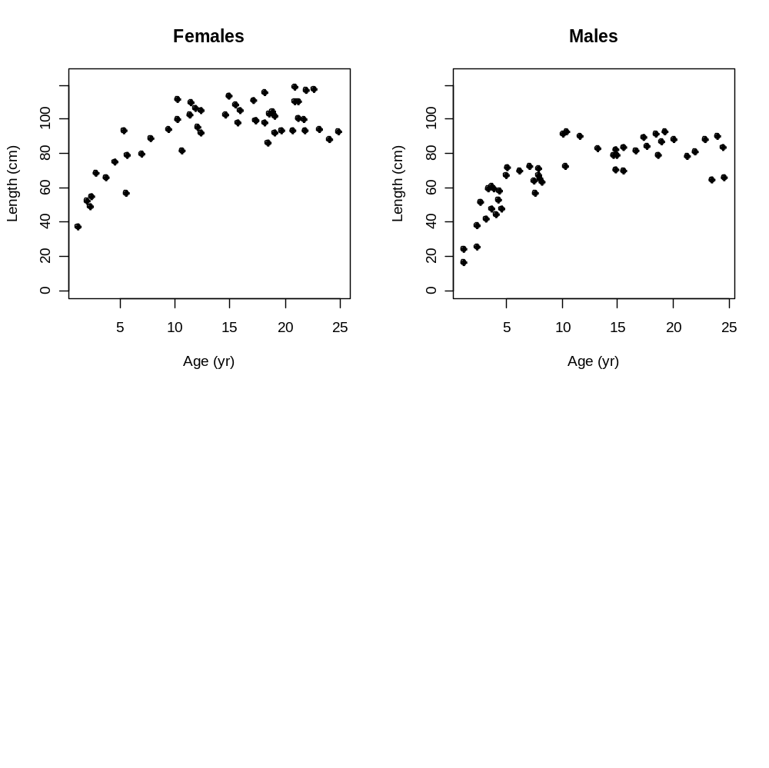
Question 3
The length of a fish is related to its age according to the von Bertalanffy growth curve:
Below find some data for random fish

Slide 36

Example 3-I
Estimate the values for , κ, and σ from the age and
growth data.
Create vectors with the age, sex, and length data.
  Create a function that takes values for the
  parameters as well as the data, and computes the
  negative log-likelihood.
  LL4 <- function(Linf1,Kappa1,Linf2,Kappa2,Sigma,Age,Length,Sex)
  use mle to find the maximum likelihood estimates
  Bound the region of parameter space to reasonable values
    E.g. Can the parameters be negative?

Slide 37
Likelihood Profile
Negative log-likelihood, fixing the
parameter to each value in turn
(minimize on the rest of the parameters)
-log
likelihood
MLE
•
•
•
•
•
•
•
Parameter of Interest
Alternative
values for the
parameter

Slide 38
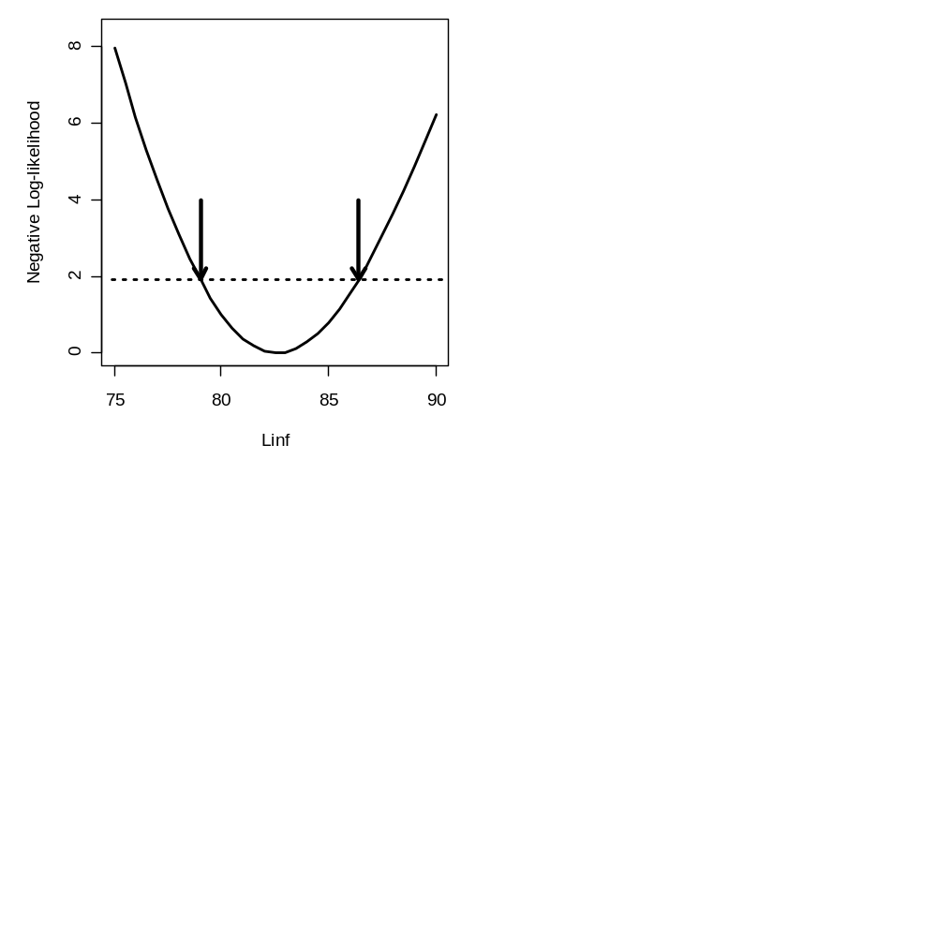
Confidence Interval
The mle() function in R does this for you, but you can pretty easily do it by hand.
95% confidence
interval
1.92

