Slide 1
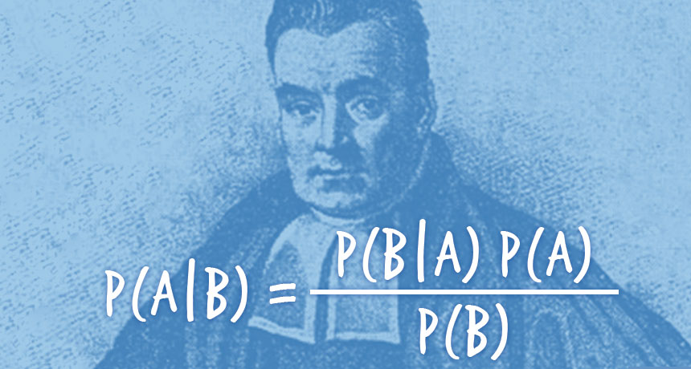
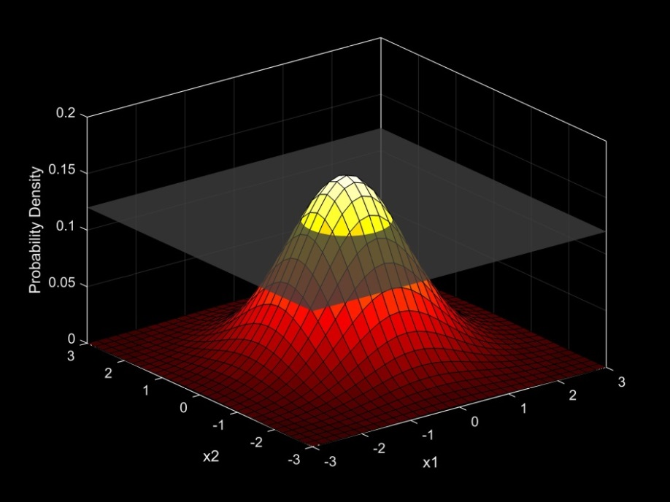
Introduction to Bayesian Analysis Part Deux
Many slides adapted from Matt Falcy ODFW, and SESYNC course by Chris Che-Castaldo, Mary B. Collins, N. Thompson Hobbs (with permission)

Slide 2
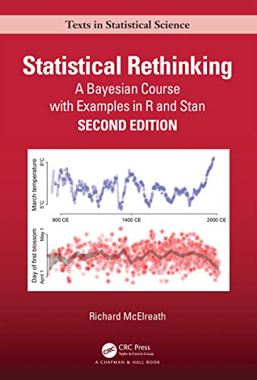
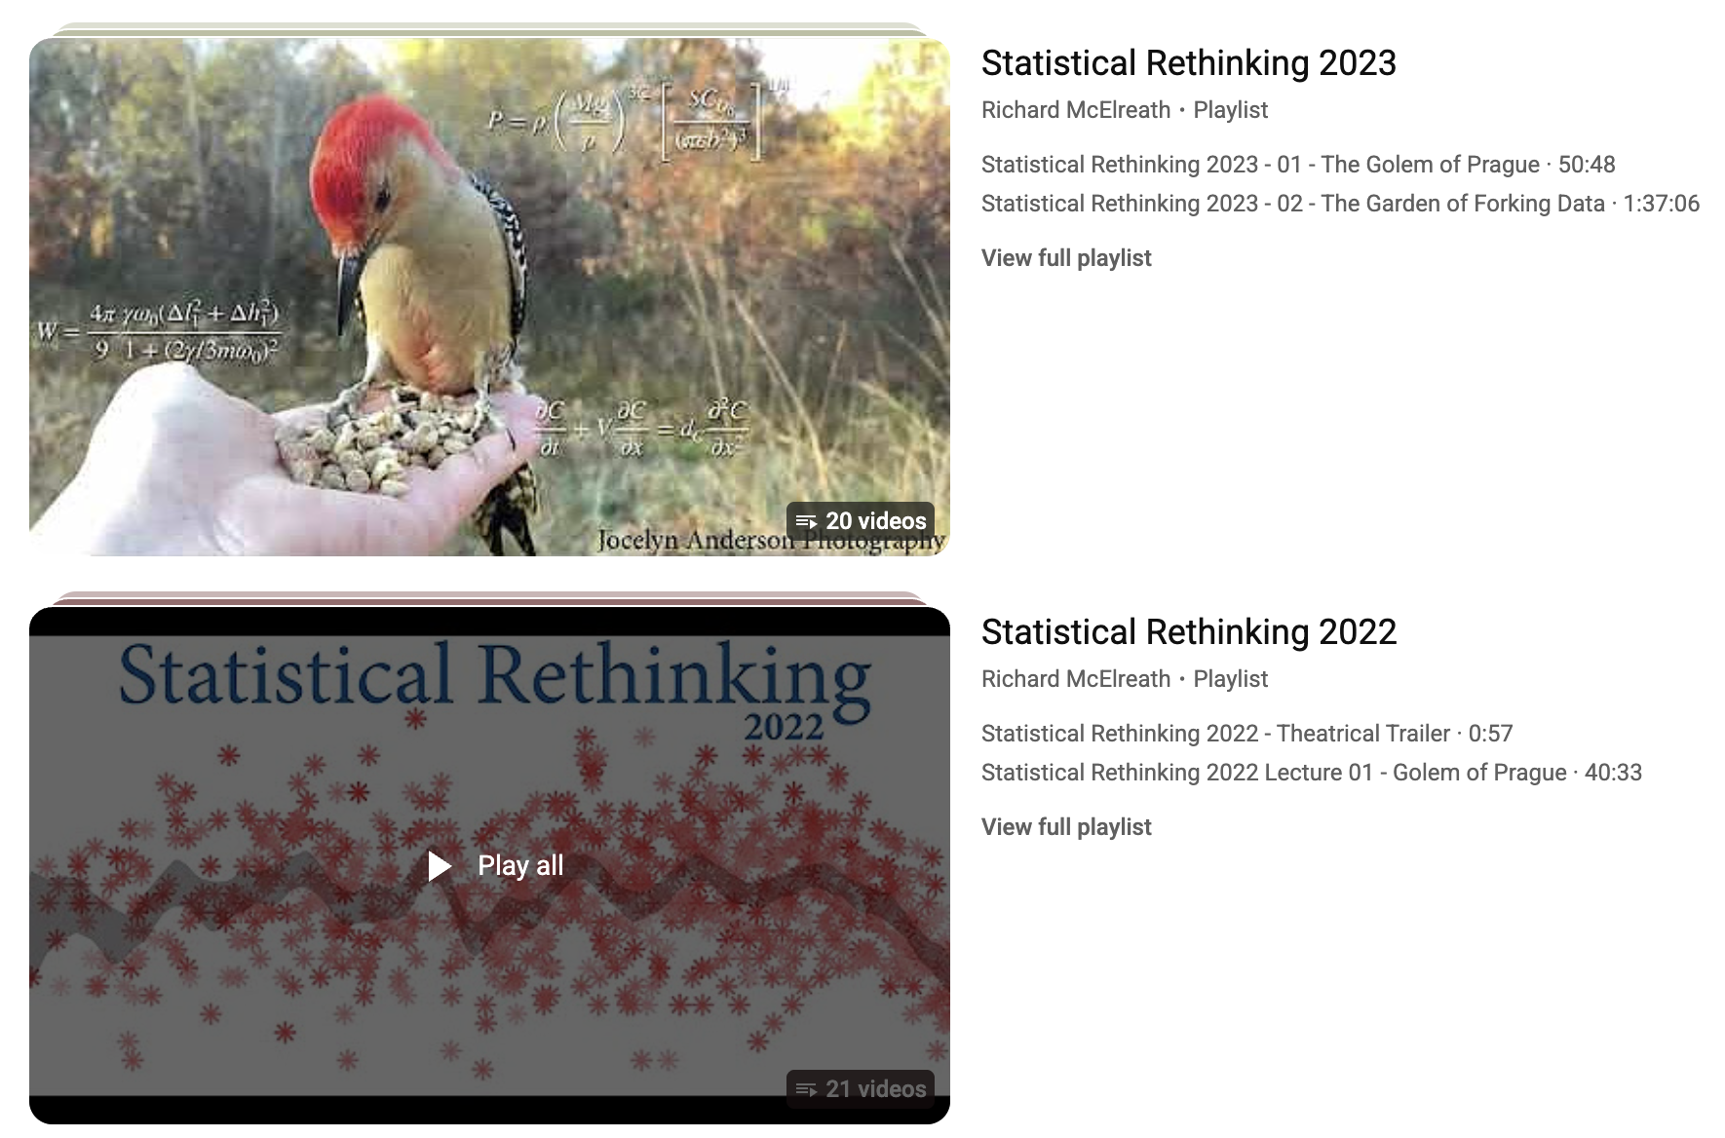
Where to go from here

Slide 3


Where to go from here
If you have strong quantitative skills and want to become a master
Covers a diverse array of topics

Slide 4






This course is just a jumping off point
Train yourself by reading books.
Consider pursuing side project using methods you want to learn
Consider attending weekly math/stats seminars

Slide 5
Model diagnostics
How to know if your chains converged?
How to know if your model is any good?

Slide 6
Model diagnostics
How to know if your chains converged?
How to know if your model is any good?

Slide 7
DID THE CHAINS CONVERGE?
Start several chains from different values. If they have all found the same posterior, the spread between chains should match the spread within a chain.
R-hat = 1.42 chains still disagree — run longer
R-hat = 1.00 chains are interchangeable
gelman.diag(samples) — want R-hat < 1.05 for every parameter though values below 1.1 deemed acceptable

Slide 8
IS THE CHAIN LONG ENOUGH?
Heidelberger–Welch runs two tests on a single chain — heidel.diag(samples)
early iterations
chopped off
Test 1 doubles as an automatic burn-in finder: if the whole chain fails, retest without the first tenth, then the first fifth, up to half. Where it first passes is your burn-in.
1. Does the chain settle down?
Compare the start of the chain to the end. If they look like samples from the same distribution, it has stopped wandering.
Fails → still drifting: burn in more, or run longer.
2. Is the mean pinned down?
How much would the reported mean move if you re-ran the sampler with a new seed? That is Monte Carlo error.
Error larger than a tenth of the mean → run longer.
Passing is necessary, not sufficient. gelman.diag and heidel.diag can only detect failure — never prove that the sampler found the whole posterior.
Clean diagnostics say the chains are trustworthy; posterior predictive checks say the model is.

Slide 9
Model diagnostics
How to know if your chains converged?
How to know if your model is any good?

Slide 10
POSTERIOR PREDICTIVE CHECKS
If the model is any good, data simulated from it should look like the data we actually collected.
1. Draw parameters
one posterior draw θ⁽ˢ⁾ = one plausible version of the world
2. Simulate data
run the likelihood forward to get a fake dataset yᵣₑₚ
3. Compare
does the observed y sit comfortably inside the simulated ones?
Repeat across hundreds of draws and you get a whole distribution of datasets the model finds believable.
A systematic mismatch — too many zeros, too much spread, missing extremes — means the model is missing something real.

Slide 11
BAYESIAN p-VALUES
Summarize each dataset with one discrepancy number T, then ask: how often is the simulated T at least as extreme as the real one?
p ≈ 0.5
simulated data look like the real data
p near 0 or 1
the model cannot reproduce that feature
Not a hypothesis test. It is a diagnostic — it tells you which feature fails, so pick T to target what matters: zeros, variance, extremes.
observed T(y)

Slide 12
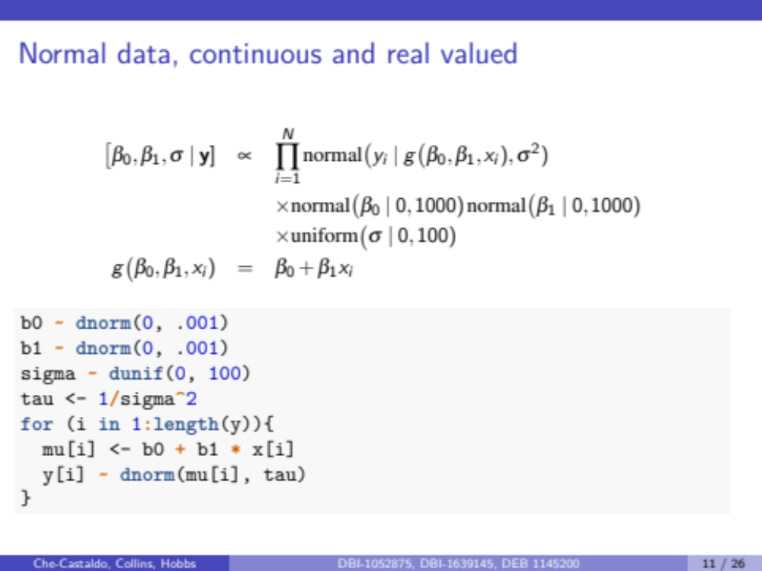
Regression model

Slide 13
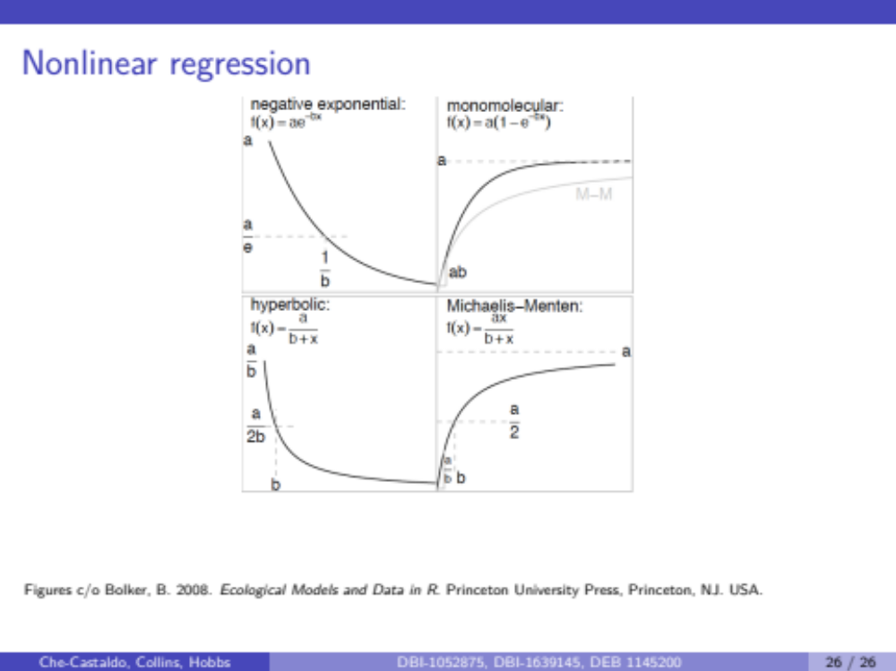
Unlike with lm() and glm()
this easily extends to nonlinear functional forms

Slide 14
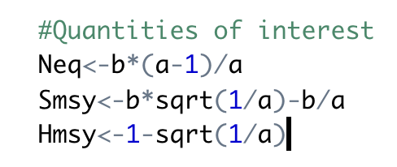
Spawner-Recruit
Another Example with Derived Quantities
Spawner-recruit problem. We want to estimate
  equilibrium number of spawners without harvest, Neq
  Spawners that maximize sustained yield
  The MSY harvest
Beverton-Holt Model
R = (a*S)/(1+a/b*S)
Hmsy
Smsy
Neq
How would you estimate these with uncertainty in frequentist framework?

Slide 15
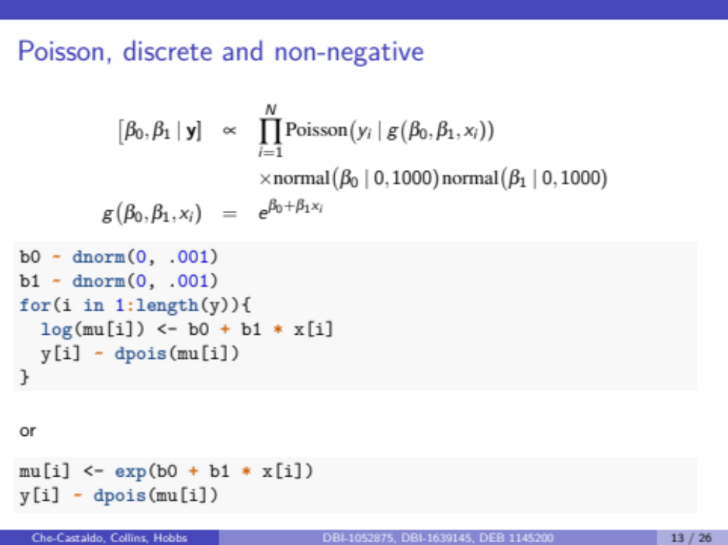
Ant Species Richness:
Beware of Vague Priors with Link Functions

Slide 16
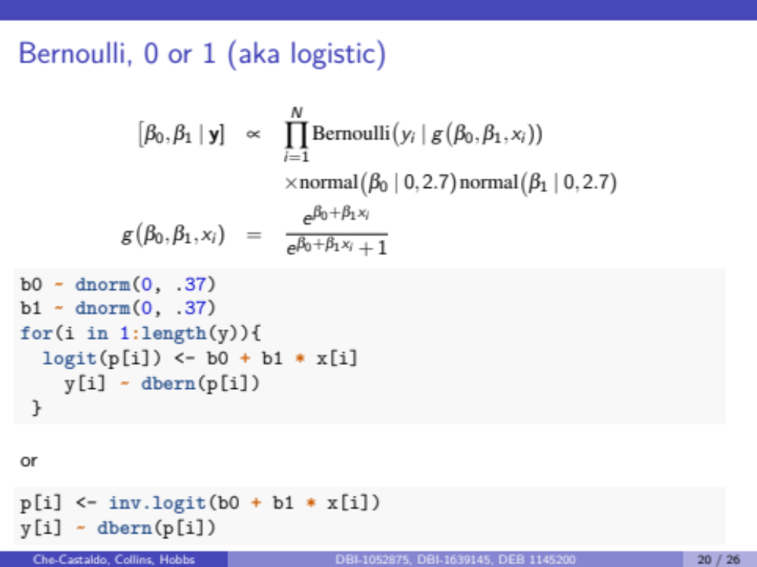
Lizard Occurrence on Islands

Slide 17
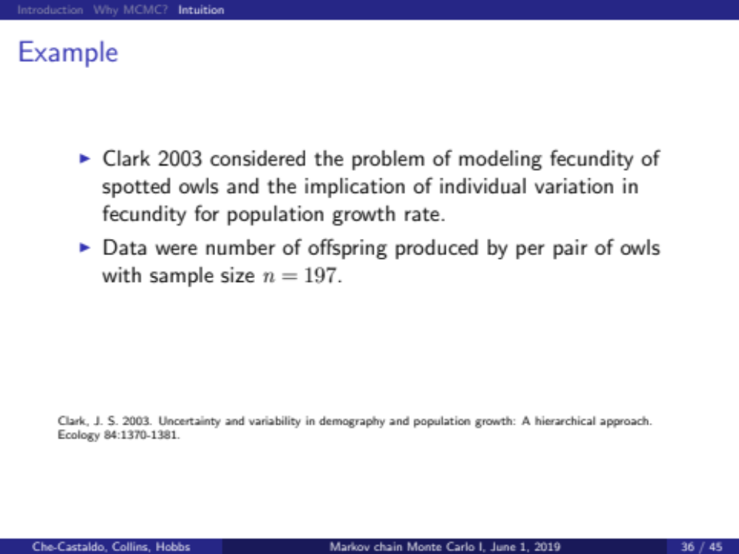
Hierarchical models are very natural in a Bayesian framework

Slide 18
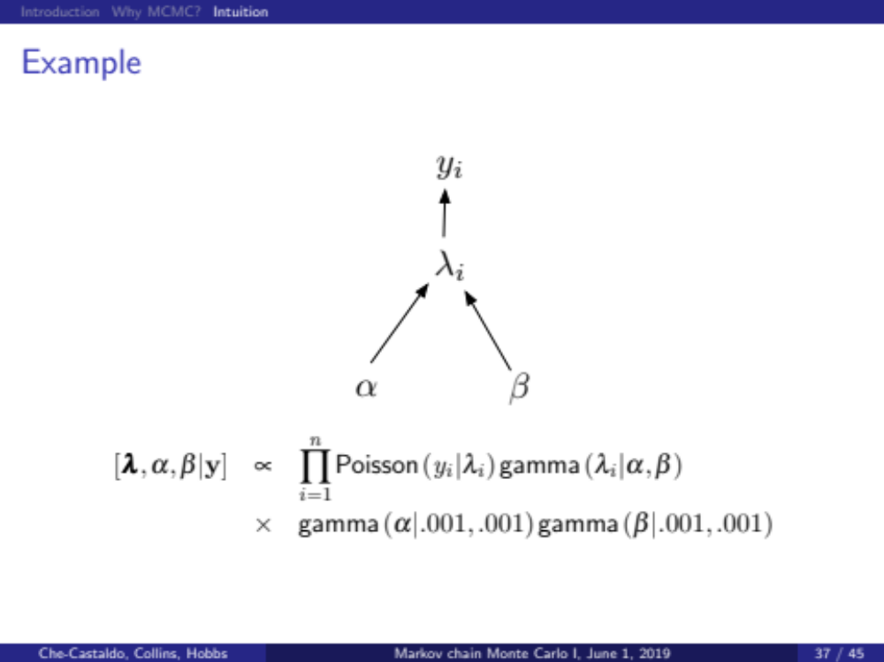
#offspring per pair of owls
Model offspring counts with Poisson, but each individual’s rate parameter drawn from a Gamma distribution.
Not just variance in counts, but variance within owl pair and among owl pairs!
Gamma is the conjugate prior and flexible/non-negative. Good choice here
These are called hyperpriors.

Slide 19
This model is hierarchical.
Individual fecundity comes from data from that individual and is informed by entire population
Every individual has one of these
But they arise from a common distribution
Gamma is the conjugate prior and flexible/non-negative. Good choice here
These are called hyperpriors.

Slide 20
HIERARCHICAL OR MULTILEVEL MODELING
Soil nitrous-oxide emissions are measured at multiple sites across the world. Each site has multiple measurements of (nitrogen input, emission). Different sites have wildly different soil organic carbon, climate, and microbial communities — so we expect site-level structure.
Build complexity incrementally!
We will fit no pooling, complete pooling, and random intercept model, before adding more complexity

Slide 21
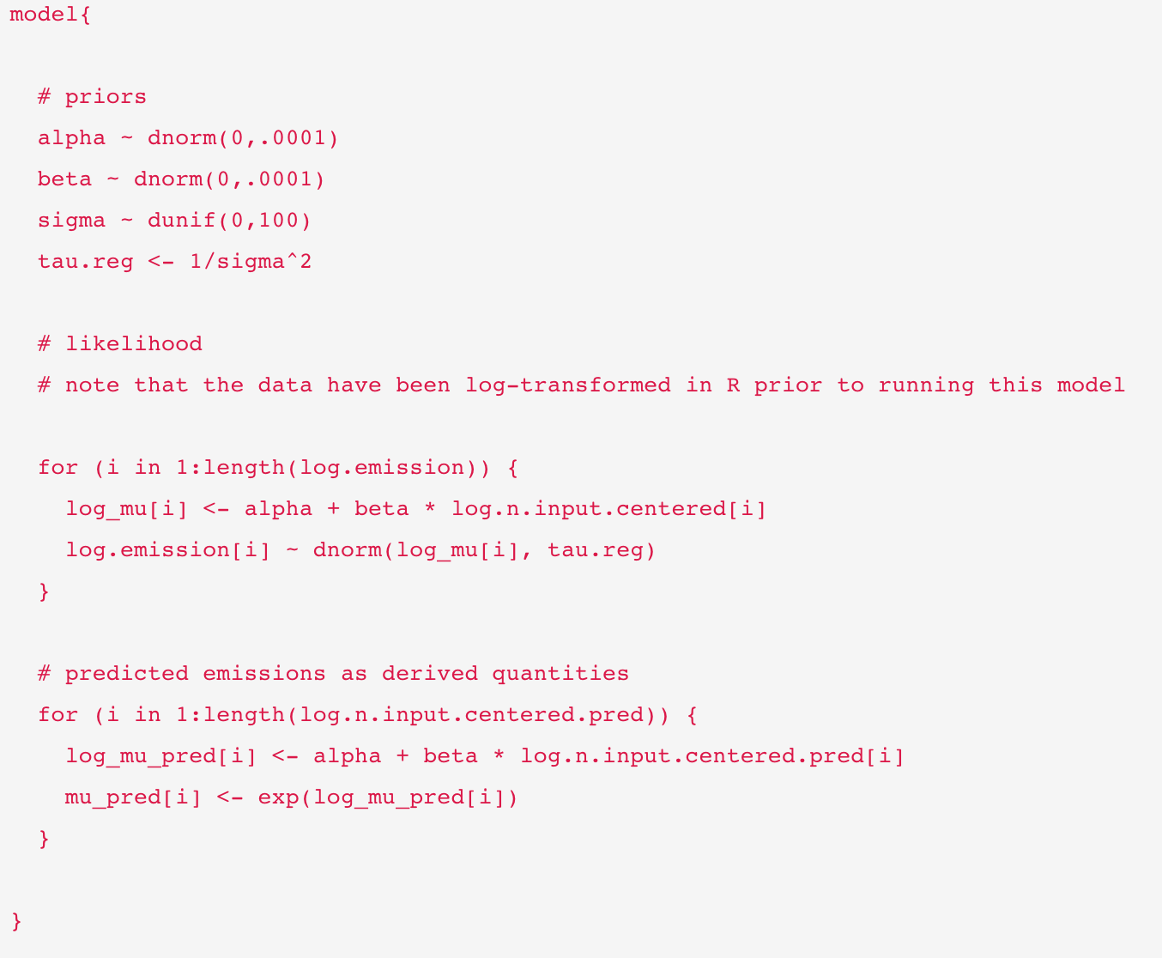
Complete pooling
Only one alpha and beta
Iterate likelihood over the data
Only one alpha and beta

Slide 22
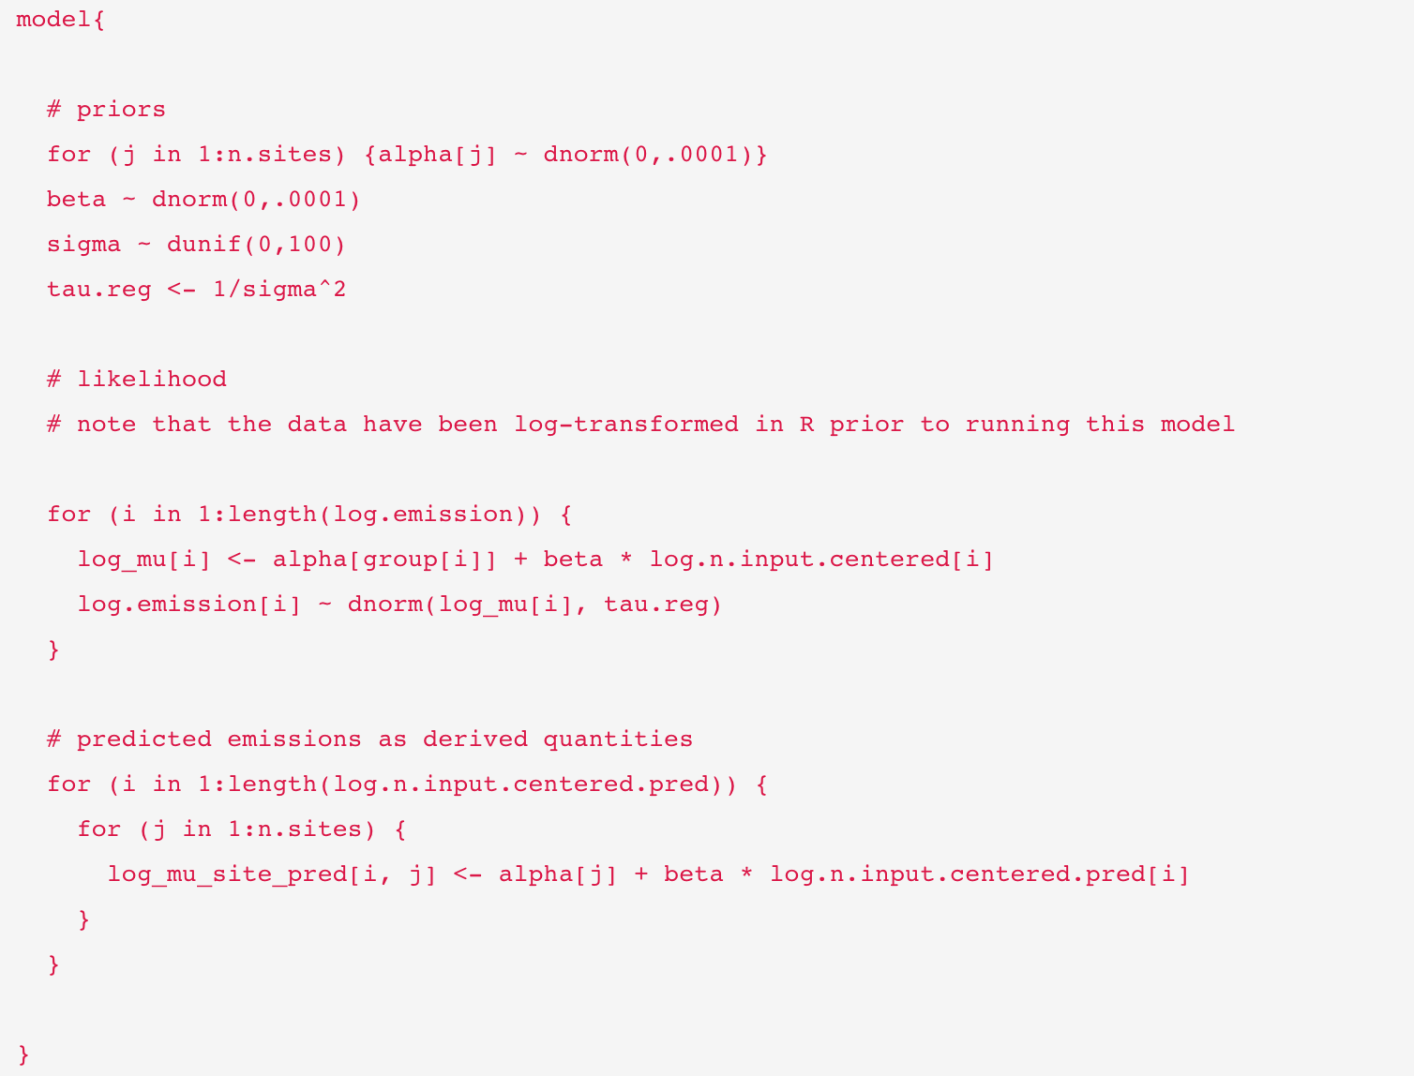
No pooling
Every site gets its own alpha
Every site gets its own alpha

Slide 23
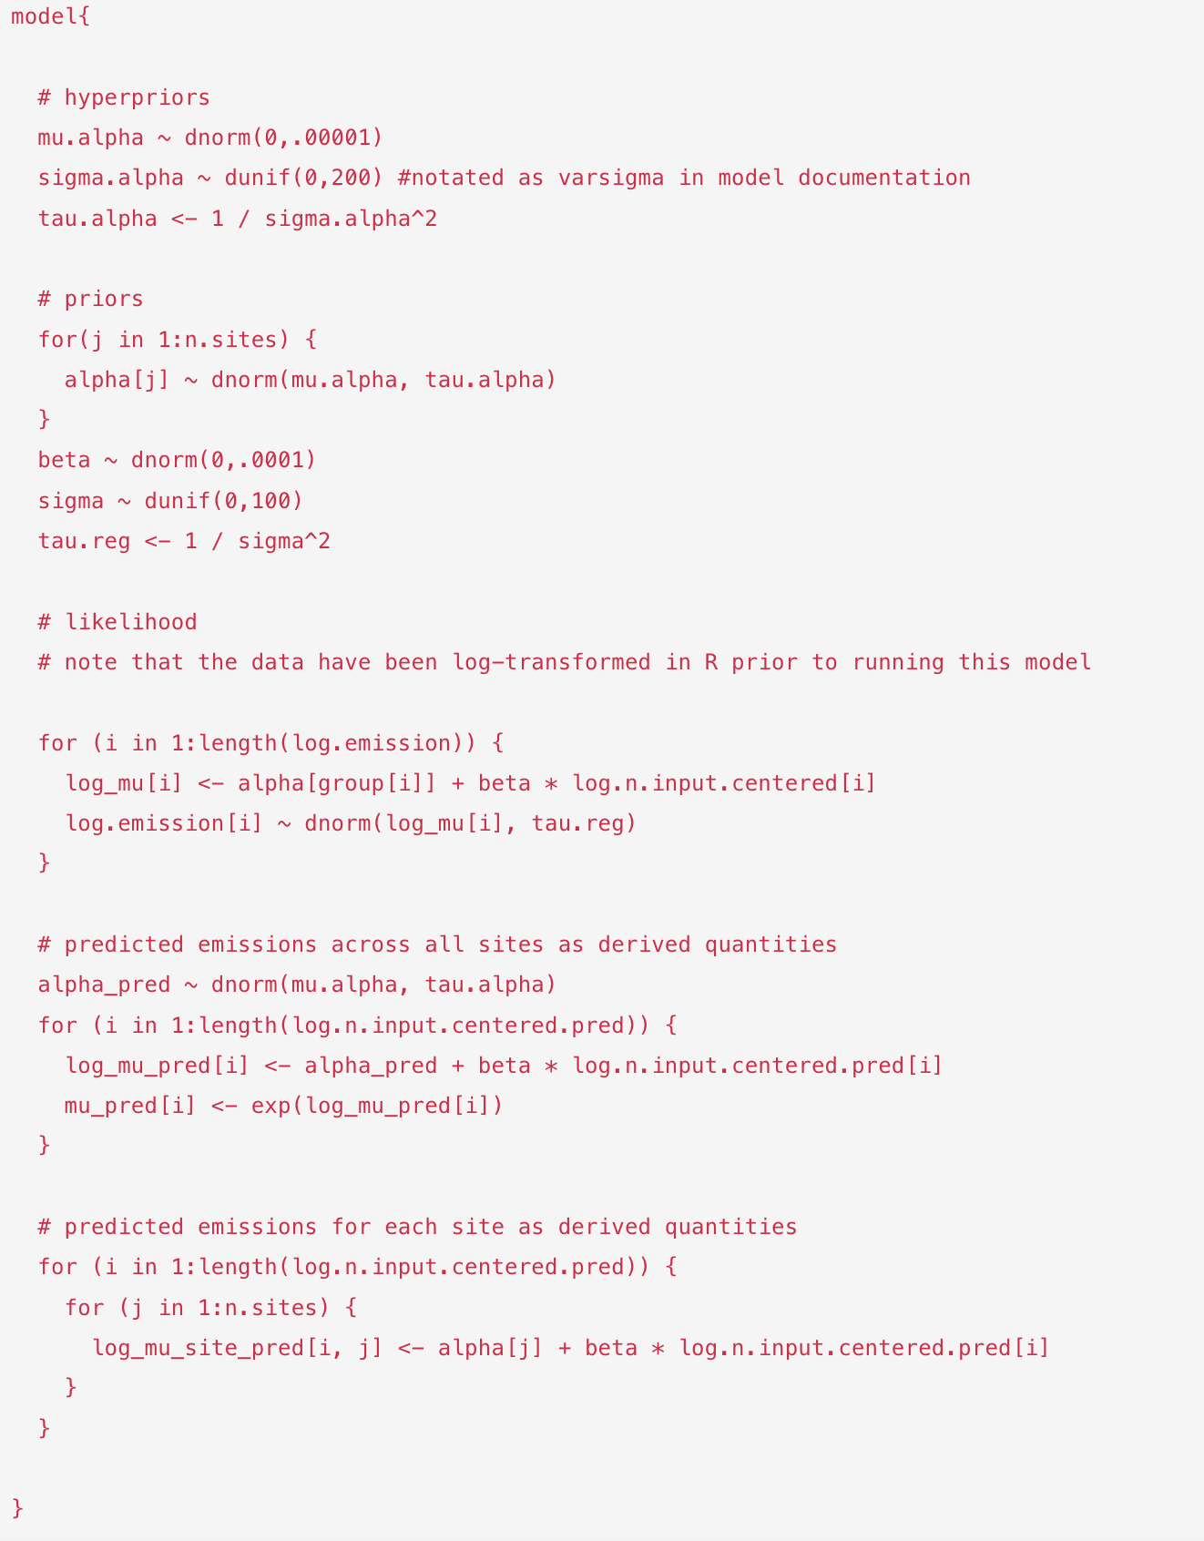
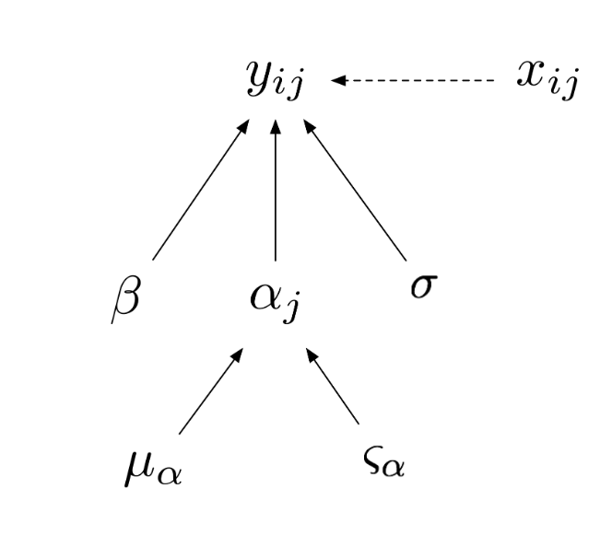
Random intercept
Partial pooling
Alpha varies by site but within shared distribution

Slide 24
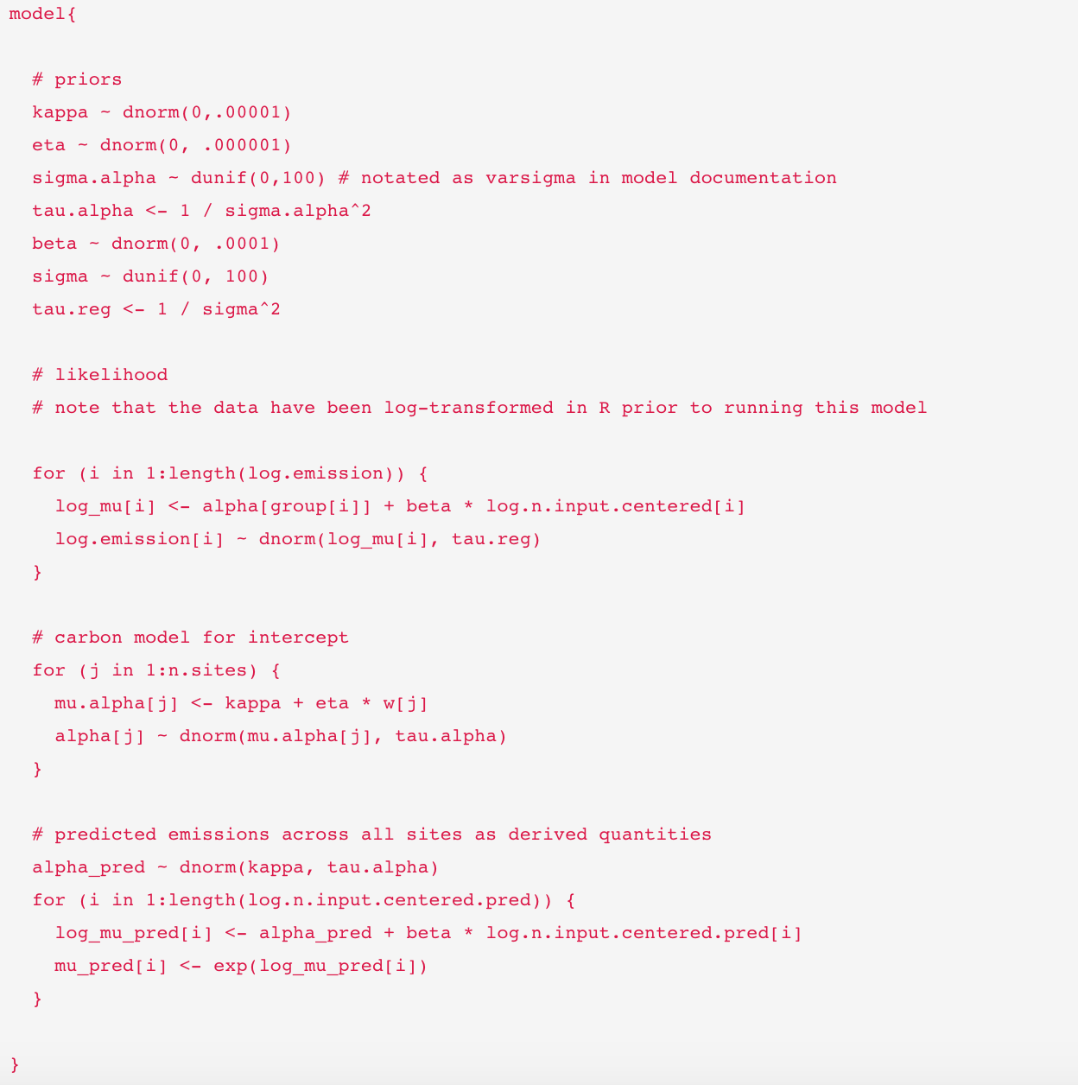
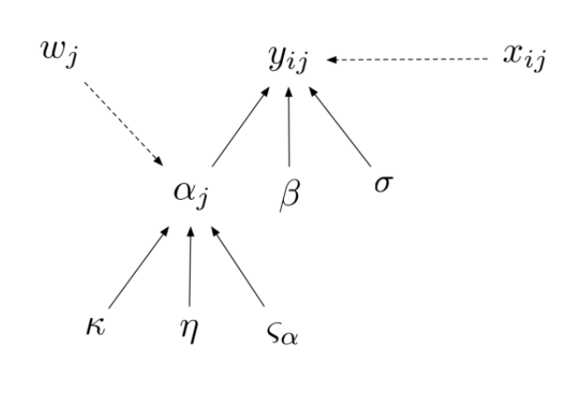
Random intercept
Partial pooling, but also attempt to EXPLAIN site-level differences
In the previous example, we assumed that the variation in the intercept was attributable to spatial variation among sites. We did not try to explain that variation, we simply acknowledged that it exists. Now we are going to “model a parameter” using soil carbon content data at the site-level to explain variation in the intercepts among sites.
Flexibility! Intercepts can depend on soil carbon
Every site gets its own alpha
Alpha varies by site but within shared distribution

Slide 25
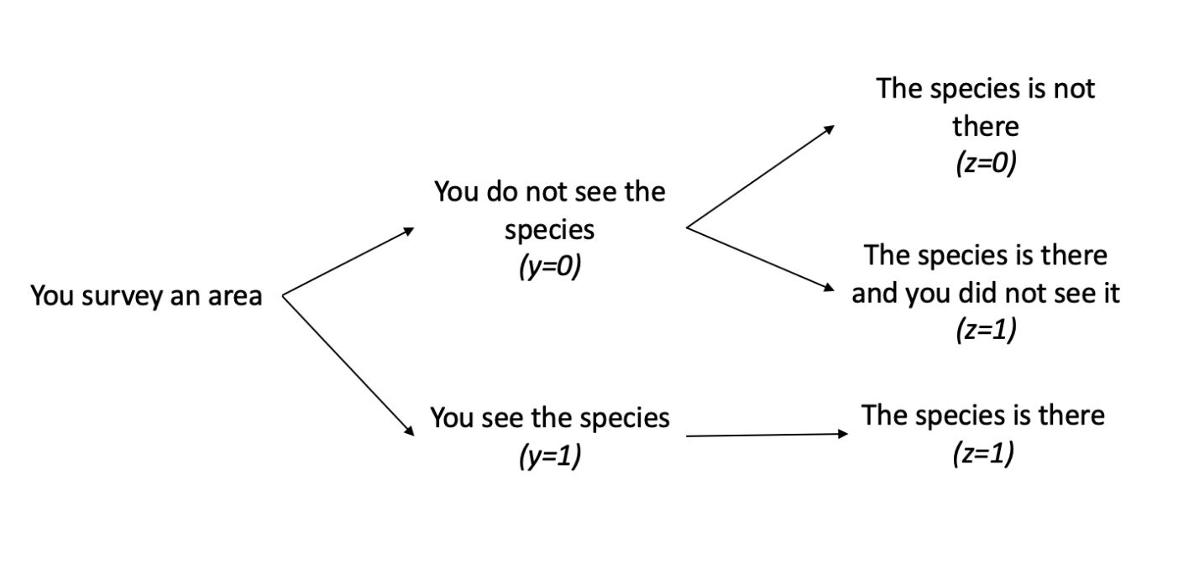
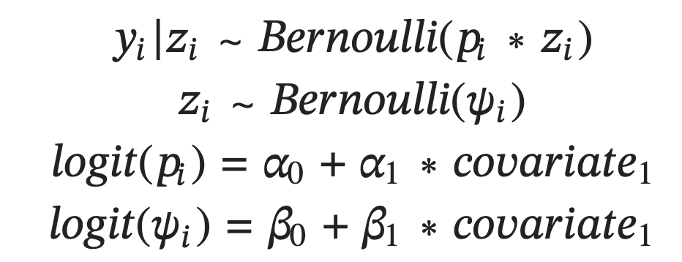
Latent Variable Modeling I - Occupancy
“Latent variable” inferred rather than observed
What should the priors be?

Slide 26
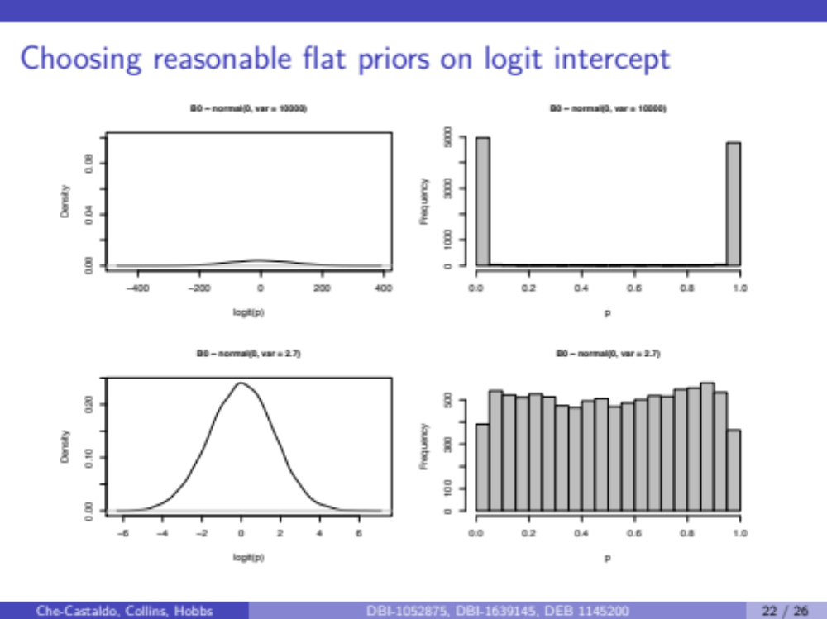
An implied Uniform(0,1) prior for ψ is a Logistic distribution prior for intercept centered at 0 with scale parameter 1
Logistic(μ = 0, σ = 1)

Slide 27
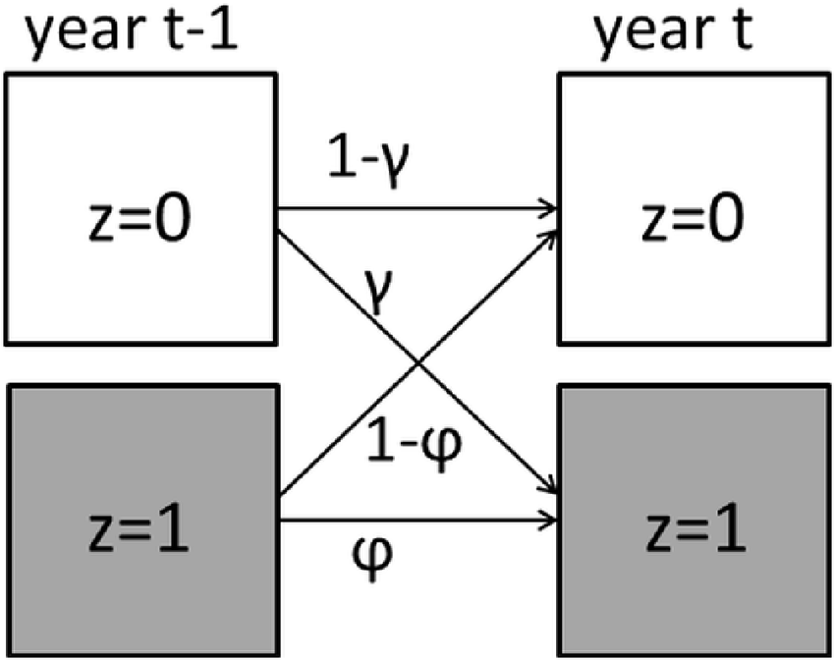
DYNAMIC OCCUPANCY MODELING
Occupancy with a time series. Model colonization and extinction

Slide 28
# Dynamic (multi-season) occupancy model in NIMBLE.
# - Sites i = 1..Nsites
# - Years t = 1..Nyears
# - Replicate visits j = 1..Nreps within each (site, year)
#
# Latent process model:
# z[i, 1] ~ Bernoulli(psi)
# z[i, t] ~ Bernoulli(z[i,t-1]*phi[t-1] + (1-z[i,t-1])*gamma[t-1])
# where phi[t] = patch persistence (year t -> t+1 if currently occupied)
# gamma[t] = patch colonization (year t -> t+1 if currently empty)
#
# Observation model:
# y[i, j, t] ~ Bernoulli(z[i, t] * p)
#
# Derived ecology (all indexed by TRANSITION t-1, i.e. 1..Nyears-1):
# psi.t[t] = expected occupancy in year t
# lambda[t-1] = finite rate of change, psi.t[t] / psi.t[t-1]
# turn[t-1] = turnover (fraction of occupied sites that are NEW colonisers)
# eq[t-1] = colonization-extinction equilibrium occupancy

Slide 29
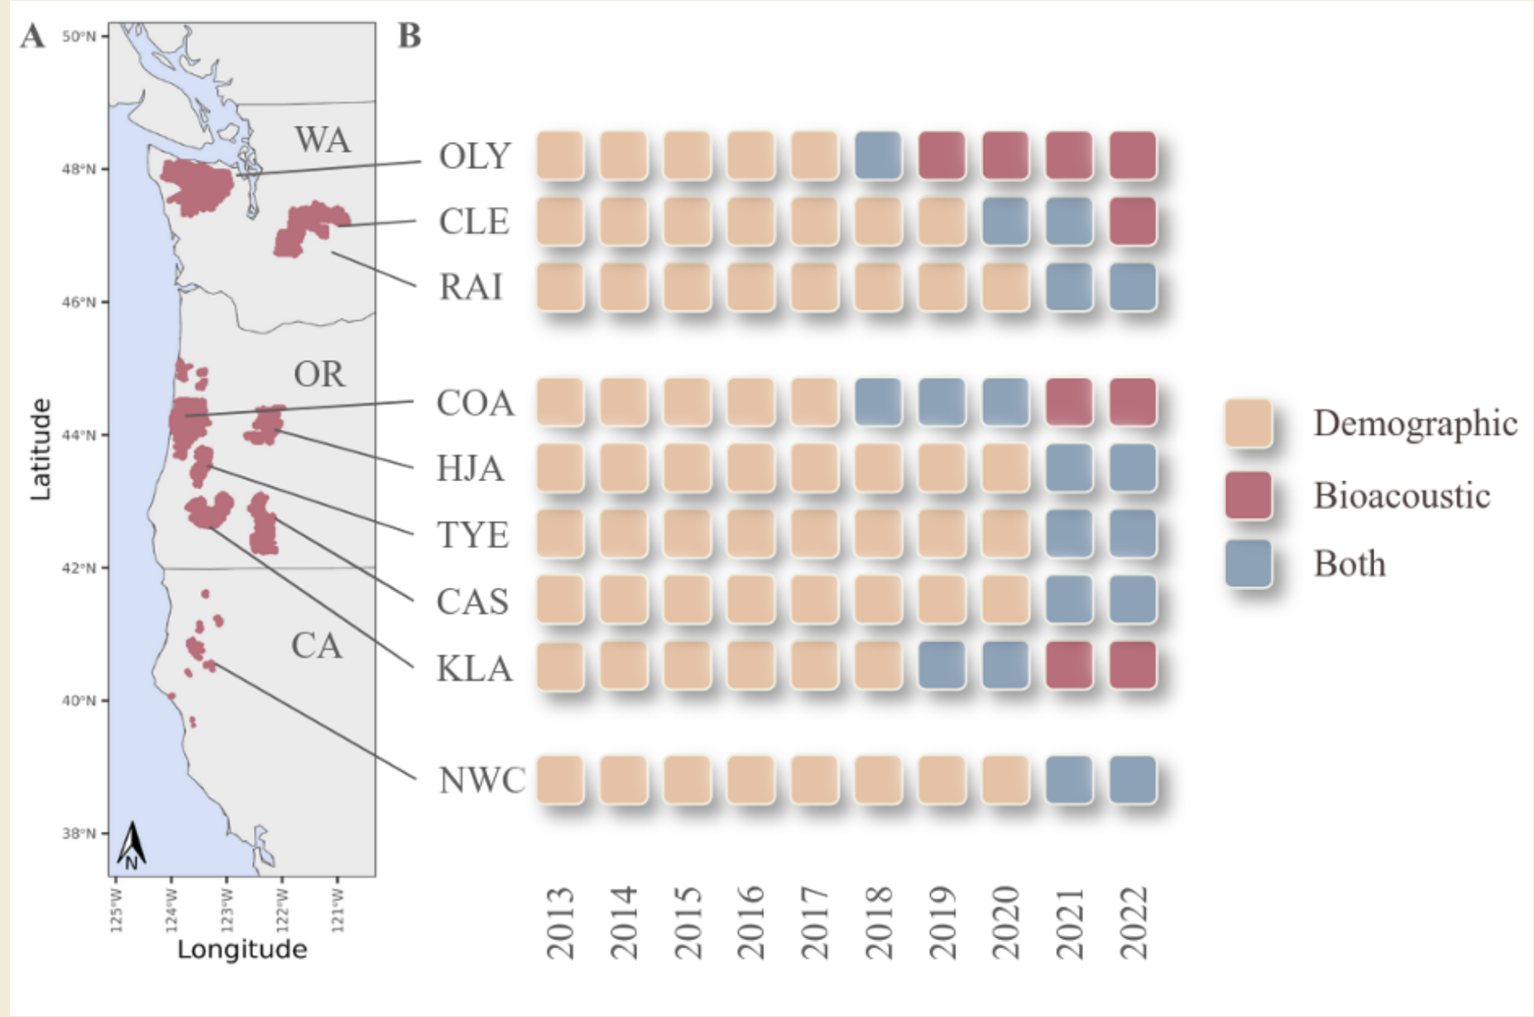
Spotted Owl, Integrated, Multistate, Dynamic Occupancy

Slide 30
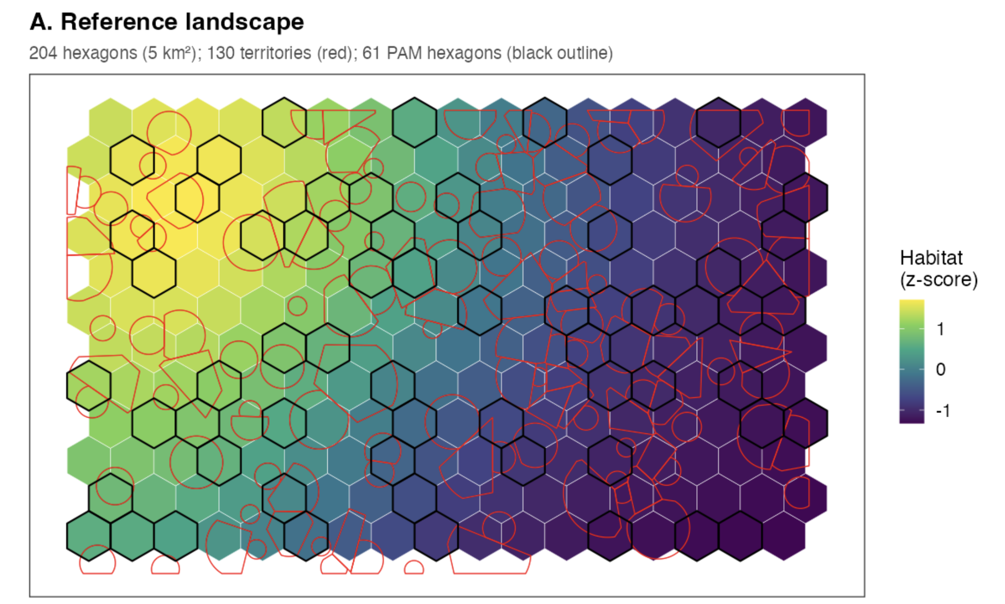

Slide 31
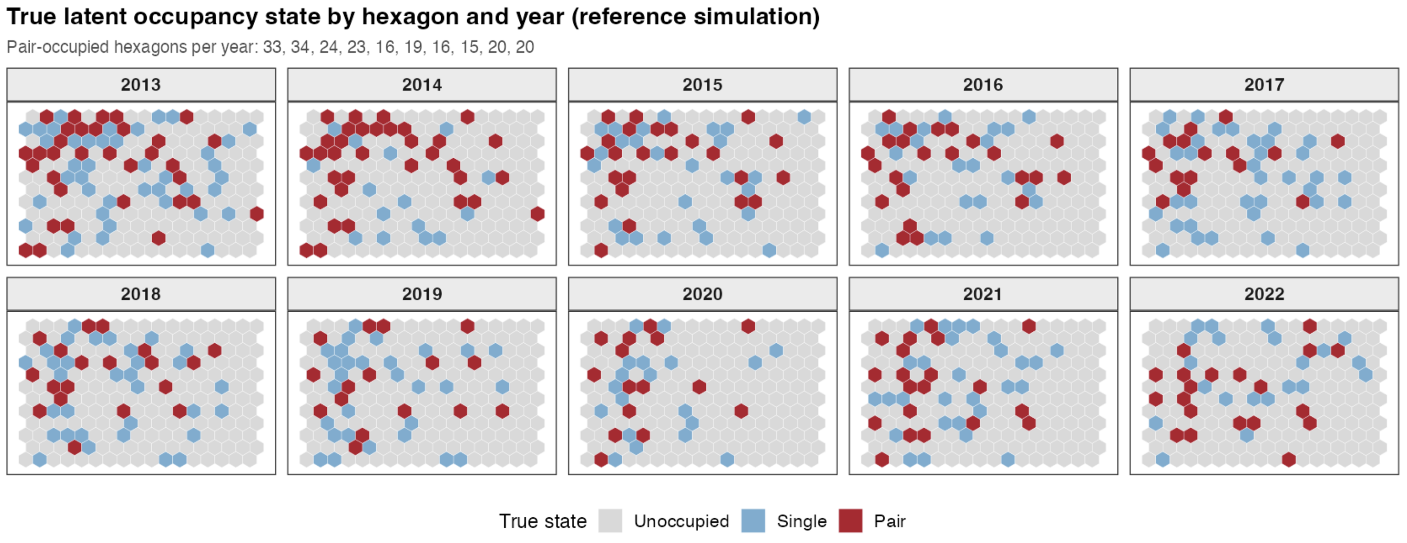

Slide 32
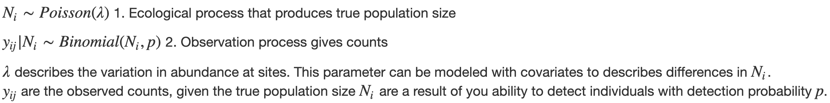
N-mixture Models
Separating Process and Observation Error
Imperfect detection is also a problem when estimating abundance
N-mixture models can account for imperfect detection of individuals within a species

